Slide 1
Sound
Coach Dave Edinger
Physical Science (8A)
J. C. Booth Middle School

Slide 2
Sound Waves
If a tree falls in a forest and no one hears it, does the tree make a sound?

Slide 3

We have to know what “sound” means.
Let’s start at the beginning:
  Think about a drum and how you make it make a sound.
    You hit it with your hand or a stick/mallet.
  This causes the drum head to
  _________________.
vibrate
4:12

Slide 4
So what has to occur for a sound to form?
A vibration!
What is a vibration?
  A rapid back and forth motion.
Does everything that makes sound vibrate?
  YES! Even the softest sounds and sounds humans can’t hear are caused by vibrations!

Slide 5

What does a vibration do to the air molecules that surround the object making sound?
It causes them to vibrate too!
  With each back and forth motion (vibration) of the drum head, a pulse is sent through the air molecules.
Drum head

Slide 6
What type of wave is created?
longitudinal
What happens to the air molecules when the “drum head” moves to the right?
To the left?

Slide 7

Parts of a Longitudinal Wave:
Compression
Rarefaction

Slide 8

Does a sound wave travel in a straight line?
Think about our classroom:
  If I speak directly to the back wall can only the people in that line hear me?
Sound waves travel out from the source in all directions!

Slide 9
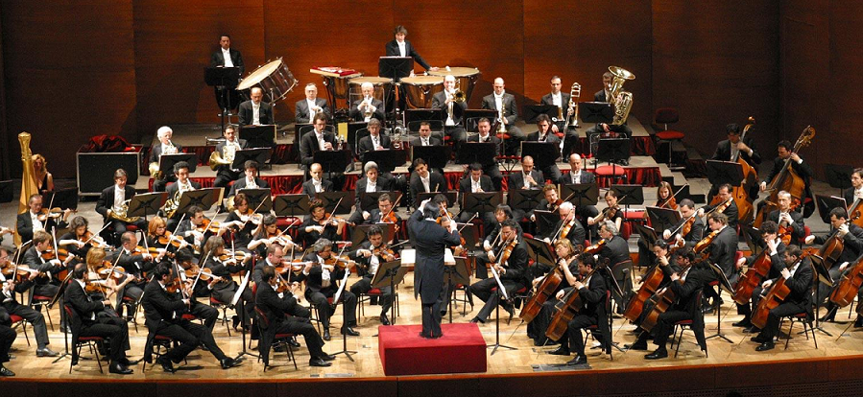
The Speed of Sound
Let’s say you’re at an orchestra concert:
  Do you hear the violins before you hear the cellos?
  The timpani before the French horns?

Slide 10
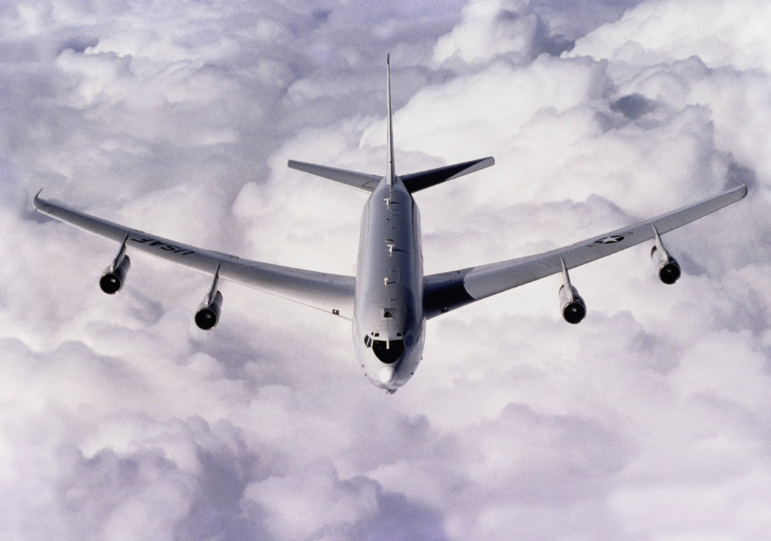
That’s because the sounds travel through the air at the same speed.
At room temperature (about 20*C), sound travels through air at about 343 meters per second!
  That’s faster than most jet planes travel!

Slide 11
BUT…
Sound doesn’t always travel at that speed.
The speed of sound depends on factors such as
  Temperature
  Density

Slide 12
What is temperature?
Not just how hot or cold something is…
Think about the molecules in a substance:
  If a substance is hot, how do the molecules behave?
  Cold?

Slide 13

SO…
If a sound wave is moving through a hot substance, will it be easier or harder for the wave to travel?
Why?
  If the particles are already moving around rapidly, bumping into each other, then they can transfer the sound’s energy easier!

Slide 14
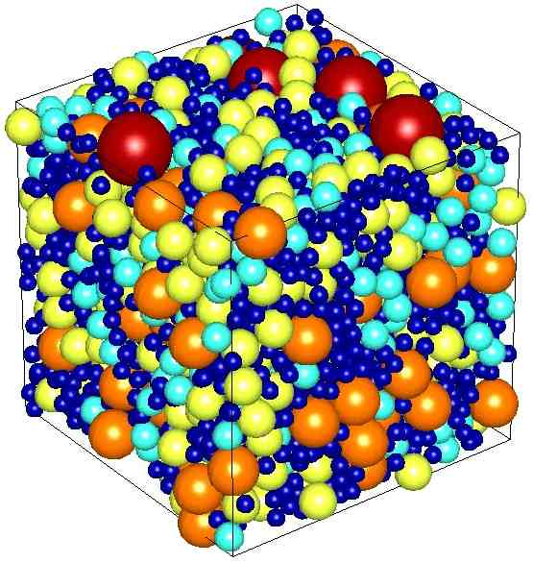
What is Density?
The number of particles in a certain amount of a substance.
Put the following in order from most to least dense:
Liquid
Solid
Gas

Slide 15
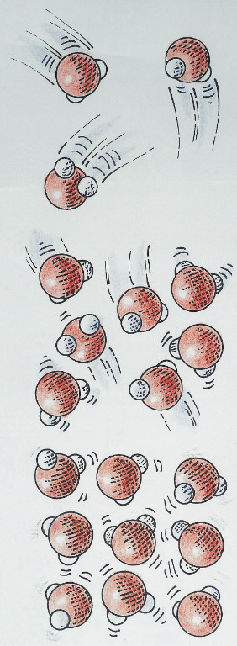
Think back to how sound waves move…
Which would transfer sound more quickly?
  Solid liquid, or gas?
Why?
  The sound wave doesn’t have as far to travel between molecules in a more dense substance!

Slide 16

The Coat Hanger Lab:
Explain why you could hear the coat hanger better with your fingers in your ears:
  The sound traveled through a solid (the hanger, string, your fingers) all the way to your ears rather than through a gas (the air)!
Use what you’ve learned:
What are some things we could do to make it sound even better?

Slide 17
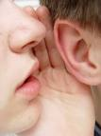

Properties of Sound
Loudness
Pitch

Slide 18
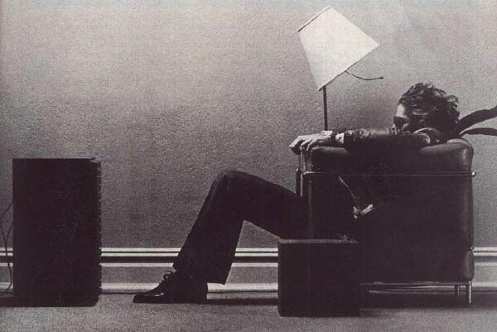
Loudness
When you yell, do you use more energy than when you speak softly?
That’s what loudness is!
  Your perception of the energy of a sound.

Slide 19
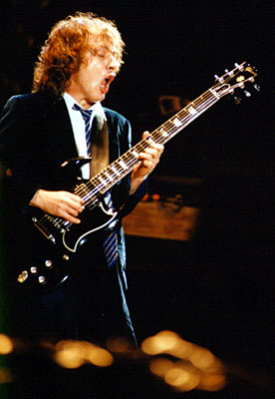
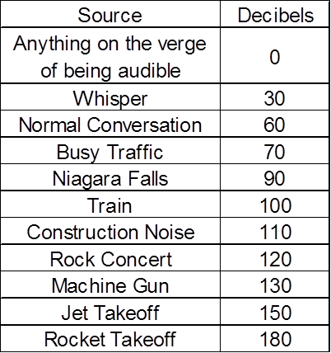
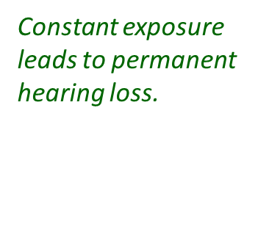

Loudness
The chart below lists the approximate sound levels of various sounds. The loudness of a given sound depends, of course, on the power of the source of the sound as well as the distance from the source. Note: Listening to loud music will gradually damage your hearing!
Damage

Slide 20
Pitch
What kind of sound do you hear when a bass drum booms?
When a seagull screeches?
The highness or lowness of a sound is pitch.

Slide 21
What determines pitch?
Think back to the tuning fork lab:
  How did the frequency of the tuning fork (Hz) relate to the pitch?
    The higher the frequency, the higher the pitch.
    The lower the frequency, the lower the pitch.

Slide 22
So frequency determines pitch!
What is frequency?
  The number of waves that pass a point in a certain amount of time.
If more waves pass a point in a certain amount of time, the pitch will be ________________.
higher

Slide 23


Which has a higher pitch?

Slide 24
This also relates to the vibrations given off by an object.

Slide 25
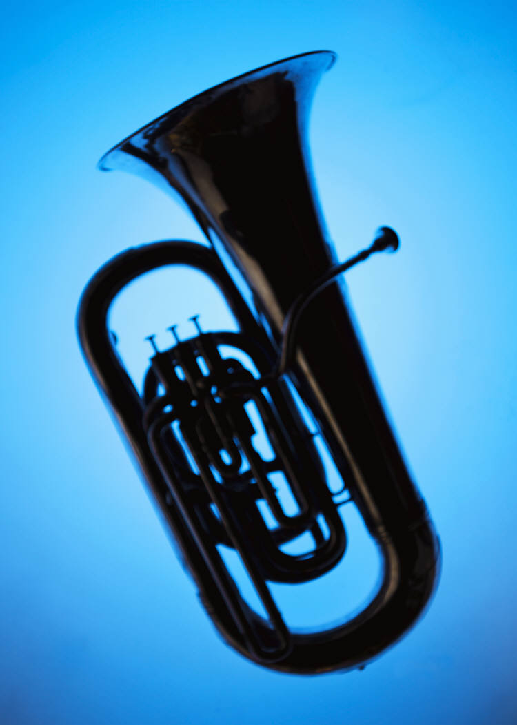


So the faster an object vibrates, the higher the pitch and vice versa.
Describe the frequency and vibrations given off by the following:

Slide 26
Glass Harp
What does the water do as you run your finger around the rim?
What makes the sound you hear?
CHECK IT OUT!
  http://www.youtube.com/watch?v=M8E-XKrbWw4

Slide 27
SO…
If a tree falls in a forest and no one hears it, does the tree make a sound?
You tell me…

