Slide 1
Coach Dave Edinger
Physical Science (8A)
J. C. Booth Middle School

Slide 2
The Law of Conservation of Energy
Energy cannot be created or destroyed;
But, it may be transformed from one form
into another, but the total amount of
energy never changes.

Slide 3
What is energy?
“the ability to do work”
The combination of energy and matter make up the universe:
Matter is substance, and energy is the mover of substance.

Slide 4
Energy is nature’s way of keeping score.
We sense energy only when the score changes,
either a transformation from one form of energy to another,
or a transfer of energy from one point to another.

Slide 5
How is all energy divided?
All Energy
Potential
Energy
Kinetic
Energy
Gravitation
Potential
Energy
Elastic
Potential
Energy
Chemical
Potential
Energy

Slide 6
Potential Kinetic
energy of position or energy in storage.
Water behind a dam
Hammer over head
Food on the plate
energy of motion, the form capable of doing work
Flowing water
A falling hammer
A basketball player running down the court, receiving a pass, & making a shot

Slide 7
PE = mgh
m = mass (kg)
h = height (m)
g = gravity
(9.8 m/s²)

Slide 8
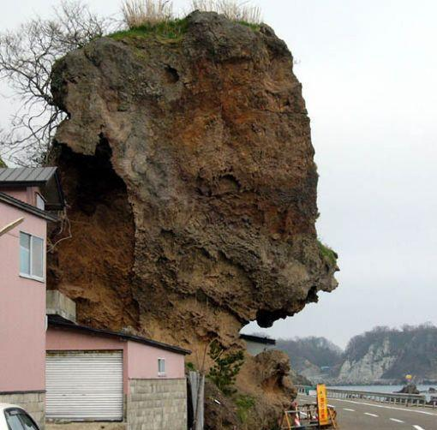
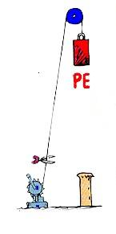
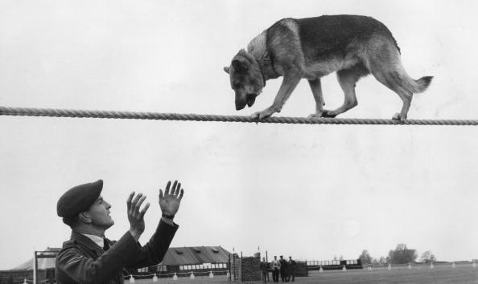
What is Gravitational Potential Energy?
Potential energy due to an object’s position
P.E. = mass x
height x gravity
Don’t look down, Rover!
Good boy!

Slide 9
What is Potential Energy?
Energy that is stored and waiting to be used later

Slide 10
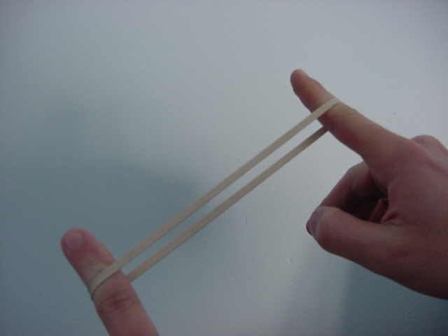
What is Elastic Potential Energy?
Potential energy due compression or expansion of an elastic object.
Notice the ball compressing
and expanding

Slide 11
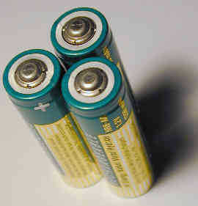
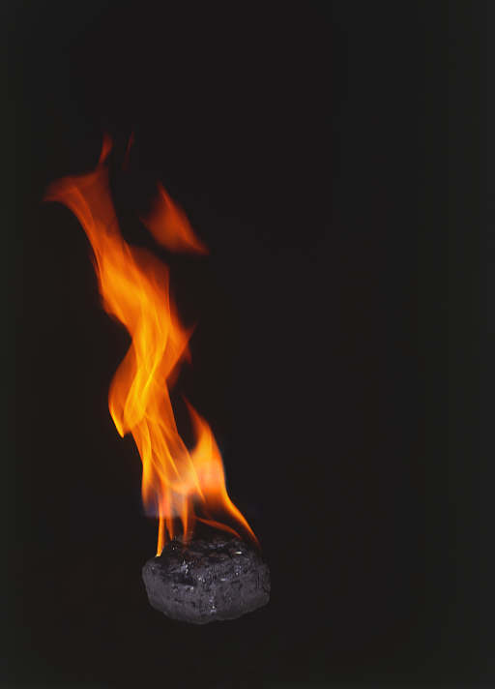
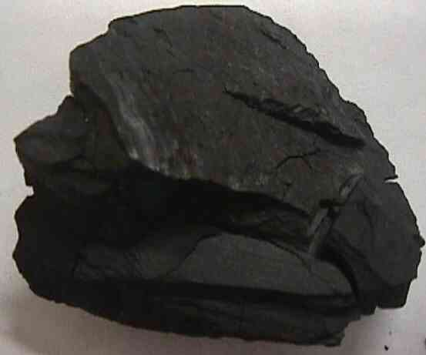
What is Chemical Potential Energy?
Potential energy stored within the chemical bonds of an object

Slide 12
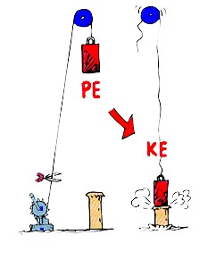
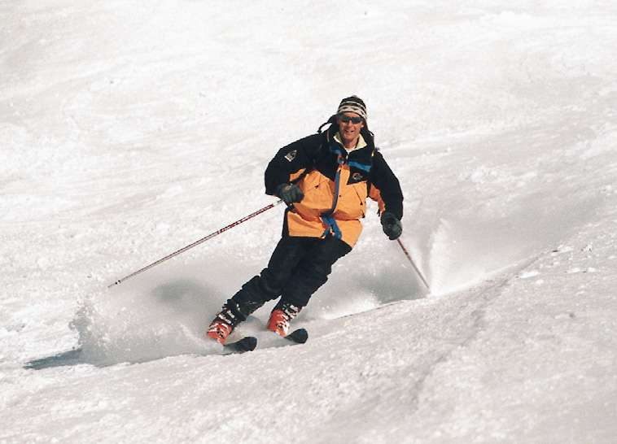
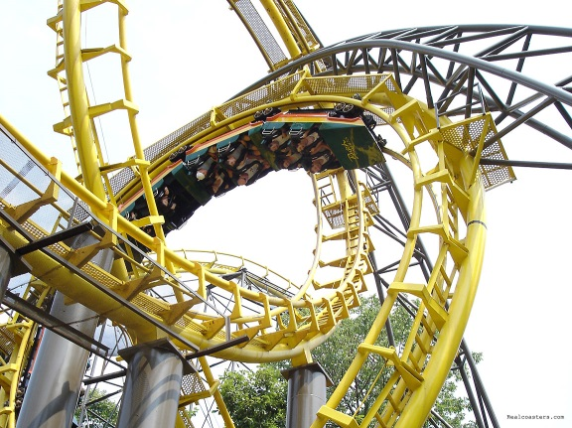
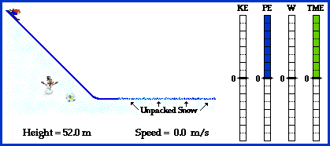
What is Kinetic Energy?
Energy an object has due to its motion
KE = ½ mv²
K.E. = 0.5 (mass x speed²)

Slide 13
KE = 1/2 m v²
4 kg bowling ball
at 10 m/s
= .5 (4kg) (10m/s)²
= 200 kg ⋅ m²/s²
= 200 J
0.25 kg baseball
at 50 m/s
= .5 (.25kg) (50 m/s)²
= 312 kg ⋅ ^{m2/s2}
= 312 J

Slide 14
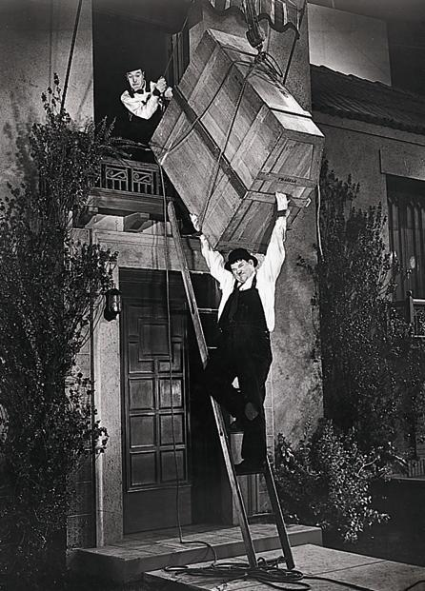
Courtesy Jerry Ohlinger’s Movie Material Store
Work is done when a force is exerted over a distance.

Slide 15
Work
is equal to the force that is exerted times the distance over which it is exerted.
W = F x d
The unit of work combines the unit of force (N) with the unit of distance (m)
Newton-meter (N-m) aka Joule.

Slide 16
You carry a 20 kg suitcase upstairs, a distance of 4m. How much work did you do?
W = F x d
F = ma
= (20 kg) (10m/s²) = 200 N
W = F x d
= (200 N) (4m)
= 800 J

Slide 17
Power
measures the rate of work done.
or the rate at which energy is expended.
Power is the amount of work done, divided by the time it takes to do it.
Power (watts) = work (joules) / time (sec)
P = W/t

Slide 18
Power
Since work performed equals energy expended,
Power (watts) = energy (joules) / time (sec)
The watt is defined as the expenditure of
1 joule of energy in 1 second.
(75 watt light bulb consumes 75 J/sec)

Slide 19
Important formulas and units
Quantity Definition Units
Force mass x accel. newtons
Work force x distance joules
Energy power x time joules
Power work / time watts

Slide 20
Ex. Problem on Power:
Your CD system, uses 250 watts of electrical power.
You play it for 3 hrs. How much energy used? About how much would it cost? If one kWh is $.08.
Energy (J) = power (watts) x time (sec) = (250w) (3hr) = 750 Whr = .75 kWh
The cost = 8 cents/ kWh x .75 kWh
= 6 cents

Slide 21
Power = work / time
Two physics students, Will N. Andable and Ben Pumpiniron, are in the weightlifting room. Will lifts the 100-pound barbell over his head 10 times in one minute; Ben lifts the 100-pound barbell over his head 10 times in 10 seconds. Which student does the most work? Which student delivers the most power?

Slide 22
Drawing Conclusions
Two divers of equal mass about to dive
Diver A has > Potential Energy than B
Compare divers positions
Which diver will hit water @ highest speed
What happens to energy when diver enters the water?

Slide 23
Diver A
Fastest
Diver B

Slide 24
7 fundamental forms of energy
mechanical energy
Sound
Thermal (heat) energy
chemical energy
electromagnetic energy
electrical energy
nuclear energy

Slide 25
What is the source of our energy?
The source of practically all our energy is the Sun.

Slide 26
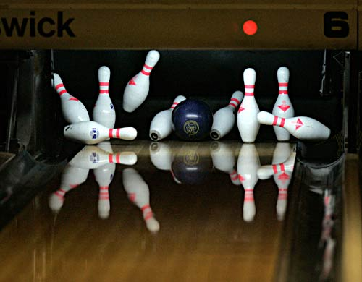
What is Mechanical Energy?
Energy due to a object’s motion (kinetic) or position (potential).
The bowling ball has mechanical energy.
When the ball strikes the pins, mechanical energy is transferred to the pins!

Slide 27
Examples of Mechanical Energy

Slide 28
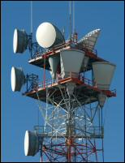
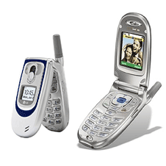
What is Electromagnetic Energy?
Light energy
Includes energy from gamma rays, xrays, ultraviolet rays, visible light, infrared rays, microwave and radio bands

Slide 29
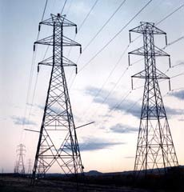
What is Electrical Energy?
Energy caused by the movement of electrons
Easily transported through power lines and converted into other forms of energy

Slide 30
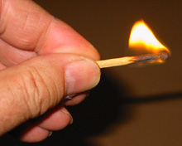
What is Chemical Energy?
Energy that is available for release from chemical reactions.
The chemical bonds in a matchstick store energy that is transformed into thermal energy when the match is struck.

Slide 31
Examples of Chemical Energy

Slide 32
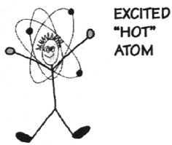
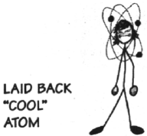
What is Thermal Energy?
Heat energy
The heat energy of an object determines how active its atoms are.
A hot object is one whose atoms and molecules are excited and show rapid movement.
A cooler object's molecules and atoms will show less movement.

Slide 33
QUIZ TIME!
What type of energy cooks food in a microwave oven?
ELECTROMAGNETIC ENERGY
What type of energy is the spinning plate inside of a microwave oven?
MECHANICAL ENERGY

Slide 34
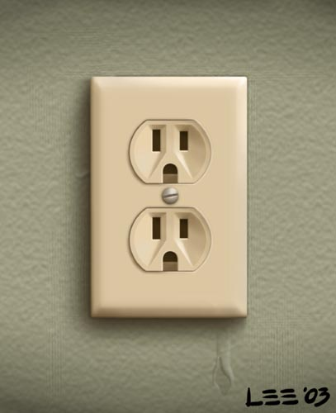
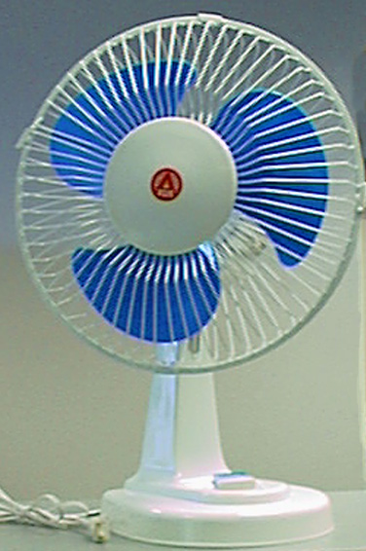
QUIZ TIME!
Electrical energy is transported to your house through power lines.
When you plug an electric fan to a power outlet, electrical energy is transform into what type of energy?
MECHANICAL ENERGY

Slide 35
QUIZ TIME!
What energy transformation occurs when an electric lamp is turned on?
ELECTRICAL ENERGY
↓
ELECTROMAGNETIC ENERGY

Slide 36
What types of energy are shown below?
Mechanical and Thermal Energy
(Don’t forget friction)

Slide 37
What type of energy is shown below?
Electromagnetic &
Chemical Energy

Slide 38
What types of energy are shown below?
Electrical, Mechanical and
Electromagnetic Energy

Slide 39
What type of energy is shown below?
Chemical Energy (yummy)

Slide 40
What type of energy is shown below?
Electrical & Thermal Energy

Slide 41
What types of energy are shown below?
Mechanical, Electromagnetic, Electrical, Chemical, Sound and Thermal Energy

Slide 42
The Law of Conservation of Energy
Energy cannot be created or destroyed; it may be transformed from one form into another, but the total amount of energy never changes.

