Slide 1
Electromagnetic Waves & the Electromagnetic Spectrum
Coach Dave Edinger
Physical Science (8A)
J. C. Booth Middle School

Slide 2
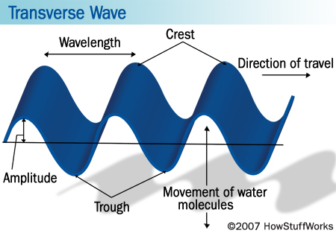
Electromagnetic Waves
Transverse waves without a medium!
(They can travel through empty space)

Slide 3
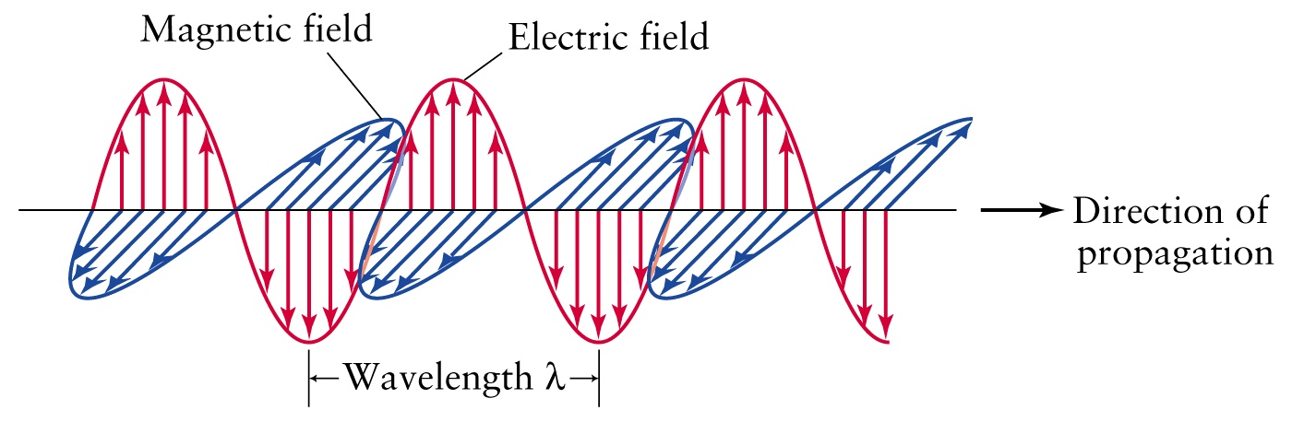
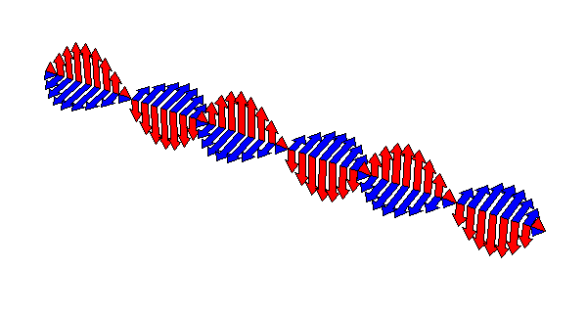
They travel as vibrations in electrical and magnetic fields.
  Have some magnetic and some electrical properties to them.

Slide 4

When an electric field changes, so does the magnetic field. The changing magnetic field causes the electric field to change. When one field vibrates—so does the other.
RESULT-An electromagnetic wave.

Slide 5
Electromagnetic waves travel VERY FAST – around 300,000 kilometres per second (the speed of light).
At this speed they can go around the world 8 times in one second.

Slide 6
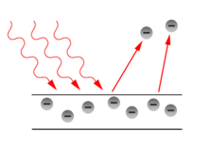

Waves or Particles?
Electromagnetic radiation has properties of waves but also can be thought of as a stream of particles.
  Example: Light
    Light as a wave: Light behaves as a transverse wave which we can filter using polarized lenses.
    Light as particles (photons): When directed at a substance light can knock electrons off of a substance (Photoelectric effect)

Slide 7
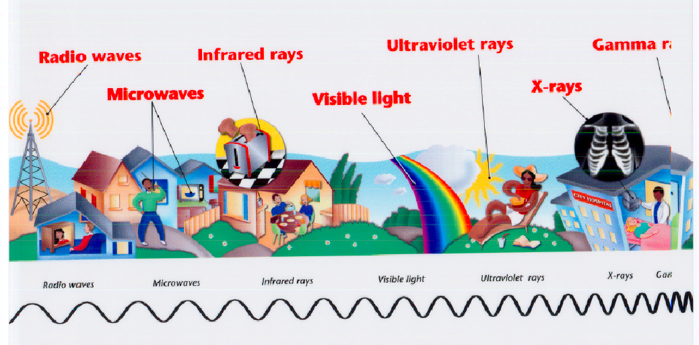
Electromagnetic Spectrum—name for the range of electromagnetic waves when placed in order of increasing frequency
ULTRAVIOLET RAYS
GAMMA RAYS
RADIO WAVES
INFRARED RAYS
MICROWAVES
X-RAYS
VISIBLE LIGHT

Slide 8
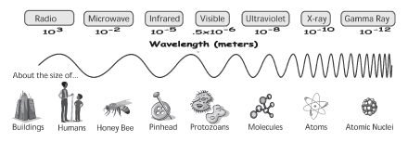
Notice the wavelength is
long (Radio waves) and gets shorter (Gamma Rays)

Slide 9
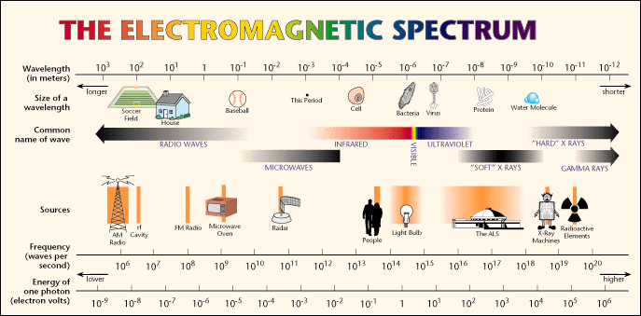

Slide 10
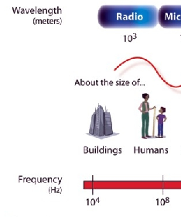
RADIO WAVES
Have the longest wavelengths and lowest frequencies of all the electromagnetic waves.

Slide 11
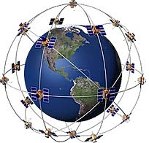
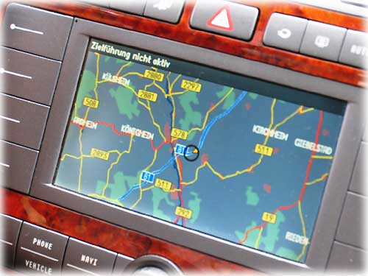
Global Positioning Systems (GPS) measure the time it takes a radio wave to travel from several satellites to the receiver, determining the distance to each satellite.

Slide 12
A radio picks up radio waves through an antenna and converts it to sound waves.
  Each radio station in an area broadcasts at a different frequency.
    # on radio dial tells frequency.

Slide 13
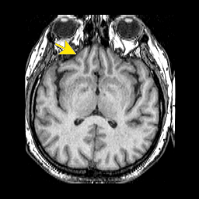
MRI
(MAGNETIC RESONACE IMAGING)
  Uses Short wave radio waves with a magnet to create an image.

Slide 14
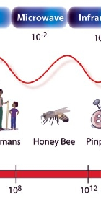
MICROWAVES
Have the shortest wavelengths and the highest frequency of the radio waves.

Slide 15
  Used in microwave ovens.
    Waves transfer energy to the water in the food causing them to vibrate which in turn transfers energy in the form of heat to the food.

Slide 16
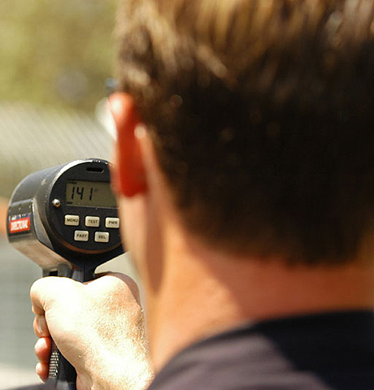
  RADAR (Radio Detection and Ranging)
    Used to find the speed of an object by sending out radio waves and measuring the time it takes them to return.

Slide 17
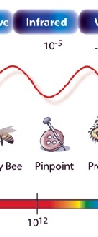
INFRARED RAYS
Infrared= below red
Shorter wavelength and higher frequency than microwaves.

Slide 18
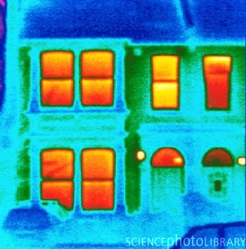
You can feel the longest ones as warmth on your skin
Warm objects give off more heat energy than cool objects.

Slide 19
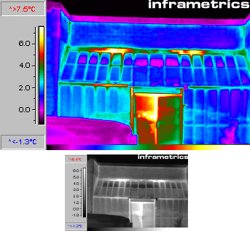
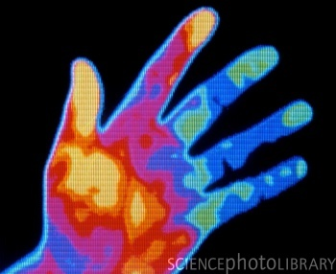
Thermogram—a picture that shows regions of different temperatures in the body. Temperatures are calculated by the amount of infrared radiation given off.
Heat lamps give off infrared waves.
Therefore people give off infrared rays.

Slide 20
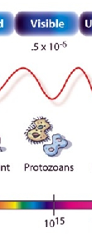
VISIBLE LIGHT
Shorter wavelength and higher frequency than infrared rays.
Electromagnetic waves we can see.
Longest wavelength= red light
Shortest wavelength= violet (purple) light

Slide 21


When light enters a new medium it bends (refracts). Each wavelength bends a different amount allowing white light to separate into it’s various colors ROYGBIV.

Slide 22
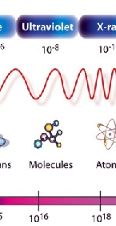
ULTRAVIOLET RAYS
Shorter wavelength and higher frequency than visible light
Carry more energy than visible light

Slide 23
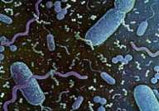
Used to kill bacteria. (Sterilization of equipment)

Slide 24
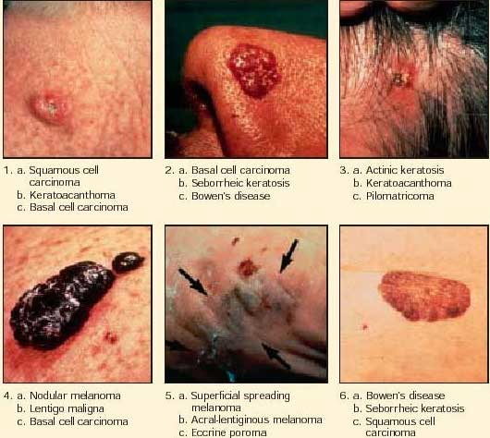
Too much can cause skin cancer.
Use sun block to protect against (UV rays)

Slide 25
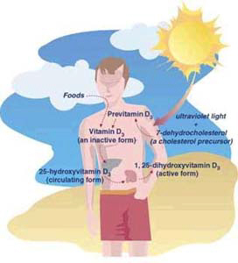
Causes your skin to produce vitamin D (good for teeth and bones)

Slide 26
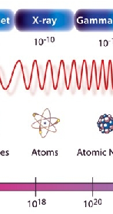
X- RAYS
Shorter wavelength and higher frequency than UV-rays
Carry a great amount of energy
Can penetrate most matter.

Slide 27
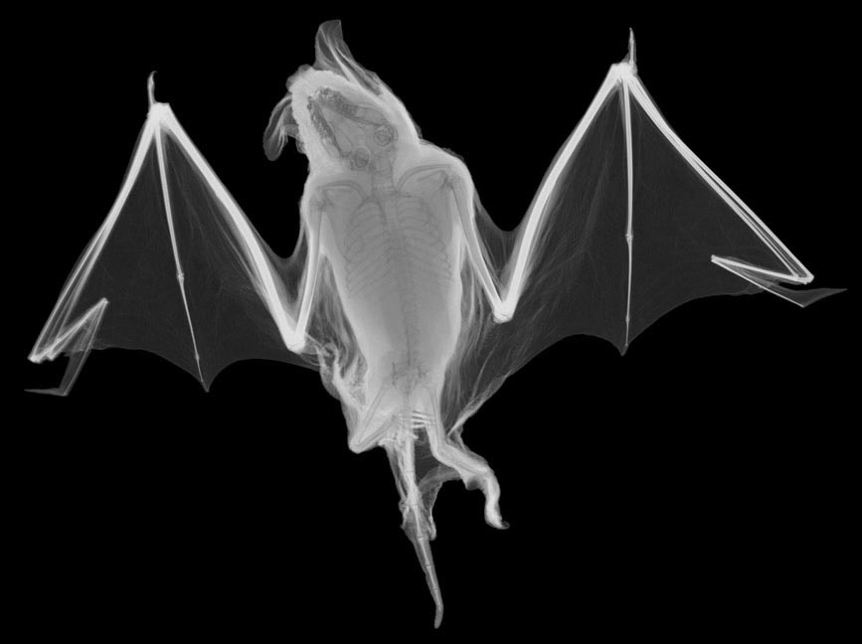
Bones and teeth absorb x-rays. (The light part of an x-ray image indicates a place where the x-ray was absorbed)

Slide 28
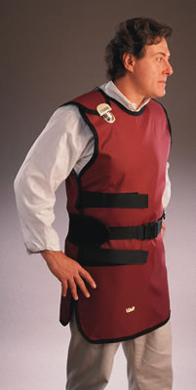
Too much exposure can cause cancer
  (lead vest at dentist protects organs from unnecessary exposure)

Slide 29
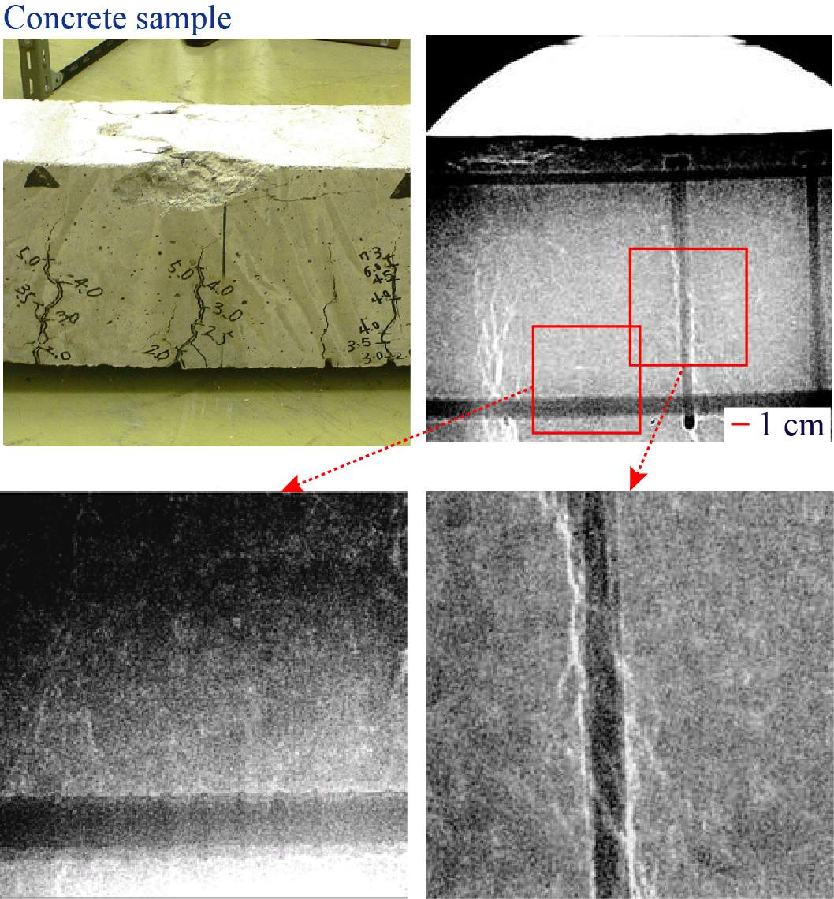
Used by engineers to check for tiny cracks in structures.
  The rays pass through the cracks and the cracks appear dark on film.

Slide 30
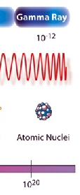
GAMMA RAYS
Shorter wavelength and higher frequency than X-rays
Carry the greatest amount of energy and penetrate the most.

Slide 31
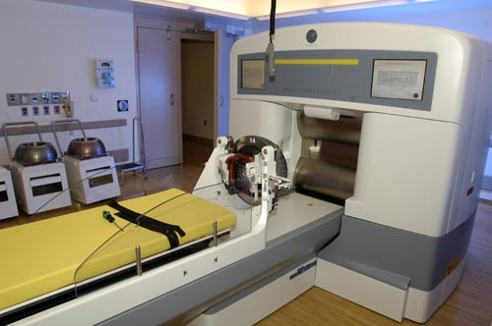
Used in radiation treatment to kill cancer cells.
Can be very harmful if not used correctly.

Slide 32
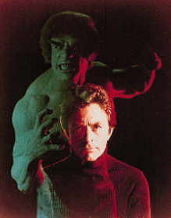
The Incredible Hulk was the victim of gamma radiation.

Slide 33

Exploding nuclear weapons emit gamma rays.

Slide 34
Brief SUMMARY
A. All electromagnetic waves travel at the same speed. (300,000,000 meters/second) in a vacuum.
B. They all have different wavelengths and different frequencies.
  Long wavelength-→lowest frequency
  Short wavelength→ highest frequency
  The higher the frequency the higher the energy.

