Slide 1








-
The Nature of
FORCES

Slide 2

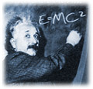
I. WHAT IS A FORCE?
a. A force is ___________________
b. A force is described by:
1.___________________
2.___________________
c. The strength of a force is measured in a unit called ____________ [SI unit = ______ ]
“You exert about 1 newton of force when you lift a small lemon”
a push or a pull
its strength
the direction
NEWTON
N

Slide 3

I. WHAT IS A FORCE?
d. Often, more than a single force acts on an object at a time. The combination of all forces acting on an object is called the ____________.
e. When forces act on an object from the same direction, _____________________________.
f. The object will always move in the direction ____________________.
net force
“add” the forces together
1 N
6 N
5 N
NET FORCE
of the larger force

Slide 4
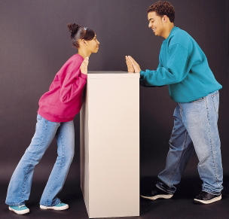
I. WHAT IS A FORCE?:
g. When forces act on an object from
“opposite” directions ____________________.
h. If the opposing forces are of equal strength
_______________________________________________________________________________
subtract the forces
5 N
10 N
5 N
there is “no net force” and no change in the
object’s motion (forces cancel out)

Slide 5
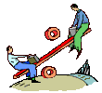
II. TIPPING THE BALANCE
1. Unbalanced forces cause an object to:
a. _________________
b._________________
c._________________
2. Unbalanced forces acting on an object results in a ___________ and cause a change in ______________________.
start moving
stop moving
change direction
net force
the object’s motion

Slide 6
II. TIPPING THE BALANCE
3. When forces are exerted on an object, the object’s motion does not always change.
4. Balanced forces:
      __________________________________________________________________
      _________________________________
5. Write 3 examples of balanced forces:
  _________________________________
  _________________________________
  _________________________________
are equal forces acting on one object in opposite directions
do not change the object’s motion
a cup resting on a table
a truck moving at constant speed
arm wrestling or “tug of war”

Slide 7

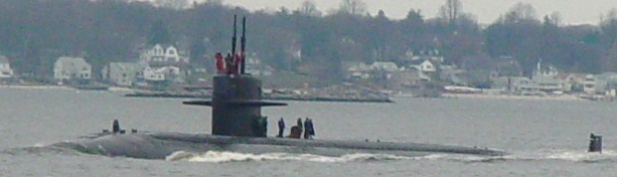
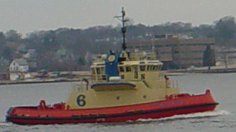
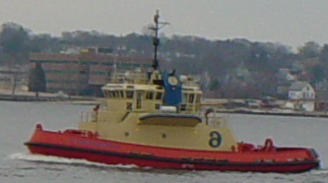
II. TIPPING THE BALANCE
Practice:
Two tug boats are TOWING a submarine into port. Tugboat A exerts a
force of 2000 newtons on the submarine. Tugboat B exerts a force of
4000 newtons in the opposite direction.
  Draw arrows showing the individual and combined forces of the tugboats.
  What is the combined force on the barge?
  Is this is a balanced or unbalanced force?
Tugboat A
Tugboat B
2000 N
4000 N
2000 N (←tugboat B)
unbalanced

Slide 8
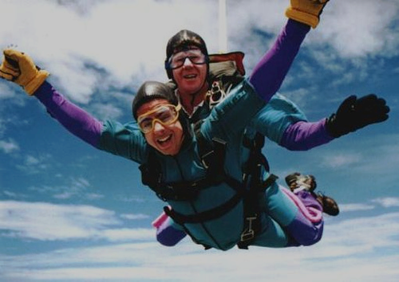

III. THE FORCE OF GRAVITY
The force of GRAVITY
  Gravity is the force that
  ________________________
    Two factors that affect gravity are:
      ______________________
      ______________________
  2. The force of gravity acts _______________________
  3. If mass increases, the force of gravity ____________
  4. If distance increases, the force of gravity ____________
pulls objects to Earth
mass of object
distance
between all objects
increases
Decreases

Slide 9
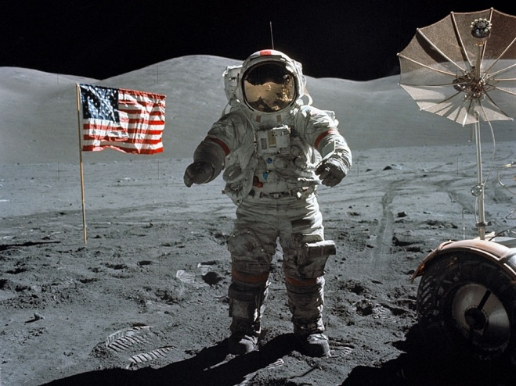
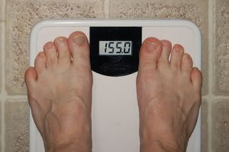
IV. WEIGHT
WEIGHT is _______________________________________________________________________
________varies with the strength of the gravitational force, but ______ does not.
A measure of the gravitational force
exerted on the an object.
WEIGHT
MASS
WEIGHT = mass x gravity or [W=mg]

Slide 10
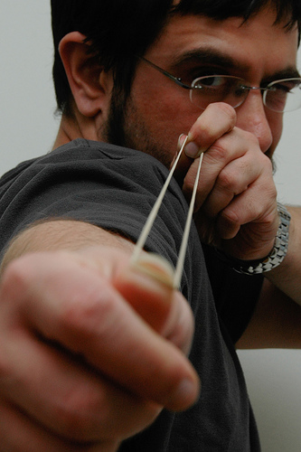
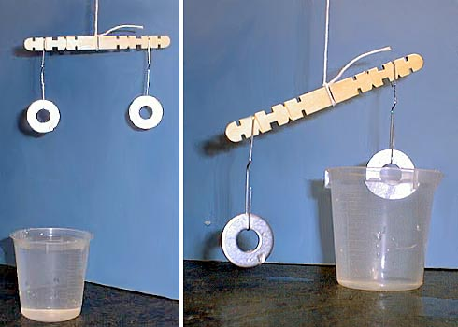
V. OTHER FORCES
  1. Elastic force: ______________________________________________________
  2. Buoyancy: ______________________________________________________
Force exerted by stretching
certain materials
Upward force by H20 on an
object

Slide 11
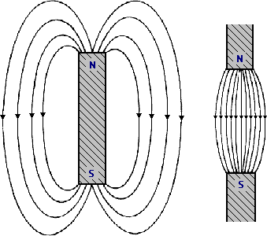
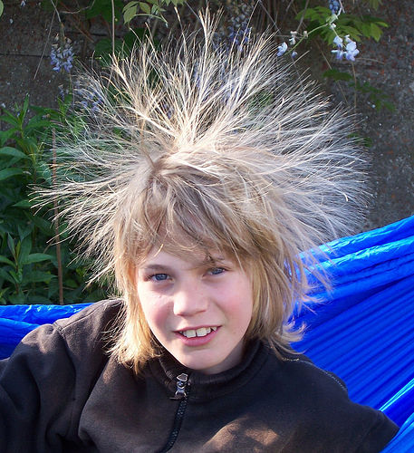
V. OTHER FORCES
  3. Magnetism: _________________________________________________________________________________
  4. Static Electric: ______________________________________________________
Objects exert an attractive or repulsive forces on each other
amount of electric charge on
the surface of an object

Slide 12
*** Reviewing this Section ***
$
What is the difference between mass and weight?
$
Explain the difference between a balanced and unbalanced force?
$
5 N 10 N = ?
$
Will an object move if the net force acting on an object are unbalanced?

Slide 13
VI. FIGHTING FRICTION
  Friction: ________________________________________________________________________________________
  The strength of friction depends on two factors:
      ___________________________________
      ___________________________________
  Friction acts in a direction ___________________________________________
  d. For an object to move __________________________
  e. Without friction ________________________________________________________________________________________
The force that 2 surfaces exert on each other when
they move against each other
how hard surfaces push together
the types of surfaces involved
Opposite to the direction of object’s motion
It must overcome friction
A moving object will not stop until it strikes another
object

Slide 14

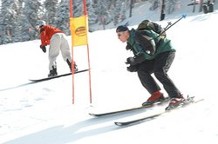
VII. TYPES OF FRICTION
  STATIC friction: ______________________________________________________
  b. SLIDING friction: _________________________________________________________________________________
acts on objects that are
not moving
friction between 2 solid
surfaces sliding past one
another

Slide 15
VII. TYPES OF FRICTION
    c. ROLLING friction:
      1.__________________________________________________________________________________
      2.______________________________________________________
the resistance that occurs
when a round object such as a
ball or tire rolls on a flat surface
is easier to overcome than
sliding friction
  d. FLUID friction:
    1._________________________________________________
    2. 3 types of fluid friction include
      ____________
      ____________
      ____________
friction between a solid object
and a fluid
Water (H₂0)
oil
air

Slide 16

VII. TYPES OF FRICTION
PRACTICE:
1. To actually move an object, you must use a force that is greater than the force of _________ friction.
2. Air resistance is a type of ________ friction.
Name 3 examples of each type of friction below:
SLIDING ROLLING FLUID
______________ ______________ _______________
______________ ______________ _______________
______________ ______________ _______________
STATIC
FLUID

Slide 17
*** Reviewing this Section ***
$
Which kind of friction keeps your shoes from slipping on the floor?
$
[T/F] To move an object, you must use a force that is less than the force of static friction?
$
What would happen if there was no friction?
$
How would you describe the texture of a surface that produces a lot of friction?

Slide 18
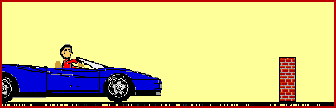
VIII. NEWTON’S LAWS OF MOTION
Newton’s FIRST law: (INERTIA)
  a. __________________________
  b. __________________________
  __________________________
  __________________________
b. INERTIA
a. _____________________________
_____________________________
b. The greater the _____of an
object the greater the inertia.
An object at rest will stay at rest
An object in motion will stay in
motion unless acted upon by an
force
The tendency of an object to
resist a change in motion
mass

Slide 19
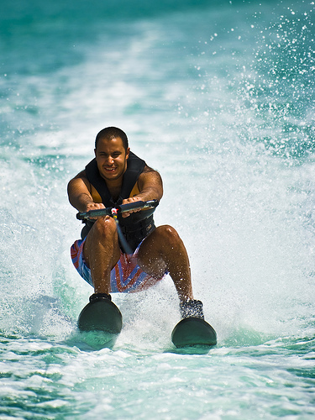
VIII. NEWTON’S LAWS OF MOTION
c. Newton’s SECOND law: (ACCELERATION)
  a. Is the rate in which an object speeds UP or DOWN
  b. acceleration depends on the
  object’s______ and on the ______
  acting on the object.
  c. Units for acceleration = ______
mass
force
m/s²
Net force
PRACTICE
Acceleration = ------------------
mass
A speedboat pulls a 55 kg water
skier. The force causes the skier
to accelerate at 2.0 m/s². Calculate
the net force that causes this
acceleration.
1. Fnet = acceleration x mass
2. Fnet = (2.0 m/s²) (55 kg)
3. Fnet = 110 kg * m/s²
Fnet = 110 N

Slide 20
VIII: NEWTON’S LAWS OF MOTION
c. Newton’s THIRD law:
  1. For every action there is an ______but _________ reaction.
equal
opposite
Normal Force
WILL NOT MOVE
Force of Gravity

Slide 21
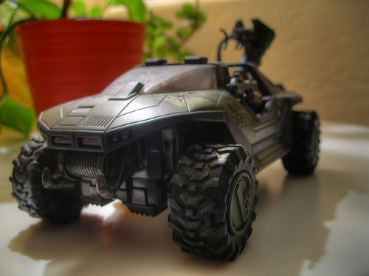
*** Reviewing this Section ***
$
Explain Newton’s First Law of Motion
$
[T/F] The greater the mass the greater the inertia
$
What is the formula for acceleration?
Name the forces acting on the
Jeep?
$

