Slide 1
WAVES
Physical Science
8th Grade

Slide 2
Waves
A wave is a rhythmic disturbance that transmits ENERGY through matter or space.
Waves carry energy NOT matter.
A wave exists as long as it has energy to carry

Slide 3
A wave is a rhythmic disturbance or movement
that transfers energy through matter or space
WAVES CARRY ENERGY
Not Matter
A wave exists as long as it has energy to carry

Slide 4
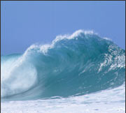
What is a Medium?
A substance through which a wave can travel
Water
People
Air
Coiled wire

Slide 5
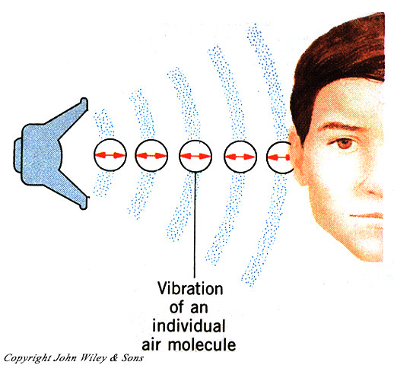
What is a Mechanical Wave?
A wave that requires a medium
Examples:
Sound
Water

Slide 6
Mechanical Waves must have matter to
Travel through.

Slide 7
Kinds of Waves:
Transverse Waves
In a transverse wave, the medium (the
material the wave is in) moves back and forth at right angles to the direction the wave travels.

Slide 8
2. Compression Waves
In compression waves, matter in the
medium moves back and forth in the same
direction that the wave travels.
Sound Waves are Compression Waves.

Slide 9
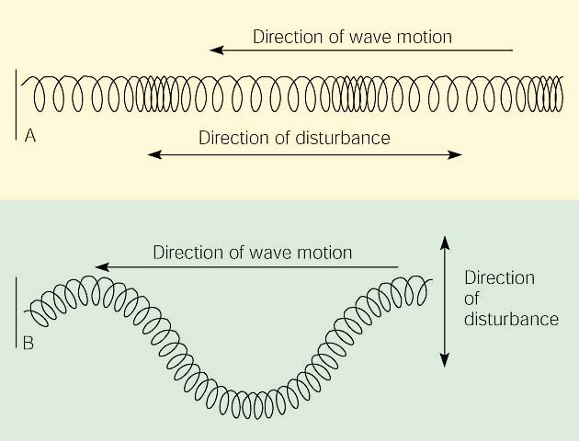

Slide 10
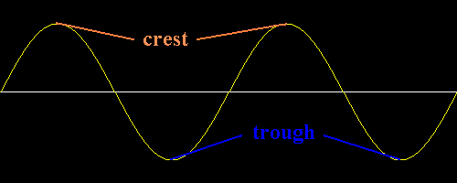
Parts of a Transverse Wave
Crest – The highest points of a transverse wave.
Trough – The lowest points on a transverse wave.

Slide 11
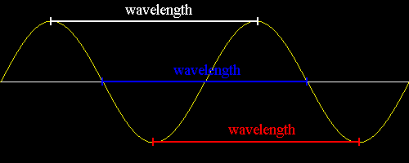
Parts of a Transverse Wave
Wavelength – The wavelength is the distance
between one point on a wave and the nearest
point just like it.

Slide 12
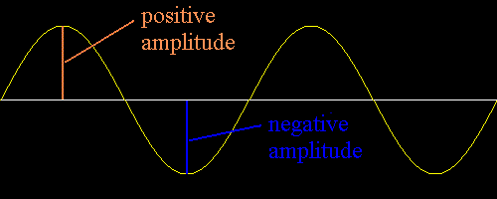
Parts of a Transverse Wave
Amplitude – Maximum distance the wave
vibrates from its rest position.
Amplitude is a measure of the energy carried
by the wave. The more energy a wave carries,
the higher the amplitude.

Slide 13
High energy waves have high amplitude and low energy waves have low amplitude.

Slide 14
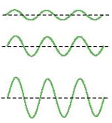
Which one of these waves has a larger amplitude?

Slide 15
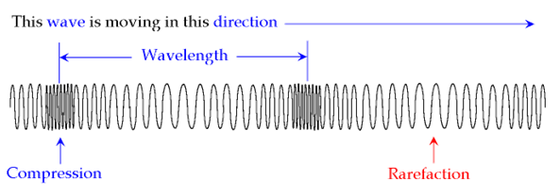
Compression – The region in a compression wave where the medium becomes crowded together and more dense.
Rarefaction – The less-dense region of a
compression wave.

Slide 16
Parts Of A Compression Wave
The amplitude of a compression wave is related to
how tightly the medium is pushed together in compressions.

Slide 17
The wavelength of a longitudinal wave can be measured as the distance between the center of two compressions or rarefactions.

Slide 18
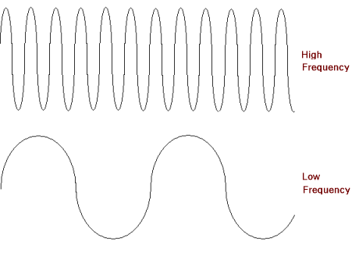
Which one of these waves has a larger wavelength (λ)?

Slide 19
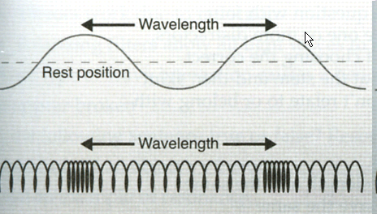

Slide 20
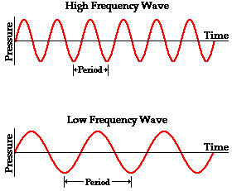
Wave Frequency
is the number of wavelengths that pass a fixed point each second.
When frequency increases, wavelength decreases.

Slide 21
Which one of these waves has a higher frequency?

Slide 22
Frequency is measured in a unit called
Hertz.
abbreviation: Hz.
A hertz is one wavelength passing by
a fixed point per second.

Slide 23
The Wave Equation
Speed = wavelength x frequency
or
v = λ x f
* Λ is the Greek letter lambda
The speed of a wave is how fast the wave is traveling. Units for speed is m/s.
Unit for wavelength is meters (m)
Unit for frequency is Hertz (Hz)

Slide 24
Review

Slide 25
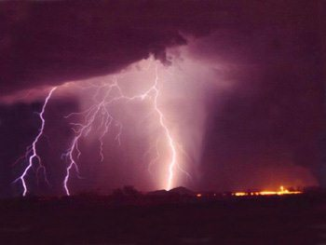
Speed of Sound
Lightning/Thunder

Slide 26
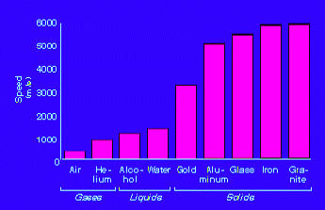
What Effects The Speed of Sound?
Medium

Slide 27
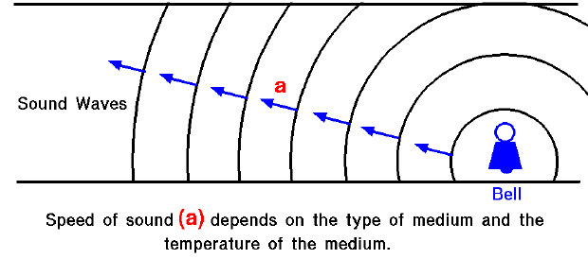
What Effects The Speed of Sound?
Temperature
As the temperature rises, the sound travels faster!

Slide 28
Summary
A wave is a repeating disturbance or movement that transfers energy through matter or space
Waves Carry Energy.
Mechanical Waves need a medium through
Which to travel.

Slide 29
Summary
Two types of mechanical waves are
Transverse
Compression
Parts of a transverse wave
Crests and troughs
Parts of a compression wave
compressions and rarefactions

Slide 30
Amplitude is how much energy the wave
carries. The more energy, the higher the
amplitude.
Wavelength is the distance between a
point on a wave and the nearest point
just like it.
Frequency is the number of wavelengths
That pass a fixed point each second.
As frequency increases, wavelength decreases.
Wave speed = wavelength x frequency.

Slide 31
That’s All Folks!

Slide 32
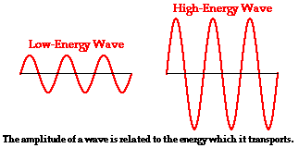
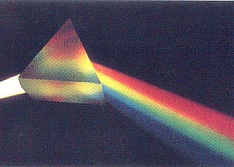

Slide 34
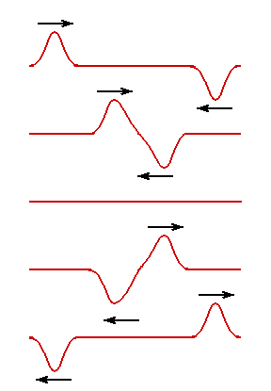
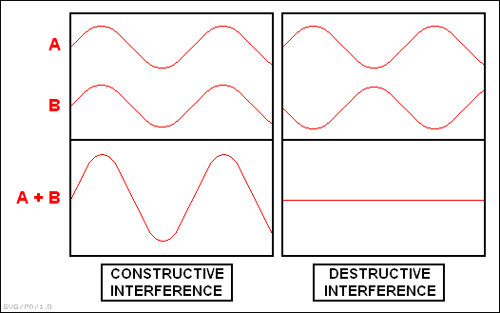
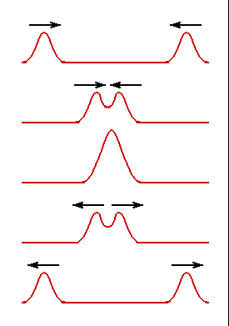

Slide 35
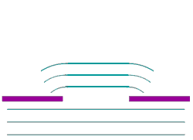

Slide 37
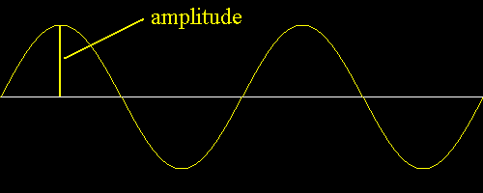
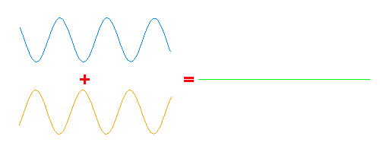
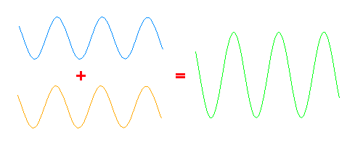

Slide 38
