Slide 1
Pascal’s Principle

Slide 2
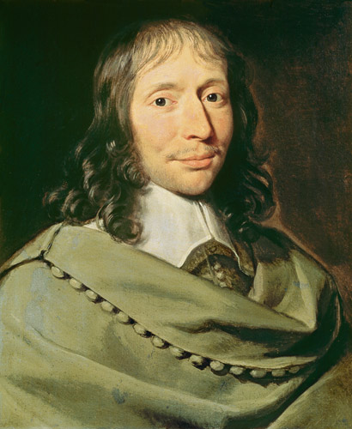
Transmitting Pressure in a Fluid
In the 1600s, Blaise Pascal developed a principle to explain how pressure is transmitted in a fluid
Fluid exerts pressure on
any surface it touches.

Slide 3
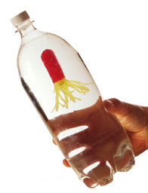
Pascal’s Principle
Pascal’s principle states that pressure increases by the same amount throughout an enclosed or confined fluid
When force is applied to a confined fluid, the change in pressure is transmitted equally to all parts of the fluid.

Slide 4
Pascal’s Principle at Work

Slide 5
Pascal’s Principle at Work

Slide 6
Hydraulic Systems
Hydraulic system uses liquids to transmit pressure and multiply force in a confined fluid.
A hydraulic system multiplies force by applying the force to a small surface area. The increase in pressure is then transmitted to another part of the confined fluid, which pushes on a larger surface area.
Because hydraulic systems use fluids to transmit pressure, hydraulic systems have few moving parts that can jam, break or wear down.

Slide 7
Hydraulic Lifts

Slide 8
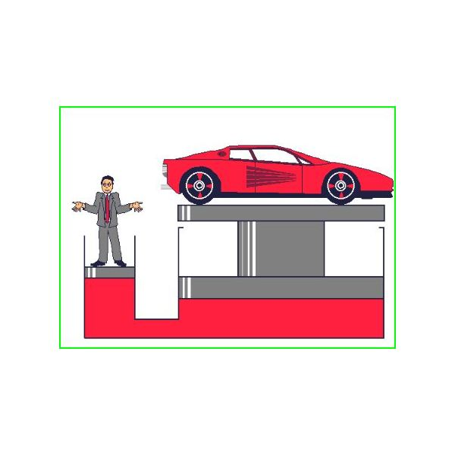
Hydraulic Lifts

Slide 9
Hydraulic Lifts

Slide 10
Hydraulic Brakes

Slide 11
Hydraulic Brakes

