Slide 1
Chemical Bonding

Slide 2
How Do We Combine Molecules Then?
Not just any 'ol combinations!!!!
Oxidation States
A number assigned to an element in a compound according to some rules

Slide 3
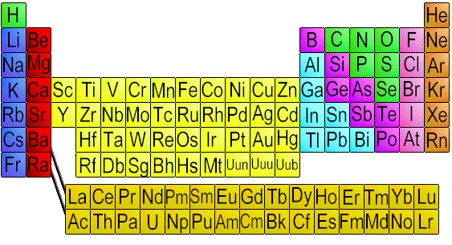
Oxidation States
+/-
4
+3
-3
-2
-1
+1
+2

Slide 4
Criss-Cross Method
-1
+1
Na
Cl
Na
Cl

Slide 5
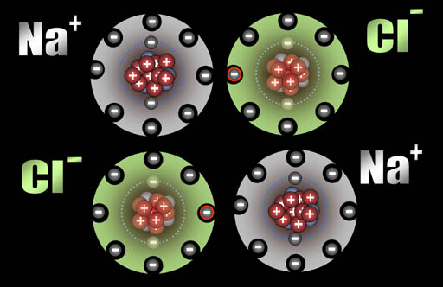
Ionic Bonding

Slide 6
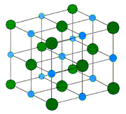
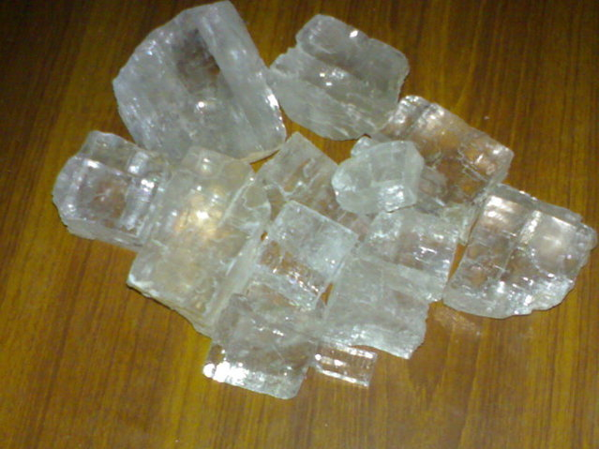
Cubic Structure

Slide 7
Example 1
+2
-2
Ca
S
Ca
S

Slide 8
Example 2
+1
-1
H
Br
H
Br

Slide 9
Example 3
+1
-4
Na
C
Na
C
4

Slide 10
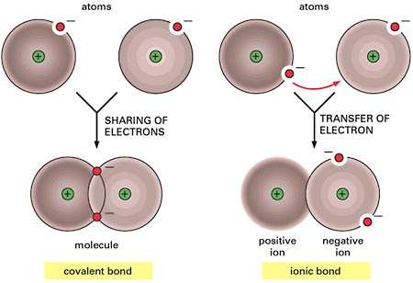
Types of Bonds

Slide 11
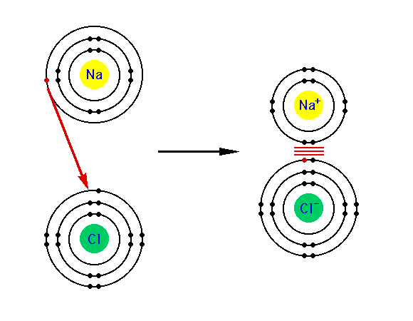
Ionic bonding

Slide 12
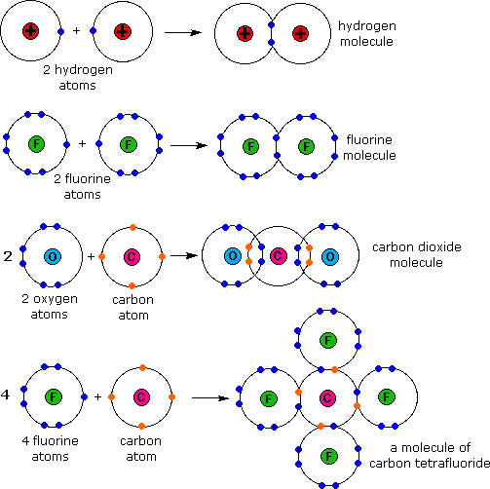
Covalent Bonding

