Slide 1
Energy
Types of energy and chemical reactions
8th Grade - Physical Science

Slide 2
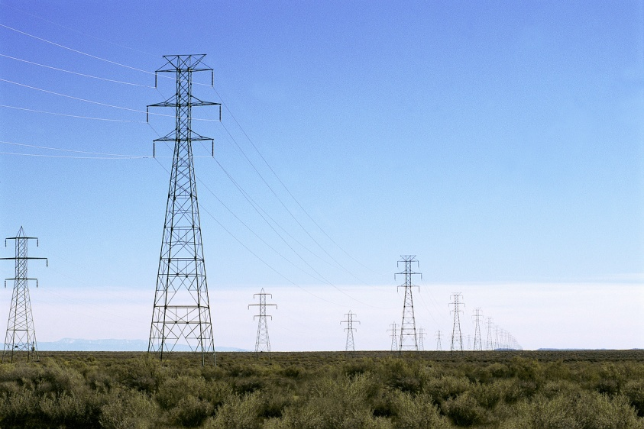
Energy
Energy: the ability to cause change
ANY type of activity requires energy.

Slide 3
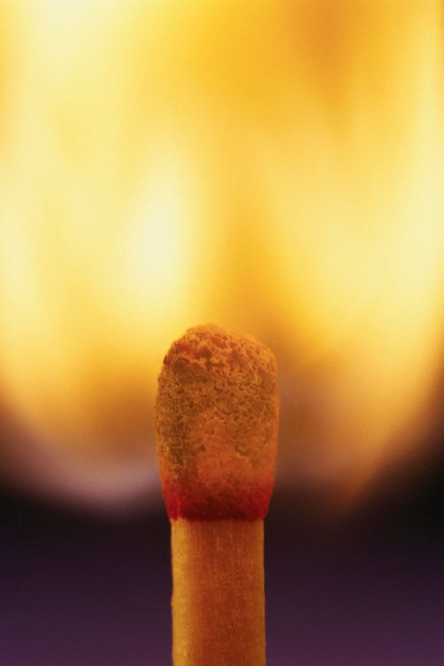
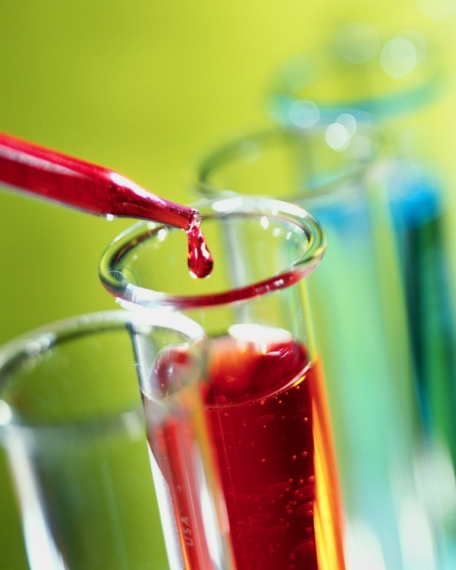
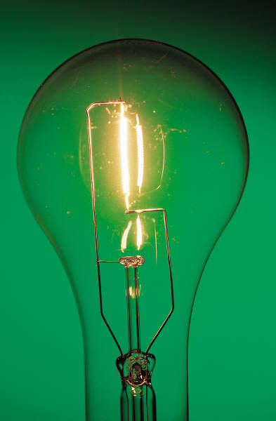

Types of Energy
Chemical
Thermal
Light
Mechanical
Electrical
Sound
Notes:
Some students might wonder which category “Solar” energy falls under: it is combination of radiation, light, and heat.

Slide 4
Energy
One or more of these types of energy are always present during physical or chemical changes!

Slide 5
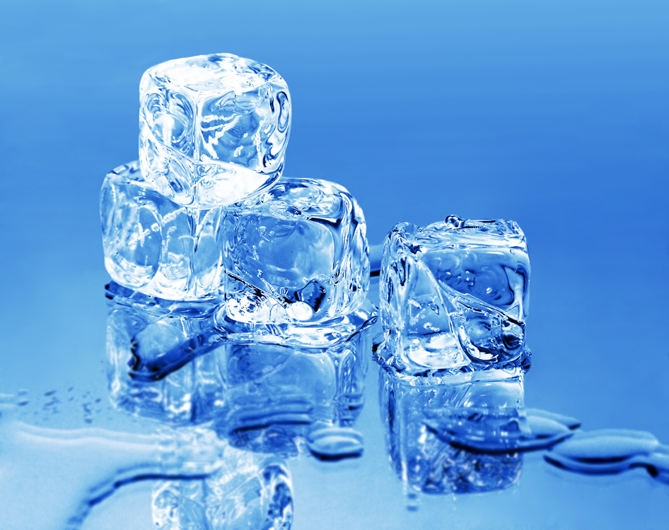
What type of energy is given off when ice melts?
Thermal

Slide 6
What type of energy is given off when glass is dropped?
Sound

Slide 7
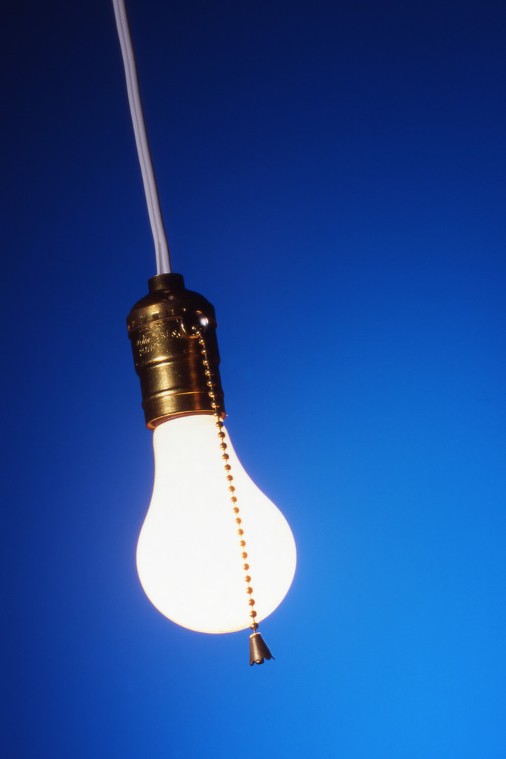
What type of energy is given off when a light is turned on?
Thermal
Sound
Light
(EM)

Slide 8

What type of energy is given off when fireworks explode?
Thermal
Sound
Light (EM)
Mechanical

Slide 9
What type of energy is given off when water boils in a kettle?
Sound
Thermal

Slide 10
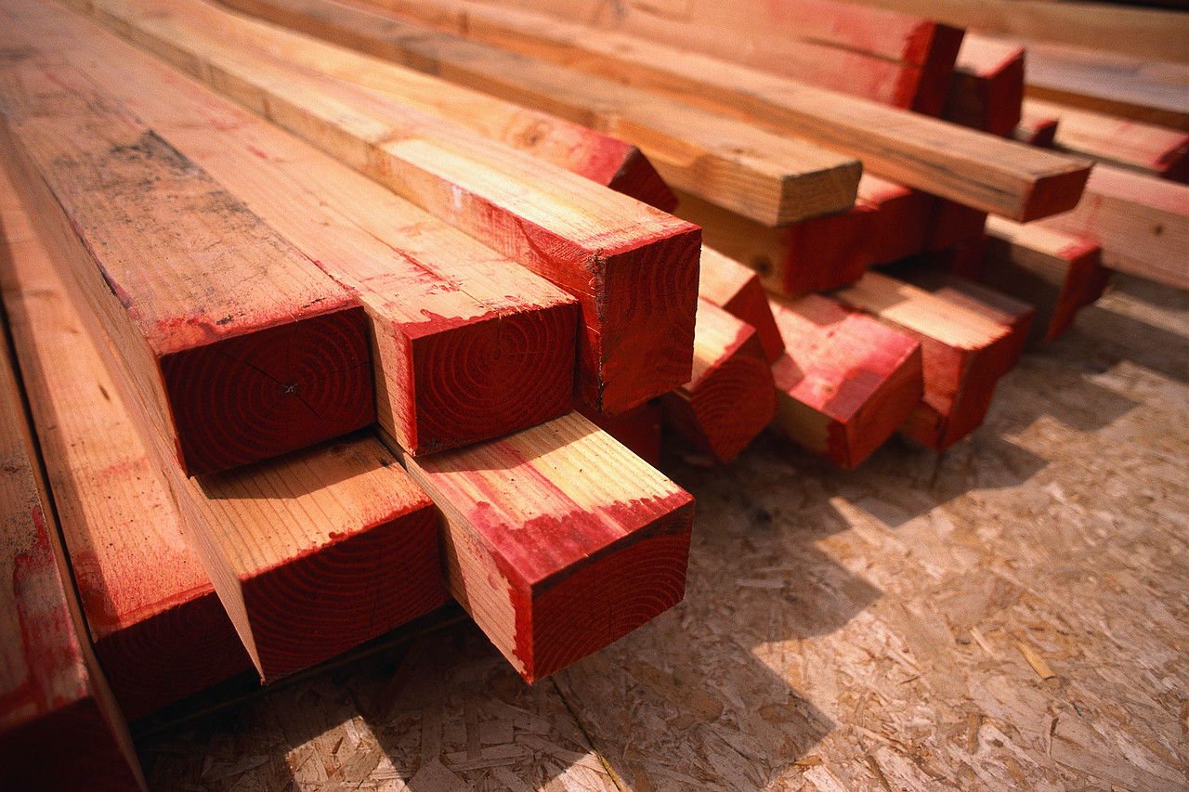
What type of energy is given off when wood is cut with a saw?
Sound
Thermal

Slide 11
Energy
Group Activity!
Roles:
  Time keeper
  Data Recorder
  Thermometer Reader
  Beaker stirrer
Notes:
This activity could also be done as a teacher-run demonstration. Instructions are on slide 13.

Slide 12
Energy
Group Activity!
Materials needed:
  A beaker ½ full of salted ice
  A thermometer (placed in the beaker)
  A spoon (to stir the ice every 2 minutes)
  Paper and pencil to record data

Slide 13
Energy
Instructions:
  Place the thermometer in the beaker of salted ice.
  After about 3 minutes, record the temperature of the salted ice. (This will be your starting temperature).
  Have one person watch the clock for TWO minutes. At the end of the two minutes record the temperature of the ice (and the time) and stir the contents of the beaker.
  Repeat this process every two minutes for a total of 16 minutes.
Notes:
I find that going through these instructions together, one at a time, eliminates most student questions right away.

Slide 14
Sample Data Table
Time (minutes) | Temperature of Ice (°C)
0 (This is the starting temp. of the ice)
2
4
6
8
10
12
14
16
Notes:
You could copy and paste this table into a Microsoft Word document and give it to students to use during their observations.

Slide 15
Energy
Data Analysis:
Which kind of energy was given off in this experiment?
Which purpose did the salt have in the experiment?
How could you modify this experiment to change the results?
What evidence do you have that a change occurred?

Slide 16
Energy
Data Analysis—Possible ANSWERS:
Which kind of energy was given off in this experiment? Thermal, maybe sound
Which purpose did the salt have in the experiment? The salt helped the ice melt more quickly (it raised the melting point)
How could you modify this experiment to change the results? Use no ice, use more ice, do not stir, stir more often, add water, etc.
What evidence do you have that a change occurred? Phase change, change in temperature

Slide 17
Energy
Energy can be given off or taken in during a reaction or change:
Energy given off is EXOTHERMIC ENERGY
Energy taken in is ENDOTHERMIC ENERGY
Hint: exo = out; endo = in

Slide 18
Energy
Exothermic Reactions RELEASE energy, and that makes them feel warm or hot to the touch.
Energy
}
We end with LESS energy than we started with! That “lost” energy escaped as heat.
Time

Slide 19
Energy
Examples of Exothermic Reactions:
  Burning a log in a campfire
  Burning match
  Respiration (the process your cells use to break down the food you eat)
  “Gummy Bear” Torture…

Slide 20

Energy
Notes:
If the video does not automatically work, find it here: http://www.youtube.com/watch?v=nSYDd3j1Luk

Slide 21
Energy
Endothermic reactions ABSORB energy, and that makes them feel cold to the touch.
We end with MORE energy than we started with! The extra energy was absorbed from around the reaction.
Energy
}
Time

Slide 22
Energy
Examples of Endothermic Reactions:
  Melting Ice (heat goes into the solid ice to make it liquid water)
  Photosynthesis (plants absorb sunlight to make food)
  Instant Ice Packs (used for first aid)
  And this one…

Slide 23

Energy
Notes:
If the video does not automatically work, find it here: http://www.youtube.com/watch?v=MyAzjSdc3Fc

Slide 24
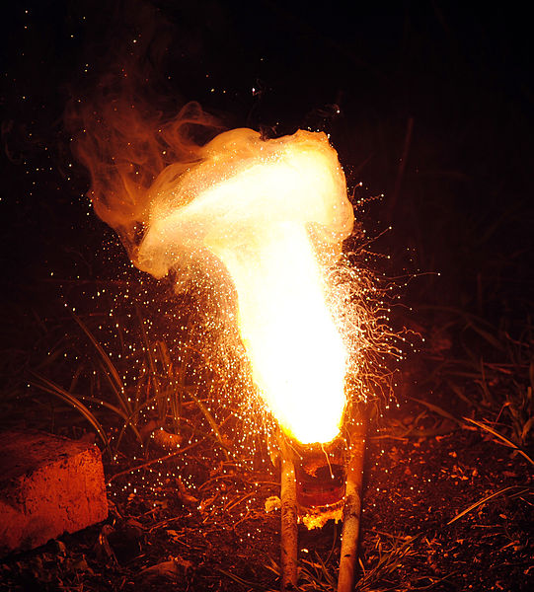
Energy
Which type of reaction is being shown in the picture, exothermic or endothermic?
EXOTHERMIC
You can see from the picture that heat is being RELEASED by this chemical reaction.
Fe₂O₃ + 2 Al → 2 Fe + Al₂O₃

Slide 25
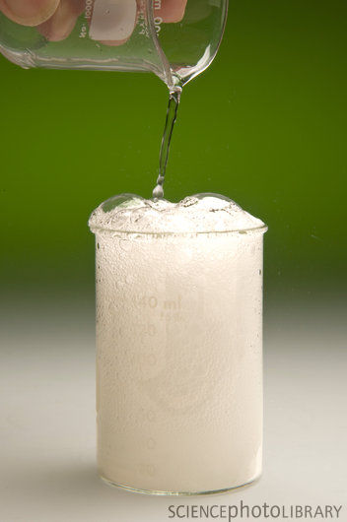
Energy
What type of reaction is being shown in the animation below, exothermic or endothermic?
ENDOTHERMIC
This baking soda and vinegar reaction is absorbing the heat from the environment.
heat
heat
heat
heat
heat
heat
heat
heat
heat
heat
heat
heat
heat
heat
heat
heat
heat
heat
heat
heat
Notes:
The first “click” will start the animation. The second “click” will reveal the answer.

Slide 26

Energy
Discuss with a partner:
  If you were to hold an ice cube in your hand and let it melt, would you be completing a endothermic or exothermic reaction?

Slide 27

Energy
Answer:
ENDOTHERMIC
  Melting ice is a phase change from a solid to a liquid, which means the water molecules must be absorbing energy. (The heat is moving from your hand into the ice).

Slide 28

Energy
Discuss with a partner:
When water vapor condenses to form rain, is an endothermic or exothermic reaction taking place?

Slide 29
Energy
Answer:
EXOTHERMIC
Rain results from a phase change of a gas to a liquid, which means the water molecules must release energy.

Slide 30
Energy
Let’s summarize:
  There are six main types of energy.
  Energy is present when an object changes either physically or chemically.
  Some changes release energy, these are called EXOTHERMIC.
  Some changes absorb energy, these are called ENDOTHERMIC.

