Slide 1
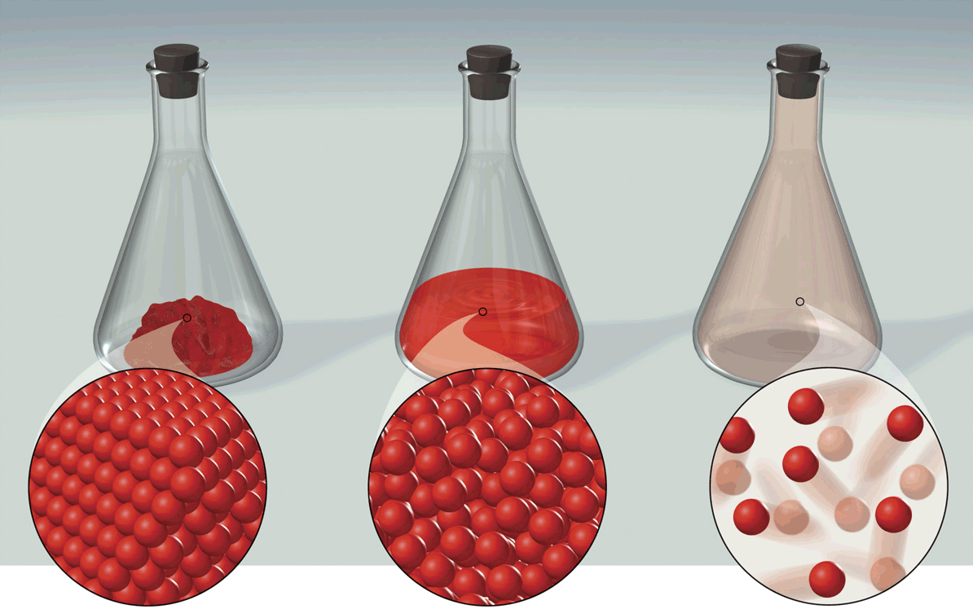
Introduction
to Matter

Slide 2
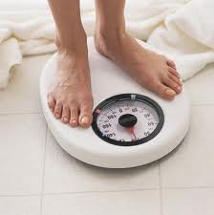
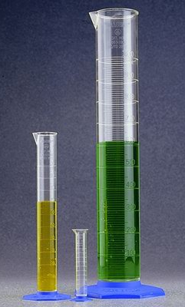
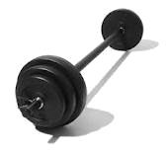
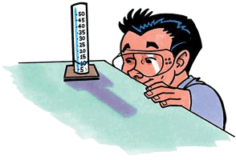
MATTER
Matter:
mass
volume
Is anything that has _____ and _______.
Mass:
quantity
Is the measure of the ________ of matter
atoms
(the amount of _____ )
a substance contains.
Units used:
g (grams)
kg (kilograms)
Note: There is usually confusion between the term mass and weight….let’s clarify...

Slide 3
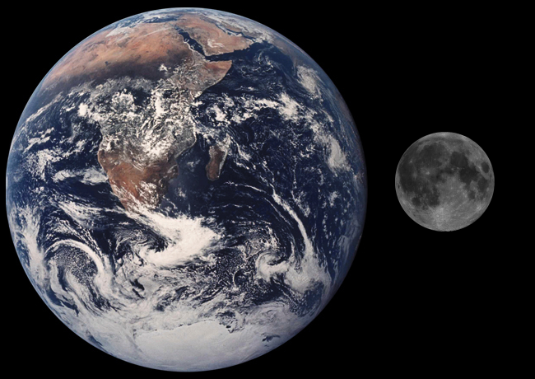
MATTER
Mass
Weight
Mass depends on the _______________ there are in an object.
Weight depends on the _______________
amount of gravity
number of atoms
acting on the amount of ____ contained in an object.
mass
weight = 5000 kg
Since the Moon is 1/6th the size of Earth, it has 1/6th of Earth’s gravitational pull.
weight = 833 kg
mass = 5000 kg
mass = 5000 kg
This means that objects will weigh 1/6th LESS on the Moon than on Earth.
Earth
BUT the mass (amount of atoms) will remain the same.
Moon

Slide 4
MATTER
Matter:
mass
volume
Is anything that has _____ and _______.
Mass:
quantity
Is the measure of the ________ of matter
atoms
(the amount of _____ )
a substance contains.
Units used:
g (grams)
kg (kilograms)
Volume:
amount of space
Is the measure of the _______________ a substance takes up.
Units used:
mL (milliliters)
L (liters)

Slide 5
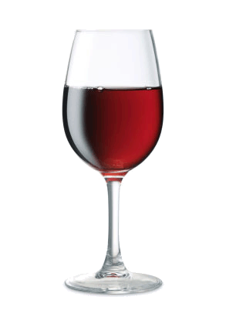
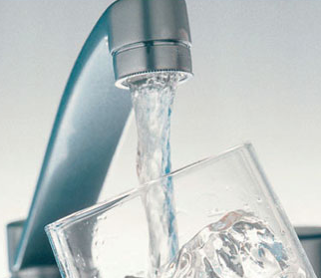
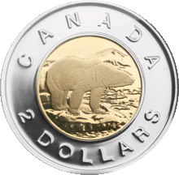
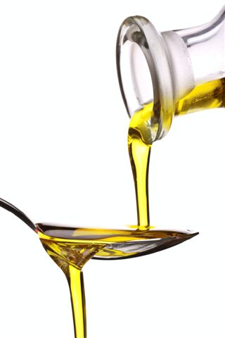
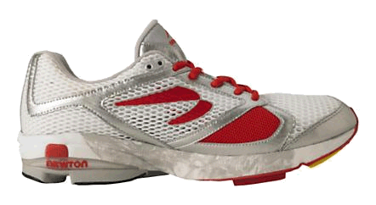
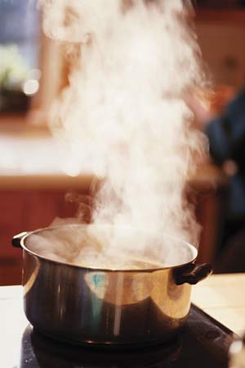
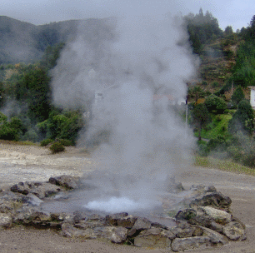
STATES OF MATTER
Guess these states of matter.
Matter comes in 3 States:
Solid
Liquid
3 States
Gas

Slide 6
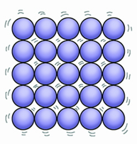
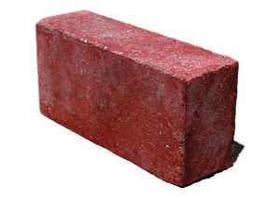
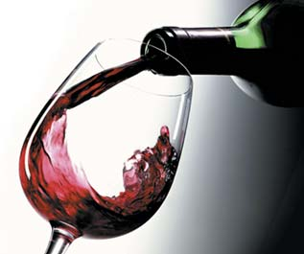
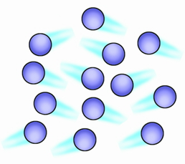
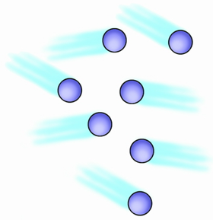
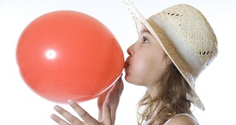
STATES OF MATTER
definite = unchangeable
indefinite = changeable
Distance Between Particles
& Energy of Particles
Shape
Volume
definite
definite
small distances
Solid
low energy and
little movement
(vibrations only)
indefinite
definite
more distances
Liquid
Takes the shape of any container.
more energy
and more
movement
indefinite
indefinite
large distances
Fills the entire volume of any size of container.
high energy
and a lot of
movement
Gas
Takes the shape of any container.

Slide 7
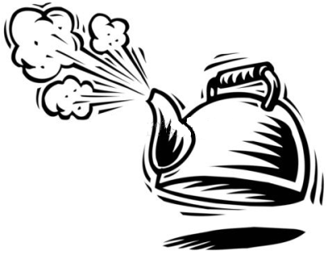
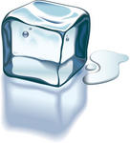
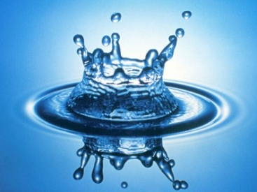
CHANGES OF STATE
Matter can change from one state to another through
six different _________.
processes
Each arrow represents a process. Guess what these are.
the process that changes a substance from the liquid state to the gas state.
Evaporation is…
GAS
Define the rest.
sublimation
condensation
Condensation is….
evaporation
deposition
Melting is….
Freezing is….
melting
Deposition is….
freezing
Sublimation is….
LIQUID
SOLID

Slide 8
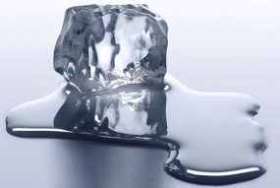
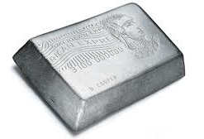
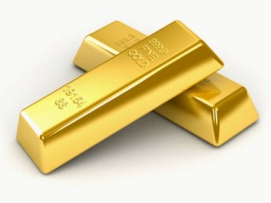
CHANGES OF STATE
temperatures
Changes of state happen at specific ____________ for
many substances.
Each arrow represents a temperature point for a change of state. Guess what these are.
freezing
point
condensing
point
melting
point
boiling
point
SOLID
LIQUID
GAS
different
Change of state temperatures are ________ for different
substances.
Water’s melting point is 0°C.
Lead’s melting point is 327.5°C.
Gold’s melting point is 1064.2°C.

Slide 9
CHANGES OF STATE
temperatures
Changes of state happen at specific ____________ for
many substances.
Each arrow represents a temperature point for a change of state. Guess what these are.
freezing
point
condensing
point
melting
point
boiling
point
SOLID
LIQUID
GAS
Freezing point is…
the temperature at which a liquid turns into a solid.
Melting point is…
Condensing point is…
Define the rest.
Boiling point is…

Slide 10
THE KINETIC THEORY OF MATTER
postulates
The four _________ of KINETIC THEORY
describe the
__________
composition
behavior
in terms of
_______.
and ________ of matter
particles

Slide 11
THE KINETIC THEORY OF MATTER
The Four Postulates of KINETIC Theory:
particles
1) All matter is composed of tiny objects called ________.
spaces
2) All particles have ______ between them.
What happens to these spaces as you go from a solid to liquid to gas?
solid
liquid
gas
From solid to liquid to gas, the spaces get ______.
bigger

Slide 12
THE KINETIC THEORY OF MATTER
The Four Postulates of KINETIC Theory:
motion
3) Particles of matter are in constant _______.
What happens to the speed of the particles if you add more energy to them?
faster
Higher energy particles move _____.
attractive forces
4) There are ______________ between particles.
What happens to the attractive forces when the particles get closer together?
These forces are _______ when particles are closer.
stronger

Slide 13
The End!

