Slide 1
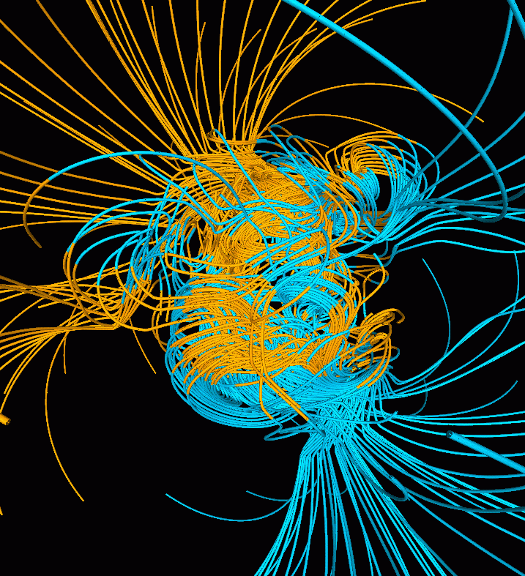
Electricity and Magnetism

Slide 2
Properties of Magnets
magnet – any material that attracts iron and materials that contain iron
magnetism – the attraction or repulsion of magnetic materials
Magnets attract iron and materials that contain iron.
Magnets attract or repel other magnets.
One part of a magnet always points north.

Slide 3
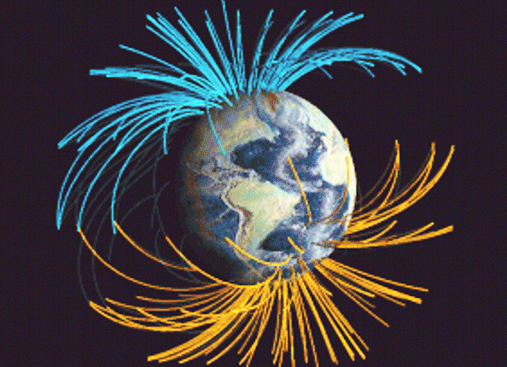
Magnetic Poles
magnetic pole – the two ends on any magnet, no matter what its shape
Magnetic poles that are alike repel each other, and magnetic poles that are unlike attract each other.
magnetic force – the attraction or repulsion between magnetic poles

Slide 4
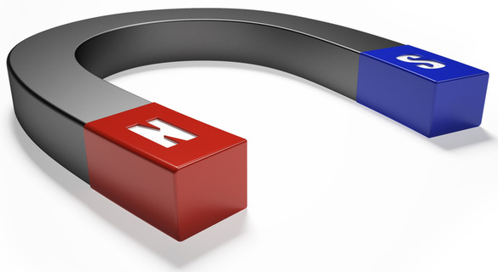
Magnetic Fields
magnetic field – the area of magnetic force around a magnet
magnetic field lines – the lines that map out the magnetic field around a magnet
Magnetic field lines spread out from one pole, curve around the magnet, and return to the other pole.

Slide 5
Inside a Magnet
atom – the smallest particle of an element that has the properties of that element
element – one of about 100 basic materials that make up all matter
nucleus – the center region of an atom
proton – a particle that carries a positive charge
neutron – a particle that does not carry an electric charge
A spinning electron produces a magnetic field that makes the electron behave like a tiny magnet in an atom.

Slide 6
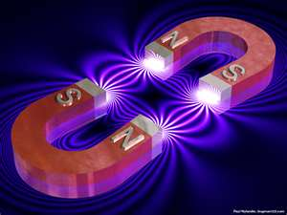
Magnetic Domains
magnetic domain – a grouping of billions of atoms that have their magnetic fields lined up in the same direction
In a magnetized material, all or most of the magnetic domains are arranged in the same direction.
ferromagnetic material – a material that has strong magnetic properties

Slide 7
Making and Changing Magnets
Magnets can be made, destroyed, or broken apart.
temporary magnet – a magnet made from a material that easily loses its magnetism
permanent magnet – a magnet made from a material that keeps its magnetism for a long time

Slide 8
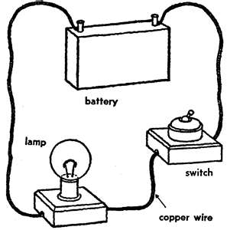
Electric Current
electric current – the continuous flow of electric charges through a material
To produce electric current, charges must flow continuously from one place to another.
electric circuit – a complete, unbroken path through which electric charges can flow

Slide 9
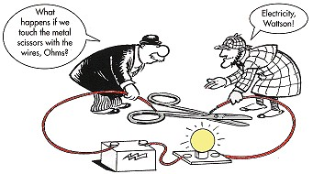
Conductors and Insulators
A conductor transfers electric charge well.
conductor – a material through which charge can easily flow
An insulator does not transfer electric charge well.
insulator – a material through which charges cannot flow easily

Slide 10
Voltage
voltage – the difference in electrical potential energy between two places in a circuit
Voltage causes a current in an electric circuit.
voltage source – a device that creates a potential difference in an electric circuit

Slide 11
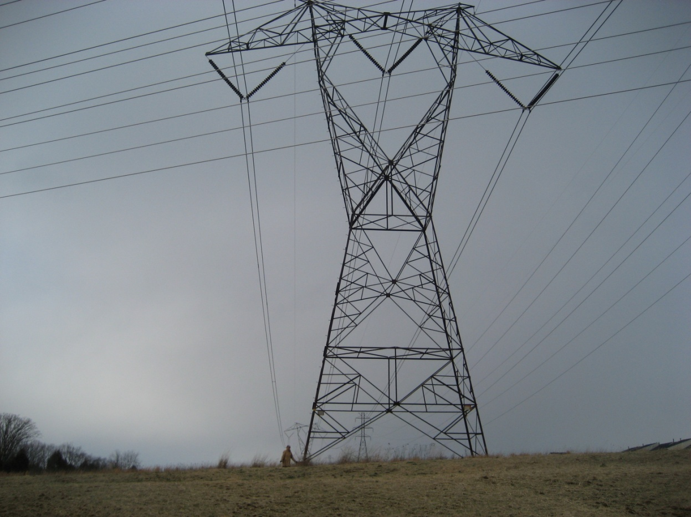
Resistance
The greater the resistance, the less current there is for a given voltage.

Slide 12
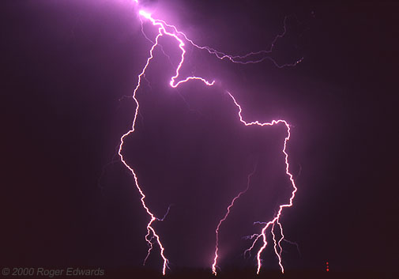
Electric Current and Magnetism
An electric current produces a magnetic field.
electromagnetism – the relationship between electricity and magnetism

Slide 13
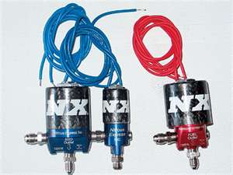
Solenoids
The magnetic field is produced by a current has three distinct characteristics.
The field…
Can be turned on or off
Have its direction reversed
Have its strength changed
solenoid – a coil of wire with a current

Slide 14
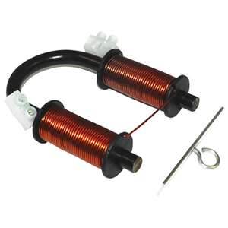
Electromagnets
electromagnet – a solenoid with a ferromagnetic core
An electromagnet is a strong magnet that can be turned on and off.

Slide 15
Induction of Electric Current
An electric current is induced in a conductor when the conductor moves through a magnetic field.
electromagnetic induction – generating an electric current from the motion of a conductor through a magnetic field
direct current – a current consisting of charges that flow in one direction
alternating current – consists of charges that move back and forth in a circuit

Slide 16
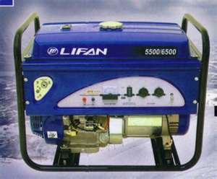
Generators
electric generator – a device that converts mechanical energy into electrical energy
A generator uses motion in a magnetic field to produce an electric current

Slide 17
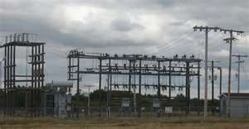
Transformers
A transformer is a device that increases or decreases voltage.
transformer – consists of two separate coils of insulated wire wrapped around an iron core
step-up transformer – a transformer that increases voltage
step-down transformer – a transformer that decreases voltage

