Slide 1
Circuits & Electronics

Slide 2
Ohm’s Law
When you connect a conductor (wire) and a device (light bulb) to the + and – terminals on a battery an electrical current flows. The amount of current depends on the amount of voltage supplied. The current around the circuit also depends on the resistance of the wire and the amount of devices in the circuit. This relationship of voltage, current, and resistance is known as Ohm’s Law.
Voltage = current × resistance
V = IR
V = Voltage (V)
I = Current → Amperes (A)
R = Resistance → Ohms (Ω)

Slide 3
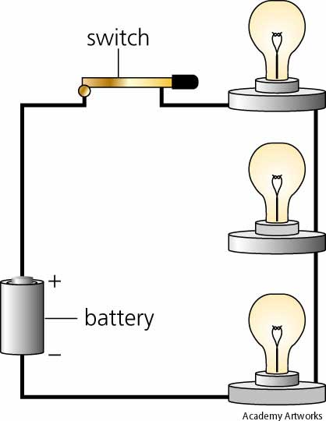
Series Circuit
A circuit needs three things.
Energy source
Path
Load
Series circuit: circuit
in which current only flows in one
direction.
-
-
-
-
-

Slide 4
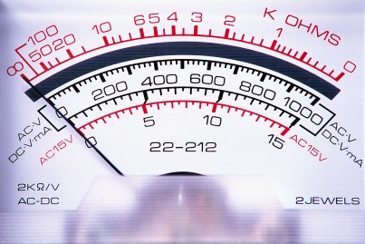
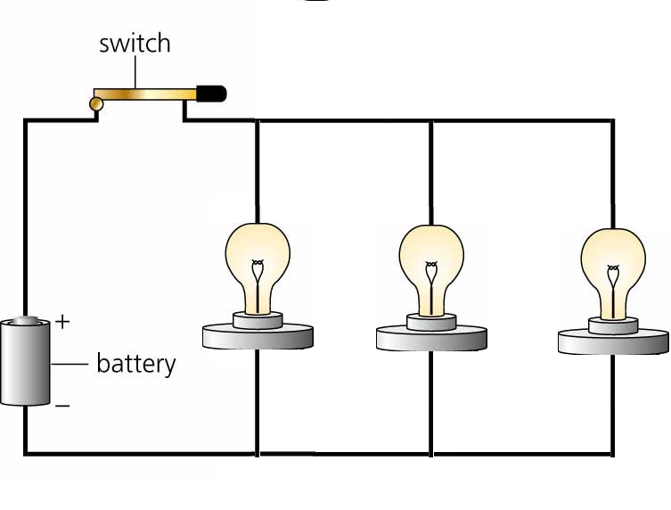
Parallel Circuit
Parallel circuit- circuit in which electric current can follow more than one path.

Slide 5
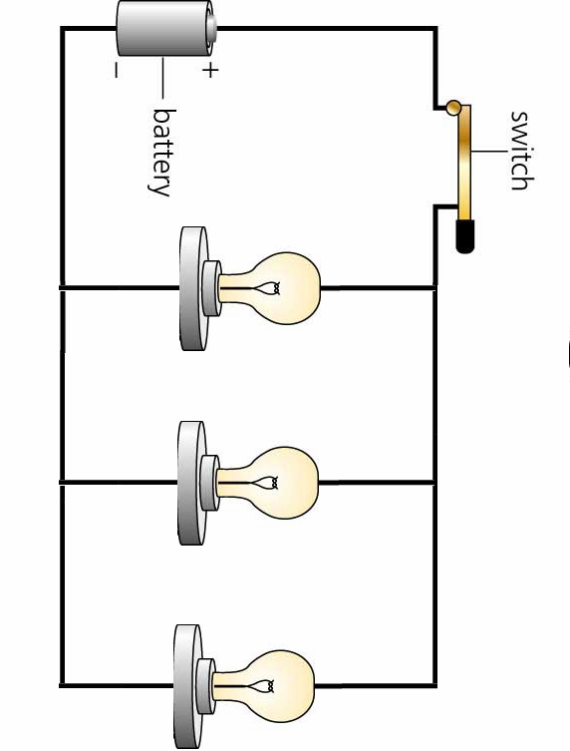
Measure Electricity
Voltage: energy that is available to push electrons through the path.
Measured in volts (V) by a voltmeter.
Current: amount of electric current.
Measured in amps (A) by an ammeter.
Resistance: material that resists the flow of electricity.
Measured in ohms (Ω).
Length, diameter, material, and temperature affect amount of resistance.

Slide 6
Ohm’s Law: current in a wire is equal to the voltage divided by the resistance.
Voltage = 6 amps × 10 Ω
Voltage = 60 Volts
6 A
-
-
-
2 Ω
3 Ω
5 Ω
-
-
-
-
-
6 A

Slide 7
Electric Power
In order for appliances to run and do work in your house the appliance or machine must convert electricity into another energy like (sound, heat, mechanical energy, etc.)
The unit for electric power is the kilowatt (kW)
1 kilowatt = 1,000 watts
Power = current × voltage
P = IV
Electric power is used by your house or a building such as a school, store, or company and Georgia Power Company charges by the kilowatt hour (kWh)
1 kWh is generally the amount of electricity needed to light 10 100-W bulbs for one hour.

