Slide 1
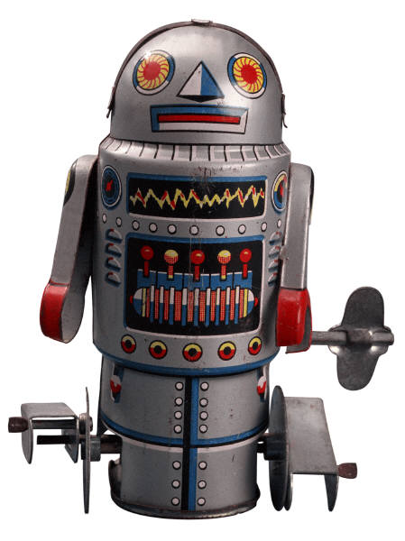
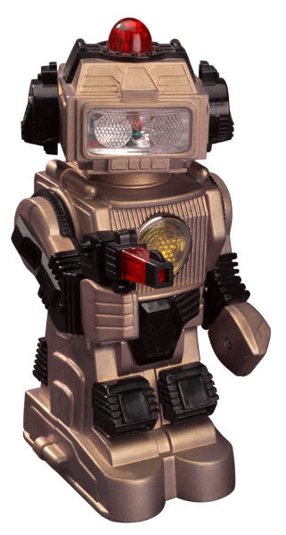
Work and Machines
What is a machine??

Slide 2
Machines: making work easier
Think about changing a tire- what tools do you all need?
Think about the amount of work put into using those tools
What if we didn’t have those tools- now how much work would it be?
Machines make work easier
Machine- a device that makes work easier by changing the size or direction of a force

Slide 3
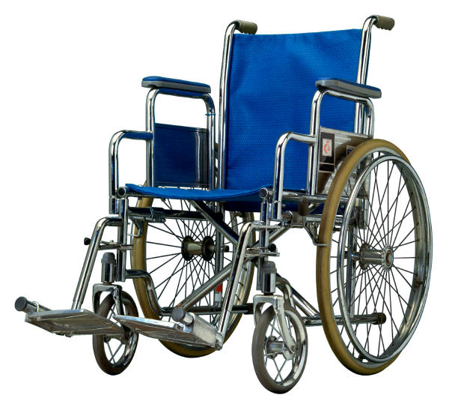
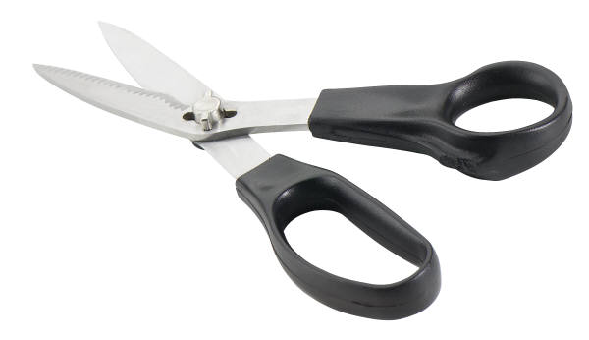
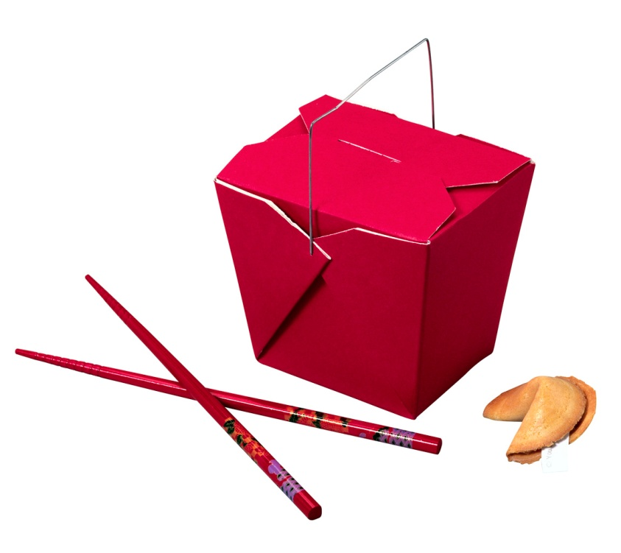
Some everyday machines

Slide 4
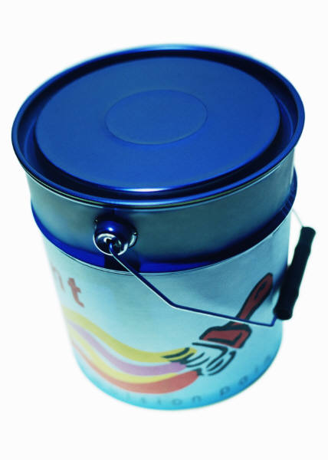
Work in, work out
How do you open up a can of paint???
A lever, such as a screwdriver!
You place the top of the screwdriver
under the edge of the lid and then push
down on the screwdriver’s handle. The
tip of the screwdriver lifts the lid as you
push down.
You do work on the screwdriver, and the screwdriver does work on the lid

Slide 5
Work in, work out
Remember, work is done when a force is applied through a distance
W = F x d
Work input- the work that you do on a machine
You apply a force called the input force, to the machine through a distance
Work output- the work done by the machine on an object
The machine applies a force, called the output force, through a distance

Slide 6
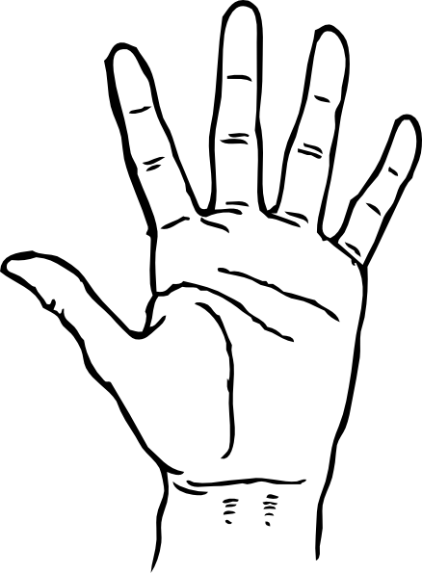
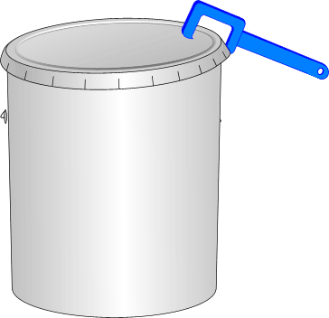
Work in, work out
Output force- the tool is doing the work on the can
Input force
The person is doing work ON the machine

Slide 7
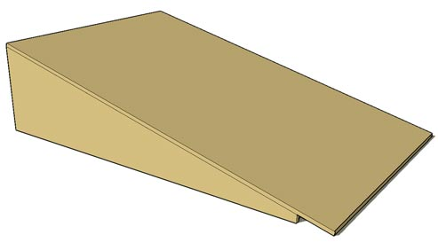
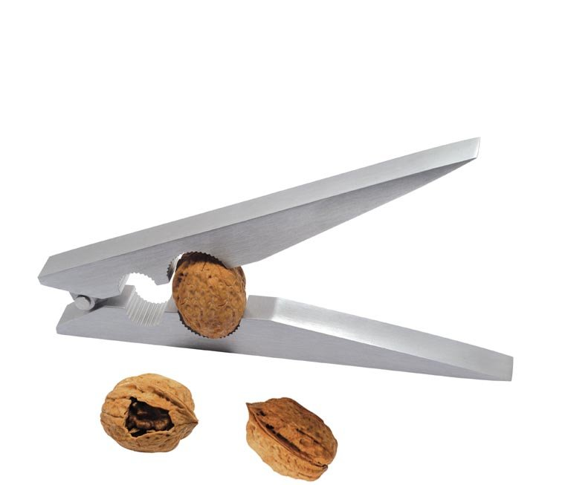
How machines help
W = F x d
A machine can help us decrease the force by increasing the distance
For example, a ramp
Or a machine can help us decrease the distance by increasing the force
For example, a nutcracker

Slide 8
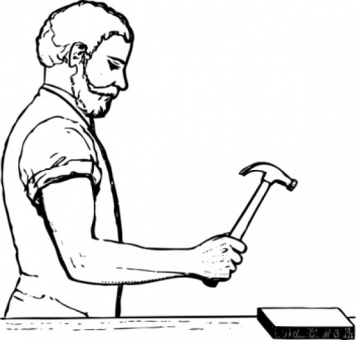
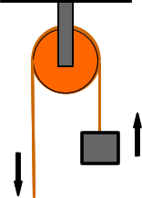
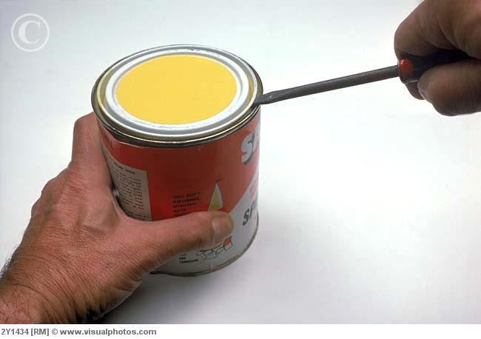
How machines help
A hammer decreases the force, but applies it over a greater distance
A nutcracker increases the force but applies it over a shorter distance
When a screwdriver is used as a lever, it increase the force and decreases the distance over which the force is applied
A simple pulley changes the direction of the input force, but the size of the output force is the same as the input force

Slide 9
Mechanical Advantage
Some machines make work easier than others do because they can increase force more than other machines can.
Mechanical advantage- number of times the machine multiplies force
compares the input force with the output force
Calculating it →
Mechanical advantage (MA) = output force / input force
Deals with FORCE

Slide 10
mechanical advantage (MA) = output force / input force
For example: imagine that you had to push a 500N weight up a ramp and only needed to push with 50N of force the entire time. The mechanical advantage would be calculated as follows…
MA = 500N / 50N
MA = 10
A machine that has a mechanical advantage that is greater than 1 can help move or lift heavy objects because the output force is greater than the input force.

Slide 11
Mechanical Efficiency
The work output of a machine can never be greater than the work input
Some work done by the machine is used to overcome the friction created by the use of the machine.
Mechanical Efficiency- a quantity (usually percent) that measures the ratio of work output to work input
mechanical efficiency = work output/ work input x 100
Deals with ENERGY

Slide 12
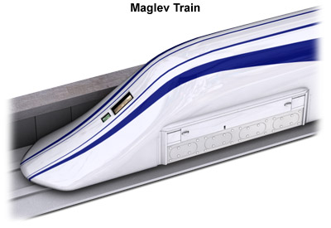
Perfect Efficiency
An ideal machine would have 100% mechanical efficiency
They are impossible to built
However, there are ways to make machines more efficient
Such as a train floating on magnets so there is almost no friction or using lubricants such as oil or grease to decrease friction.

Slide 13
review
Explain work input
Explain work output
Explain how a ramp makes work easier
What is the mechanical efficiency of a machine whose work input is 100J and work output is 25J?
Suppose that you exert 60N on a machine and the machine exerts 120N on another object. What is the machine’s mechanical advantage?

