Slide 1
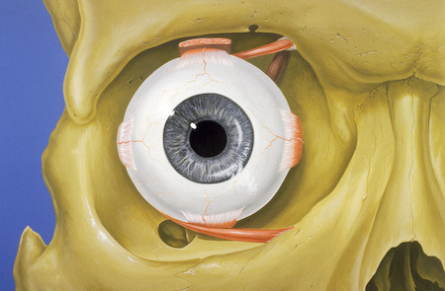
The Human Eye
The eye is about as big as a ping-pong ball and sits in a little hollow area (the eye socket) in the skull.

Slide 2
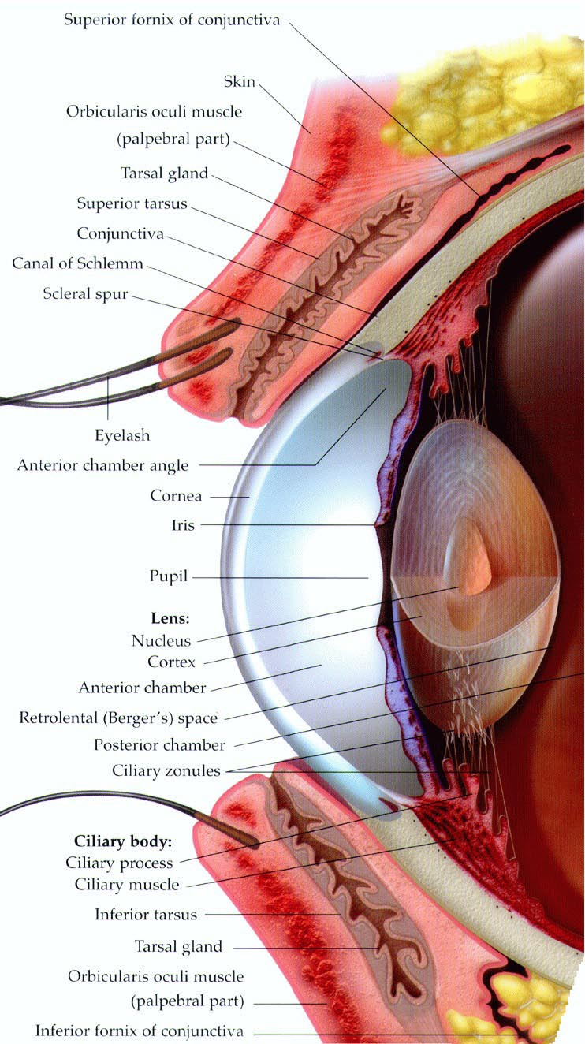
The Eyelid
The eyelid protects the front part of the eye.
The lid helps keep the eye clean and moist by opening and shutting several times a minute.
  Blinking - both a voluntary and involuntary action, meaning you can blink whenever you want to, but it also happens without you even thinking about it.

Slide 3
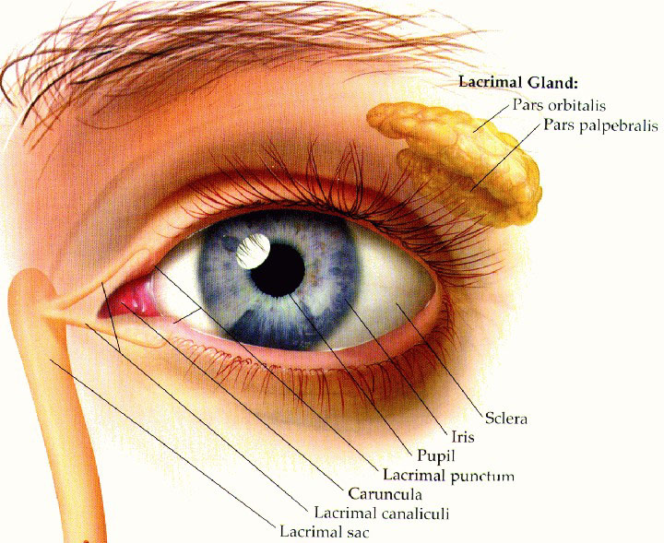
The eyelid also has great reflexes, which are automatic body responses, that protect the eye.
When you step into bright light, for example, the eyelids squeeze together tightly to protect your eyes until they can adjust to the light.
And if someone jumps out at you, your eyes will blink.
  Your eyelids shut automatically to protect the eye from possible danger.
  Don't forget eyelashes! They work with the eyelids to keep dirt and other unwanted stuff out of your eyes.

Slide 4
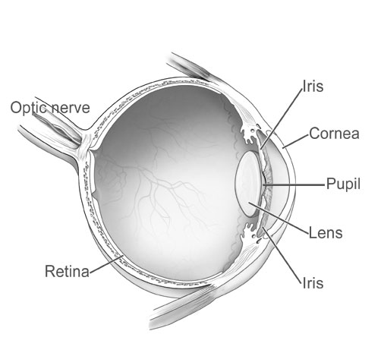
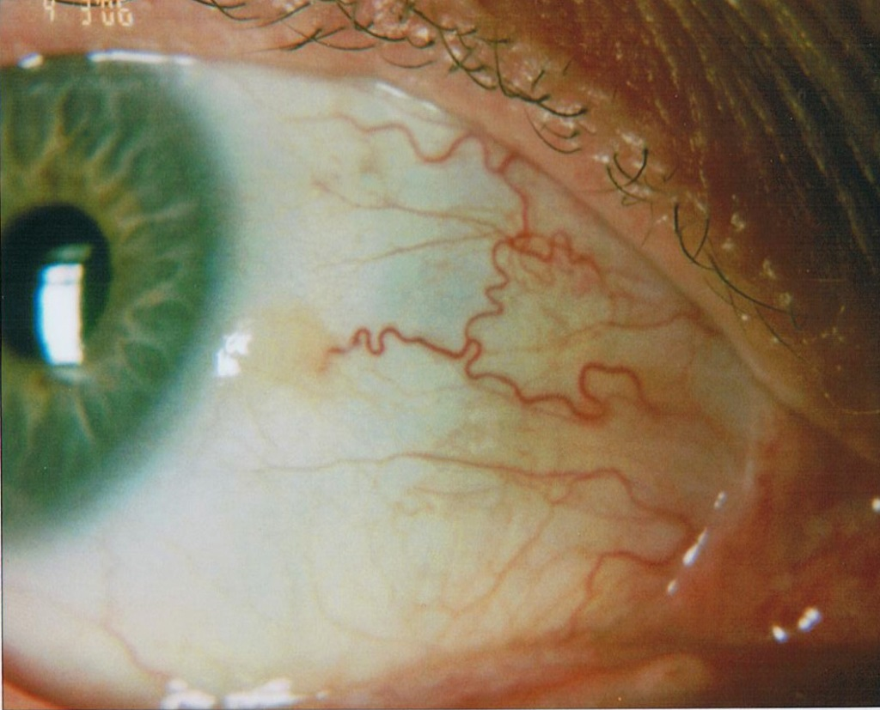
The Sclera
The white part of the eyeball is called the sclera (say: sklair-uh).
  The sclera is made of a tough material and has the important job of covering most of the eyeball.
    Think of the sclera as your eyeball's outer coat.
  Look very closely at the white of the eye, and you'll see lines that look like tiny pink threads. These are blood vessels, the tiny tubes that deliver blood, to the sclera.
Sclera

Slide 5
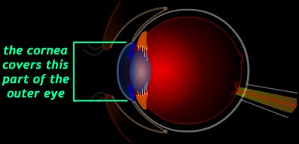
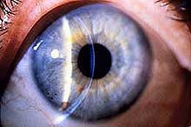
The Cornea
The cornea, a transparent, curved dome, sits in front of the colored part of the eye.
  The cornea helps the eye focus as light makes its way through.
  It also helps protect the eye.

Slide 6
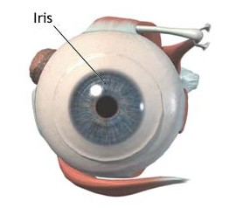
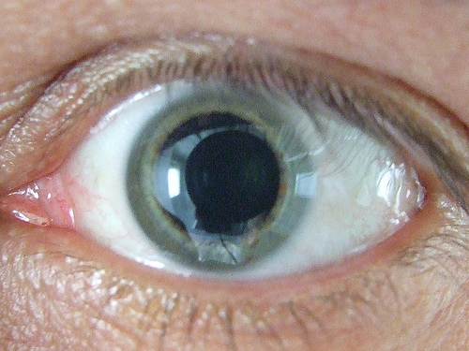
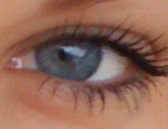
Behind the cornea are the iris and the pupil.
The iris is the colorful part of the eye.
  When we say a person has blue eyes, we really mean the person has blue irises!
The iris has muscles attached to it that change its shape.
  This allows the iris to control how much light goes through the pupil.

Slide 7
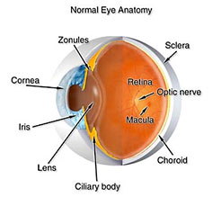
The Pupil
The pupil is the black circle in the center of the iris, which is really an opening in the iris, and it lets light enter the eye.
  The pupils will get smaller when the light shines near them and they'll open wider when the light is gone.
Pupil

Slide 8
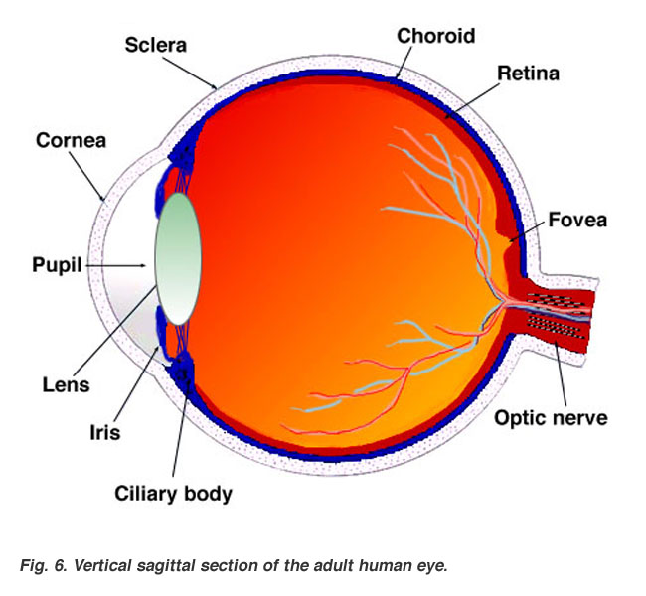
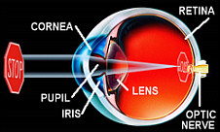
The Lens
After light enters the pupil, it hits the lens. The lens sits behind the iris and is clear and colorless.
The lens' job is to focus light rays on the back of the eyeball — a part called the retina.

Slide 9
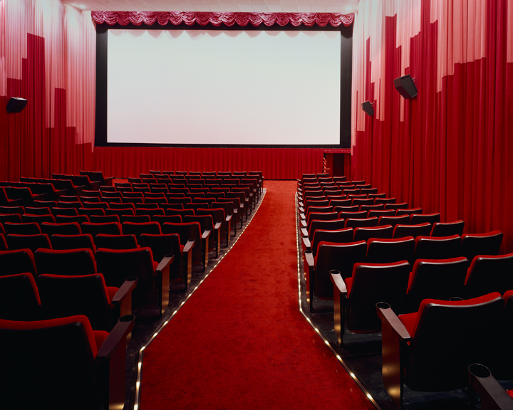
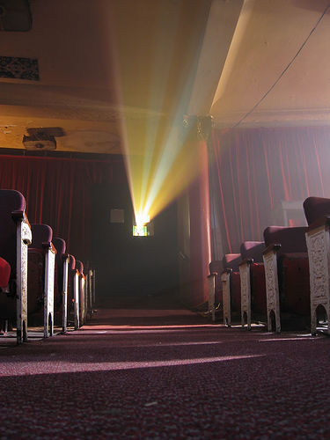
The lens works much like the lens of a movie projector at the movies.
Next time you sit in the dark theater, look behind you at the stream of light coming from the projection booth. This light goes through a powerful lens, which is focusing the images onto the screen, so you can see the movie clearly.

Slide 10
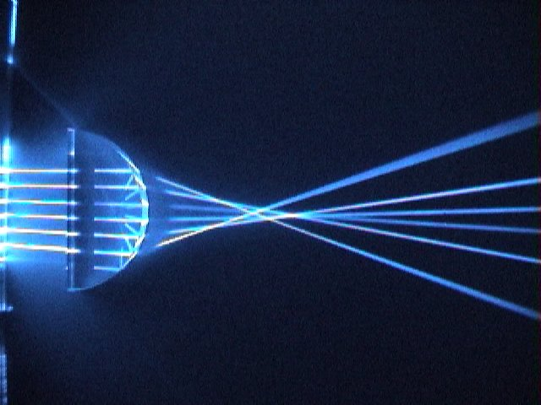
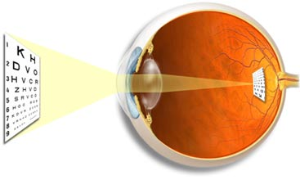
In the eye's case, however, the film screen is your retina and the image is upside down.
The lens is a convex lens.
This causes the light entering the eye to be refracted in a way that causes the rays of light to be focused together.

Slide 11
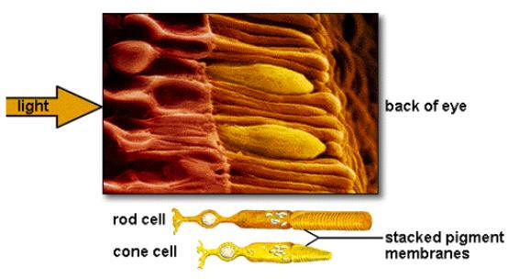
The retina uses special cells called rods and cones to process light. Just how many rods and cones does your retina have? How about 120 million rods and 7 million cones — in each eye!

Slide 12
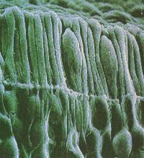

Rods see in black, white, and shades of gray and tell us the form or shape that something has.
Rods can't tell the difference between colors, but they are super-sensitive, allowing us to see when it's very dark.

Slide 13
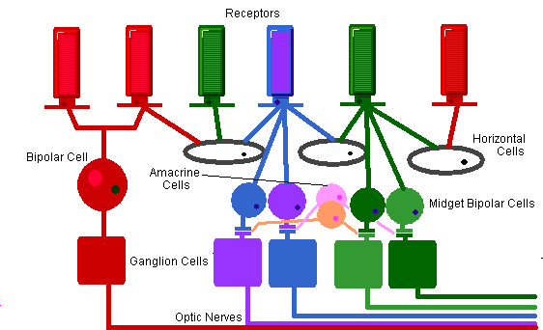
Cones sense color and they need more light than rods to work well.
  Cones are most helpful in normal or bright light.
The retina has three types of cones.
  Each cone type is sensitive to one of three different colors — red, green, or blue — to help you see different ranges of color.
Together, these cones can sense combinations of light waves that enable our eyes to see millions of colors.

Slide 14
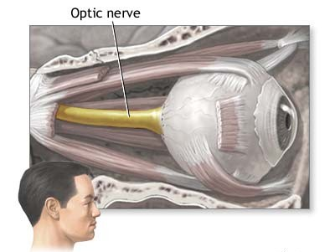
The Optic Nerve
Think of the optic nerve as the great messenger in the back of your eye.
The rods and cones of the retina change the colors and shapes you see into millions of nerve messages.
Then, the optic nerve carries those messages from the eye to the brain!

Slide 15
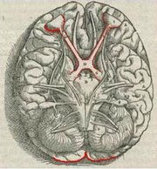

The optic nerve serves as a high-speed telephone line connecting the eye to the brain.
When you see an image, your eye "telephones" your brain with a report on what you are seeing so the brain can translate that report into "cat," "apple," or "bicycle," or whatever the case may be.

