Slide 1
Parts of the Human Ear | How we Hear | The Speed of Sound | Sound Waves | Properties of Sound
100 | 100 | 100 | 100 | 100
200 | 200 | 200 | 200 | 200
300 | 300 | 300 | 300 | 300
400 | 400 | 400 | 400 | 400
500 | 500 | 500 | 500 | 500

Slide 2
What are the three areas/parts of the human ear?
Inner, Middle, and Outer

Slide 3
What are the two main parts of the outer ear?
Pinna and Ear Canal

Slide 4
What are the two main parts of the inner ear?
Cochlea and Auditory Nerve

Slide 5
What are the four main parts of the middle ear?
Eardrum, Anvil, Hammer, and Stirrup

Slide 6
What, in the cochlea, detects sound waves?
Hair Cells

Slide 7
When sound is funneled into the ear canal, it vibrates the ________________.
Eardrum

Slide 8
The eardrum transfers sound vibrations to the ________ in the middle ear.
Bones

Slide 9
The anvil, hammer, and stirrup vibrate against the __________ in the inner ear.
Cochlea

Slide 10
What carries sound, as an electrical impulse, to the brain?
Auditory Nerve

Slide 11
When are sound waves actually interpreted as sound?
When they reach the brain

Slide 12
At ________ ____________, sound travels at 343 m/s in air.
room
temperature

Slide 13
What two factors affect how fast sound travels?
Temperature and Density

Slide 14
If a sound wave is moving through a cold substance, will it be easier or harder for the wave to travel?
Harder!

Slide 15
Which would transfer sound more slowly: Solid, liquid, or gas?
Gas

Slide 16
Why you could hear the coat hanger better with your fingers in your ears?
The sound travels through
a solid all the way to your ears

Slide 17
What has to occur for a sound to form?
Vibrations

Slide 18
Does a sound wave travel in a straight line?
No! It moves out from the
source in all directions.

Slide 19
What type of wave is a sound wave?
Longitudinal

Slide 20
What part of a wave is shown here?
Rarefaction

Slide 21
What does a vibration do to the air molecules that surround the object making sound?
Makes them vibrate too!

Slide 22
What does the loudness of a sound tell us?
The amount of energy in the sound wave

Slide 23
The highness or lowness of a sound is ____________.
Pitch

Slide 24
Which has a higher pitch?

Slide 25
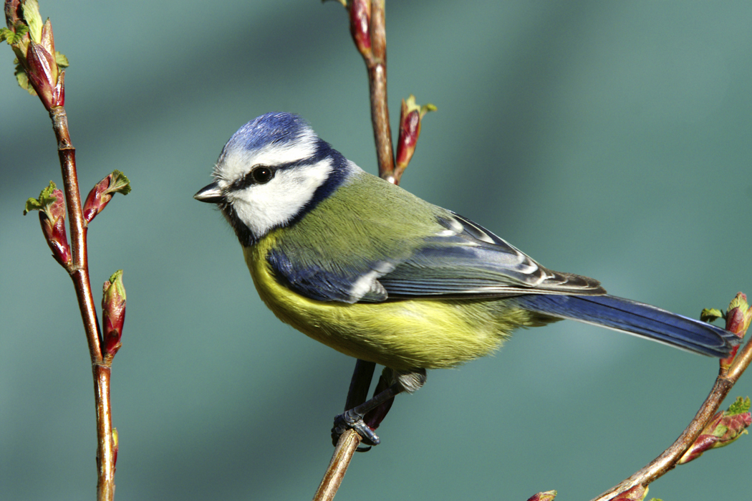
More or Less Sound Vibrations?
More!

Slide 26
If a wave has a low frequency, the pitch will be _________.
low also

