Slide 1
OPTICAL ILLUSIONS The Art of Seeing
Coach Dave Edinger
Physical Science (8A)

Slide 2
Daily Objective
Students will explore the art of perception and experience its subjectivity by viewing optical illusions and sharing the effect that they have on them.

Slide 3
What Are Optical Illusions?
Warm-up: We’ve all seen them, although you may not have even realized what they are. When you hear the phrase “Optical Illusion,” what do you think of?

Slide 4
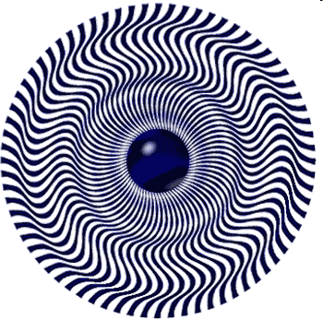
Definition
Involves an apparently inexplicable discrepancy between the appearance of a visual stimulus and its physical reality
Visually perceived images that are deceptive or misleading

Slide 5
The Ames Room
Observe this room. Take special note of the size, shape, color and details of the room.
Can one girl really be that much bigger than the other?

Slide 6
The Ames Room
Viewer assumes room is rectangular and the image cast onto the retina is consistent with this hypothesis
Naïve viewers conclude that one girl is larger, when in fact she is just closer
Further Reading: http://psylux.psych.tu-dresden.de/i1/kaw/diverses%20Material/www.illusionworks.com/html/ames_room.html

Slide 7
Optical Illusions
The perceptual hypotheses that we create become especially striking when they are wrong
Proximity, Depth Cues, Similarity, and Figure Ground perception affect the hypotheses that we make
Human perceptions are HIGHLY SUBJECTIVE

Slide 8
Let’s Try a Few
On the chart provided for you (see optical_illusion_chart.rtf) describe your perceptions for the following illusions. Be sure to submit this form along with your responses to the homework tomorrow at the beginning of class.

Slide 9
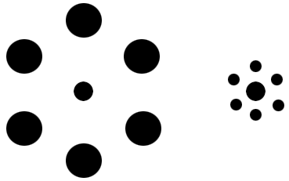
Illusion #1 Which center circle is bigger?

Slide 10
Illusion #2 Which line is longer?

Slide 11
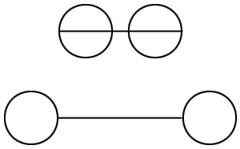
Illusion #3 Which line is longer?

Slide 12
Illusion #4 Water goblet or two faces?

Slide 13
Illusion #5 Old woman or young woman?

Slide 14
Another version!

Slide 15
Illusion #6 Skull or woman in a mirror?

Slide 16
Illusion #7 Eskimo or Native American head?

Slide 17
Illusion #8 Face or musician?

Slide 18
Illusion #9 A face? A word?

Slide 19
Illusion #10 (4) Which word do you see first?

Slide 20
Illusion #11 Stare at the center for 15 sec and then look up – what do you see?

Slide 21
Illusion #12 Stare at the center for 15 sec and then look up – what do you see?

Slide 22
Illusion #13 How many black dots are there?

Slide 23
Illusion #14 Follow directions below

Slide 24
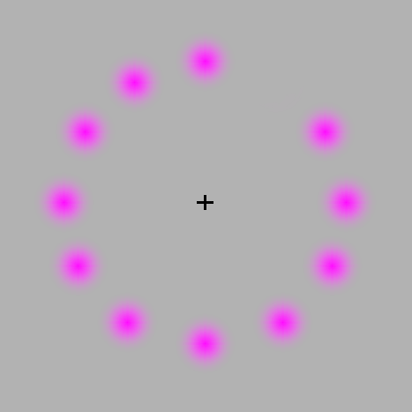
Illusion #15 Stare at the center – what color do the dots become?

Slide 25
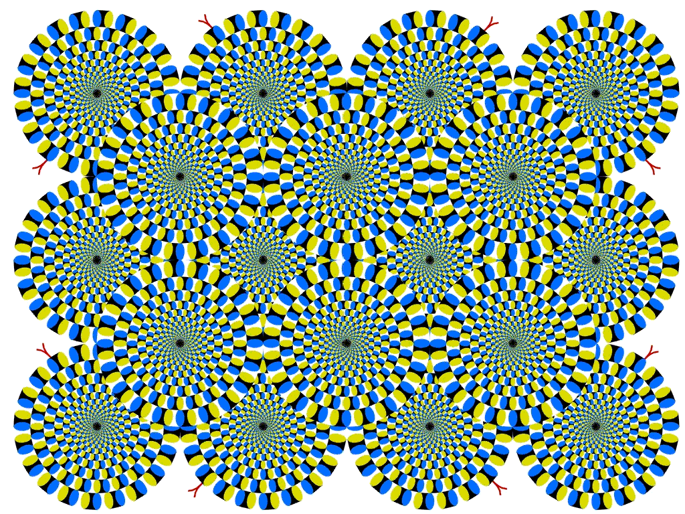
Illusion #16 Mind Warp

Slide 26
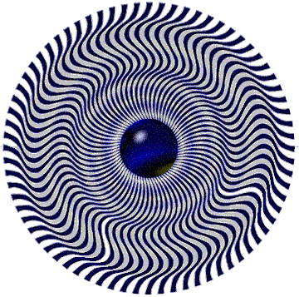
Illusion #17 How does it move?

Slide 27
Illusion #18 Impossible Figures (3)
objects that can be represented in two-dimensional pictures but cannot exist in three-dimensional space

Slide 31
Playing with Words
Perception of letters, words and phrases

Slide 32
Illusion #19 Read the following out-loud – now read it again slowly and see if you fell for the trick

Slide 33
Illusion #20

Slide 34
Illusion #21 What do you think?
Aoccdrnig to a rscheearch at an Elingsh uinervtisy, it deosn't mttaer in waht oredr the ltteers in a wrod are, the olny iprmoetnt tihng is taht frist and lsat ltteer is at the rghit pclae. The rset can be a toatl mses and you can sitll raed it wouthit porbelm. Tihs is bcuseae we do not raed ervey lteter by it slef but the wrod as a wlohe.

Slide 35
Illusion #22 The Stroop Effect Time yourself saying the word – then time yourself saying the color of the ink. What is the difference?

Slide 36
The Stroop Effect
The words themselves have a strong effect over your ability to say the color
There is an interference in the information your brain receives - and this causes a problem
Speed of Processing Theory
Words read faster that colors are named
Selective Attention Theory
Naming colors requires more attention than reading the word
For Further Reading:
http://www.snre.umich.edu/eplab/demos/st0/stroopdesc.html

Slide 37
Stereograms
Bring your eyes close to the screen. As you slowly move your head away from the screen, take your eyes out of focus and a picture will pop out.

Slide 38
Illusion #23 Try your best – what do you see?

Slide 39
Illusion #24 And another?

Slide 40
Illusion #25 Do you see something floating?

Slide 41
Homework
Describe how a person’s perceptions affect that person’s point of view. What are some examples of this bias? What role does subjectivity have in your perceptions?

