Slide 1
Mirrors & Lenses
Reflection and Refraction

Slide 2
Reflection
Occurs when an object or wave bounces back off a surface it can’t pass through
Example: a mirror or sunglasses

Slide 3
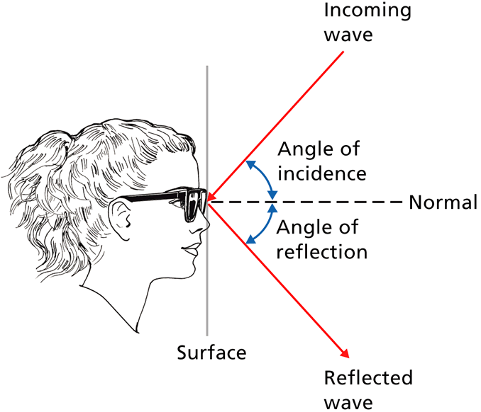
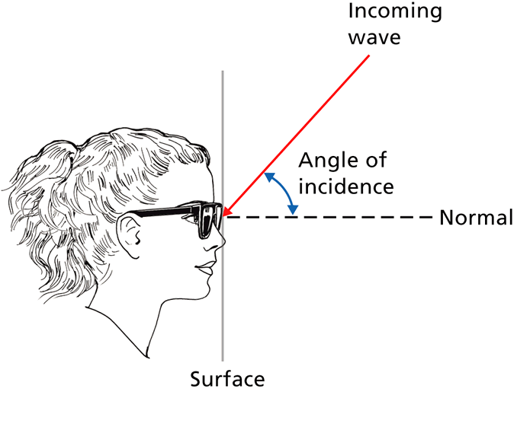
Law of Reflection
The angle of incidence equal the angle of refraction; all waves obey this law.

Slide 4
Mirrors
Plane Mirrors
Concave mirrors
Convex mirrors

Slide 5
Plane Mirror
Flat sheet of glass that has a smooth, silver-colored coating on one side
Example: the mirror in your bathroom
Coating reflects light and forms an image behind the mirror
You see a “virtual image,” which is upright, the same size as the object, but the left and right are reversed

Slide 6
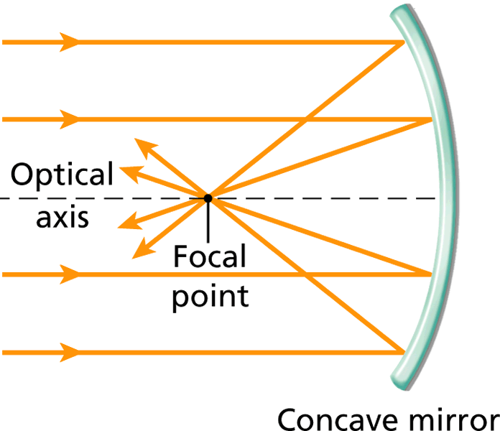
Concave Mirrors
A mirror with a surface that curves inward like the inside of a bowl is a concave mirror.
Reflects rays of light that are parallel to the optical axis, which divides the mirror in half.
The point at which these reflections meet is called the focal point. The more curved the mirror is, the closer the focal point is to the mirror.

Slide 7
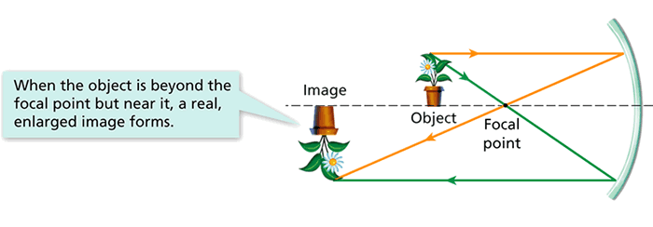
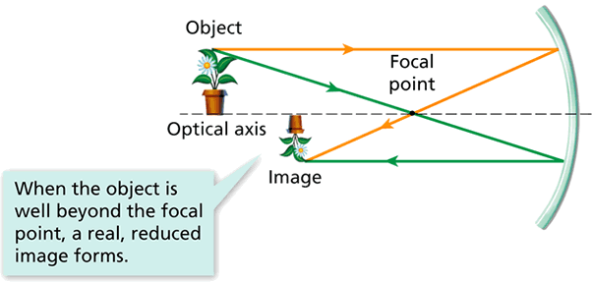
Concave Mirrors
Concave mirrors can form either virtual images or real images (when light rays actually meet).

Slide 8
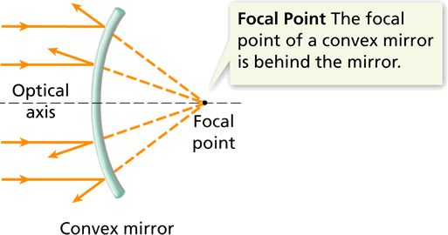
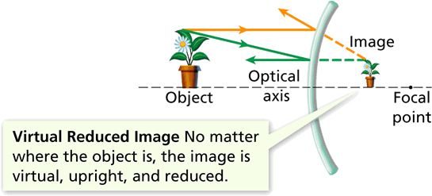
Convex Mirrors
A mirror with a surface that curves outward is called a convex mirror.
Used in passenger-side mirrors in cars. Have you ever noticed the warning “objects in mirror are closer than they appear”?

Slide 9
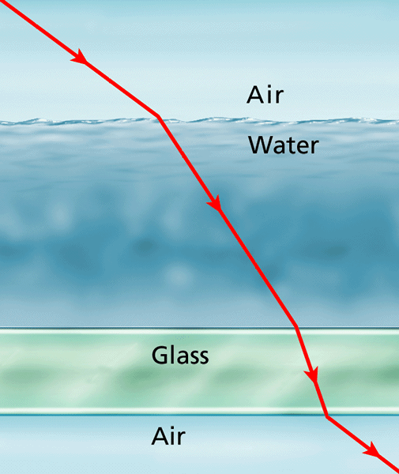
Refraction
Bending of light waves due to them changing speed when they hit a new medium.
Different mediums cause light to bend more than others. The more the light is bent (refracted) the more its speed slows down.
When the light rays enter the water, it bends and slows down. When it enters the glass, it bends more and slows down even more. When it enters the air again, it bends less and speeds up.

Slide 10
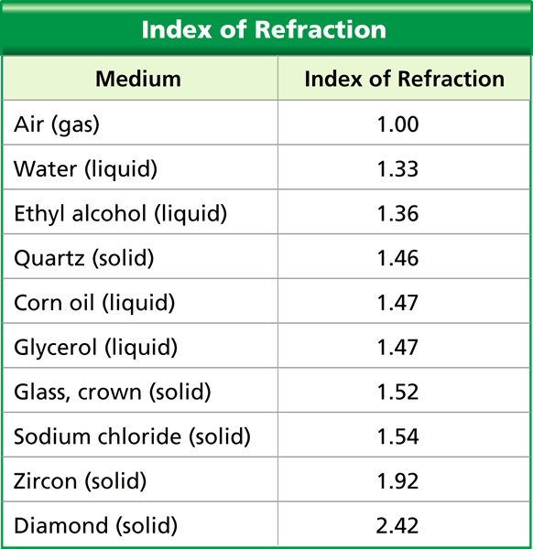
Bending Light
The “index of refraction” of a medium is a measure of how much light bends as it travels from air into the medium. The table shows the index of refraction of some common mediums.

Slide 11
Bending Light
Interpreting Data:
Which medium causes the greatest change in the direction of a light ray?
Diamond causes the greatest change in the direction of a light ray traveling from air.

Slide 12
Bending Light
Interpreting Data:
According to the table, which tends to bend light more: solids or liquids?
According to the graph, most solids bend light more than liquids do (quartz is an exception).

Slide 13
Bending Light
Predicting:
Would you expect light to bend if it entered corn oil at an angle after traveling through glycerol? Explain.
You would not expect light to bend if it entered corn oil at an angle after traveling through glycerol, because corn oil and glycerol have the same value for the index of refraction.

Slide 14
What causes a Rainbow?
Sunlight is reflected and refracted by tiny water droplets that act like prisms.
The angle of refraction is different for each color is different, so it allows you to see all the colors.

Slide 15
Lenses
Curved piece of glass or other transparent material that refracts light rays that pass through it
Cameras, telescopes, and microscopes use lenses
2 types:
1) convex lenses
2) concave lenses

Slide 16
Convex lens
Magnifying glass
Thicker in middle than at edges
The more curved the lens, the more it refracts (bends) the light

Slide 17
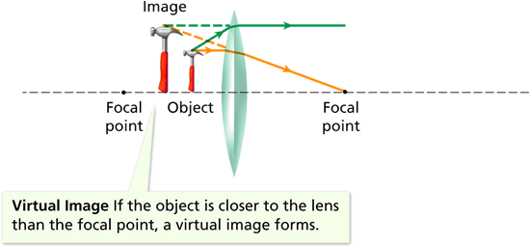
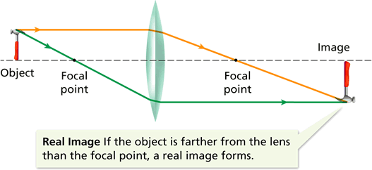
Convex Lens
An object’s position relative to the focal point determines whether a convex lens forms a real image or a virtual image.

Slide 18
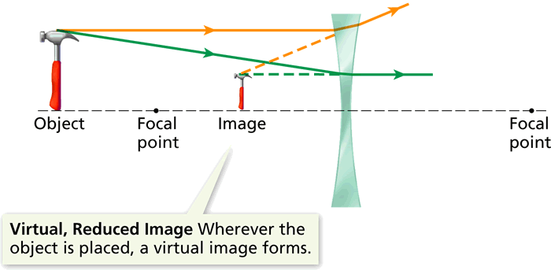
Concave Lens
Thinner in center than at edges
A concave lens can produce only virtual images because parallel light rays passing through the lens never meet.

