Slide 1
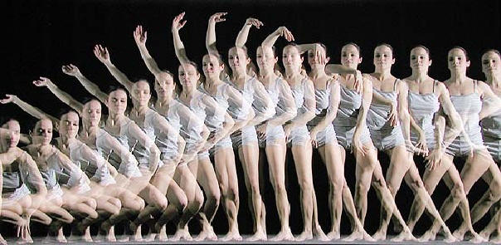
MOTION AND FORCES

Slide 2
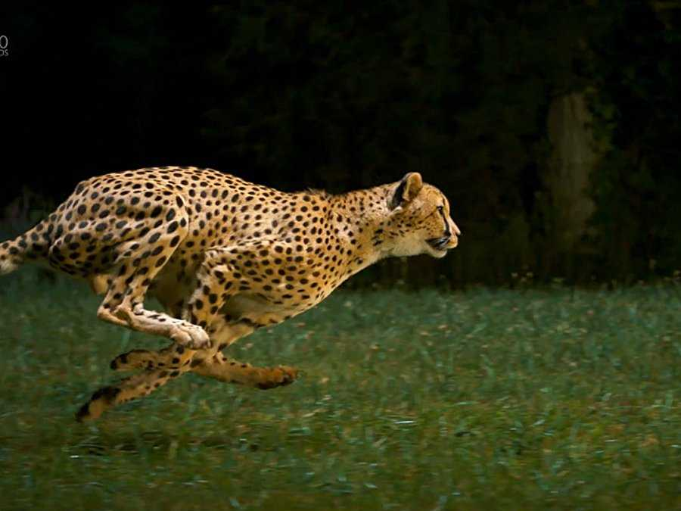
Motion: an object’s change in position.

Slide 3
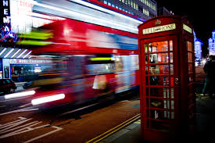
How do we know if something is in motion?
We use a reference point.
A reference point is an object that appears to stay in place…one that you can compare another object’s location to.
Examples of reference points are buildings, trees, and power poles.
How do we know that this bus is going fast?

Slide 4
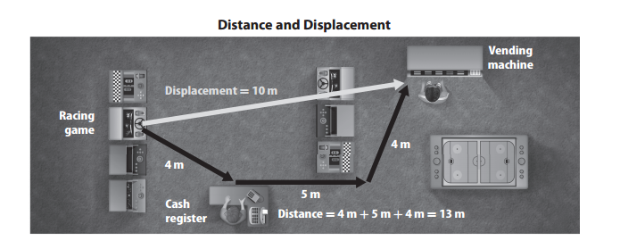
Distance: total length of the path traveled
Displacement: distance between the initial position and the final position

Slide 5
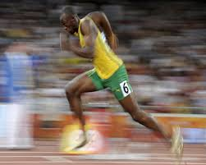
SPEED: rate of change in position
Speed = distance
time
Usain Bolt is considered the fastest man in the world. He can run 100 meters in 9.58 seconds. What is his speed?

Slide 6
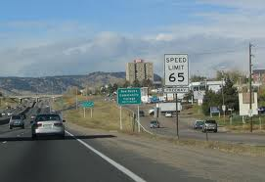
CONSTANT SPEED: speed which does not change

Slide 7
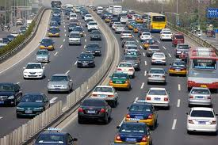
INSTANTANEOUS SPEED: Speed at any given instant
Cars, for example, can speed up or slow down depending on traffic.

Slide 8
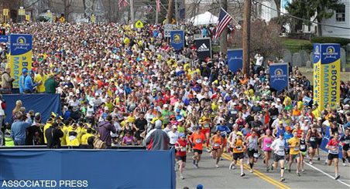
AVERAGE SPEED: total distance divided by total time
A runner in a marathon may not run the same speed for the entire race. They may start off fast, slow down as they get tired or go up hills and maybe speed up again as they get close to the finish line. Average speed figures out approximately how fast they ran the entire race.

Slide 9
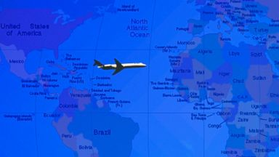
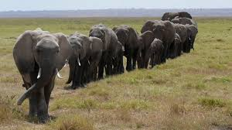
VELOCITY: speed in a specific direction
The plane travels 1120 miles east in 7 hours. Their velocity is:
160 miles/hr east.
Elephants can migrate large distances for food and water throughout the year. An example of their average velocity would be: 8 km/h southwest

Slide 10
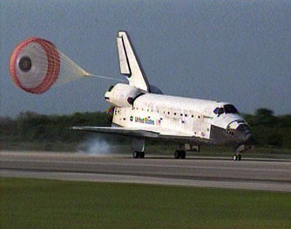
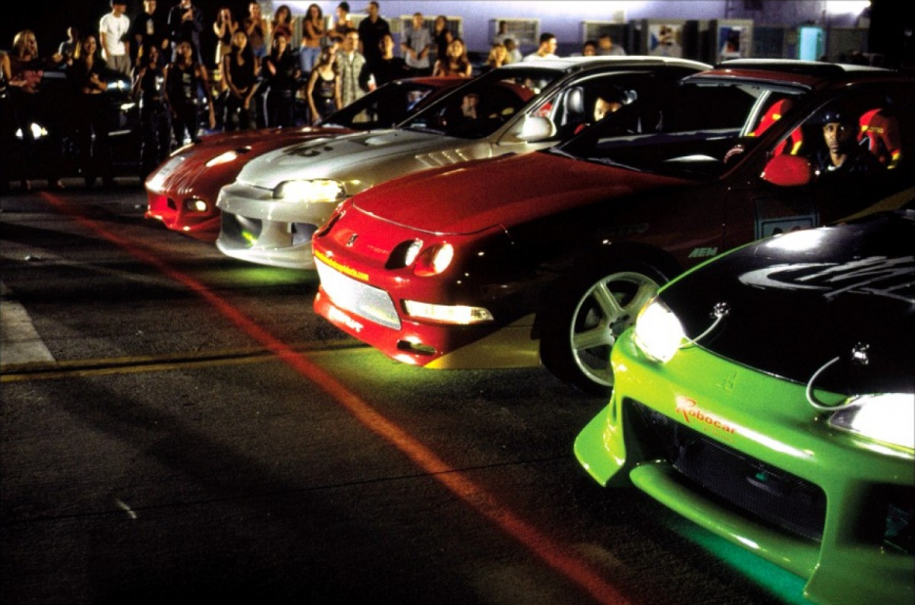
ACCELERATION: the rate of change in velocity
To find acceleration, divide the change in velocity by the time.
When you’re slowing down, it’s called deceleration or negative acceleration.
When you’re increasing speed, it’s called acceleration.

Slide 11
a = v_{f} - v_{i} or Δ v t t
In other words, figure out how fast the object was going FIRST and subtract that from how fast the object was going the last time you checked. Divide by how long it took to change velocity.

Slide 12
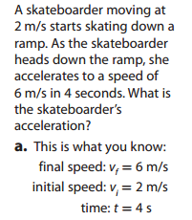
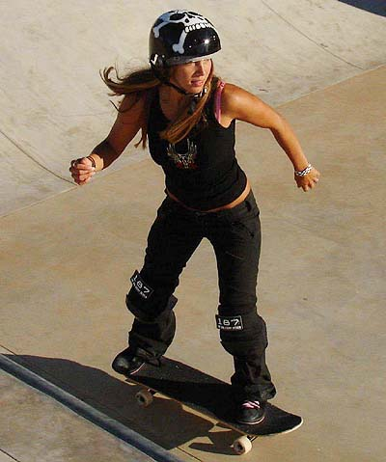
Write out the formula
Substitute in what you know, including units
Simplify.
Solve, include units in the answer
a = Vf – Vi
t
a = 6m/s – 2m/s
4s
a = 4m/s
4s
a = 1m/s²

Slide 13
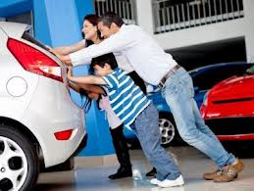
FORCE: a push or a pull that one body exerts on another

Slide 14
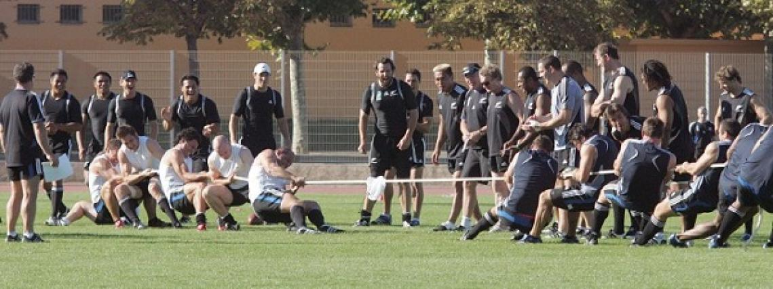
If forces are balanced, the object does not move.

Slide 15
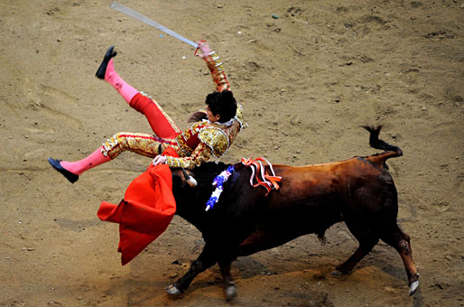
If one force is greater than another, there is a net force, and the object moves.

Slide 16
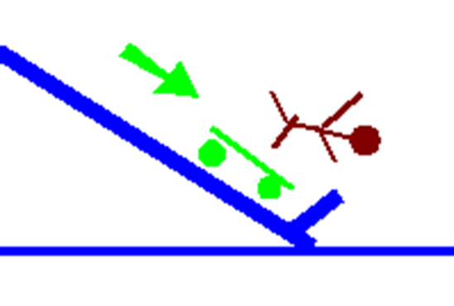
INERTIA: the tendency of a moving object to resist a change in motion.
For example, an object staying still wants to continue staying still. An object that is moving wants to keep moving.
If an object has more mass, it has more inertia than an object with less mass.
https://www.youtube.com/watch?v=y8mzDvpKzfY

Slide 17
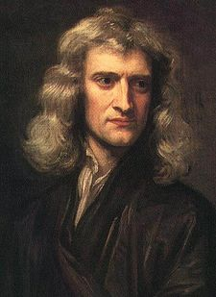
What are Newton’s 3 Laws of Motion?
Law #1: an object at rest will remain at rest and an object that is moving will continue to move unless another force acts on it.
Law #2: the amount of force applied to an object affects its acceleration and the direction of its motion.
Law #3: for every action, there’s an equal and opposite reaction.

Slide 18
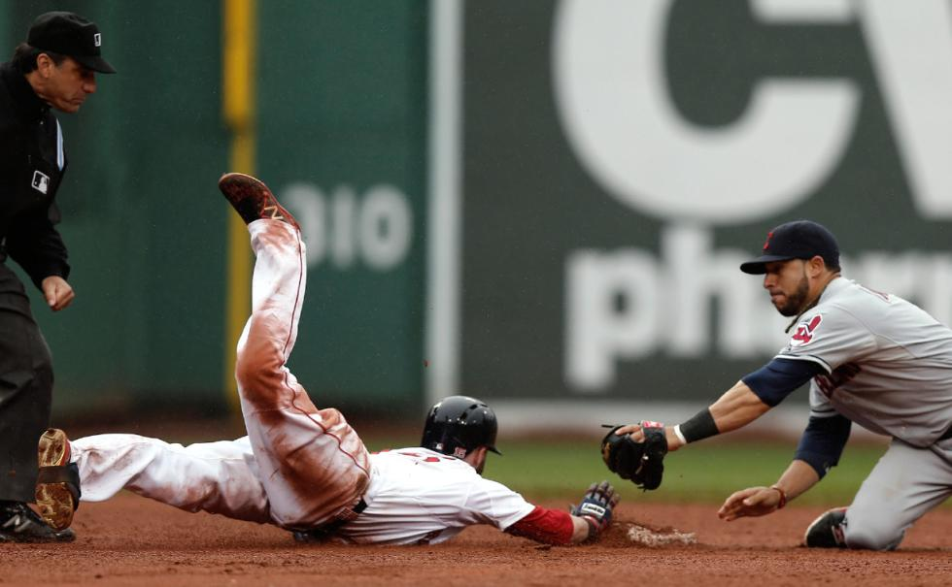
FRICTION: the force that opposes motion between surfaces that are touching each other

Slide 19
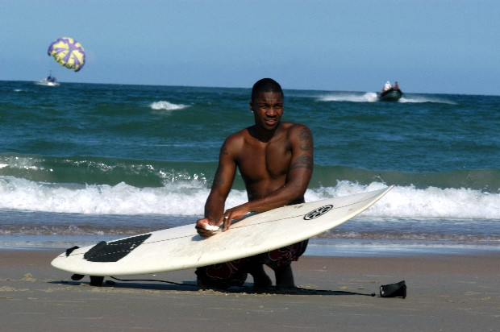
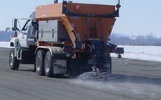
How could a person decrease friction on an object?
Waxing a surfboard
Spraying WD-40 on a squeaky door hinge
How could a person increase friction on an object?
Spreading sand on icy roads
Athletic cleats

Slide 20
FRICTION CAUSES:
Heat
Wearing away
Slowing down
Squeaking

Slide 21
GRAVITY: the force exerted by any object on any other object

Slide 22
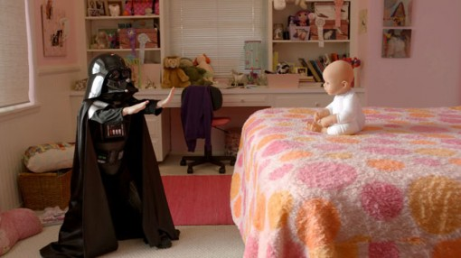
This force is usually too small to be felt.

Slide 23
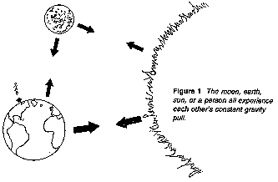
The gravity between the earth and other objects can be felt.

Slide 24
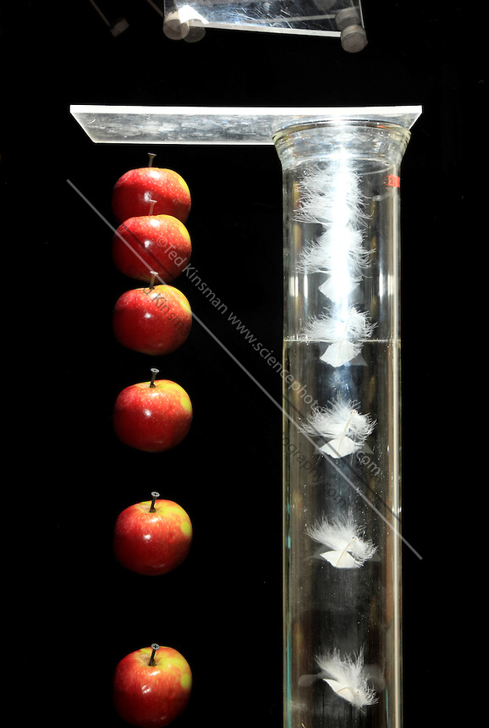
All objects falling in a vacuum (regardless of mass) accelerate at 9.8 m/s².

Slide 25
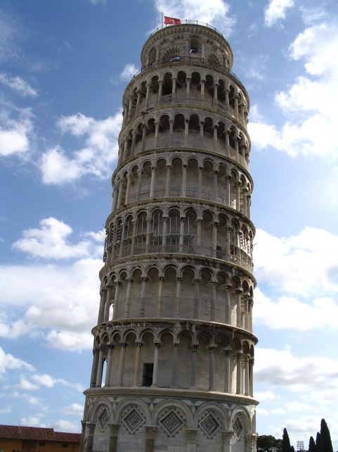
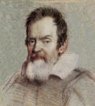
If objects of different sizes were dropped from a high place at the same time, would they all hit the ground at the same time?
Yes. Galileo experimented with falling objects.
Large objects have more gravity affecting them but take longer to accelerate. Small objects have less gravity affecting them but accelerate quickly.
It evens out in the end and they both hit the ground at the same time!

Slide 26
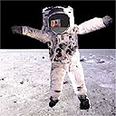
What is the difference between mass and weight?
Mass: a measure of how much matter makes up an object
Weight: a measure of gravitational pull on an object

Slide 28
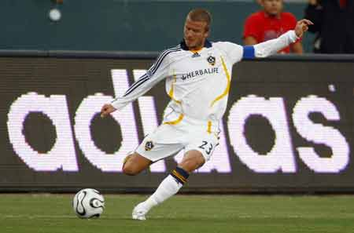
Force is measured in Newtons.
F = m x a

Slide 29
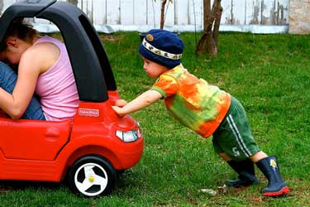
This means the harder you push it, the faster it speeds up.

Slide 30
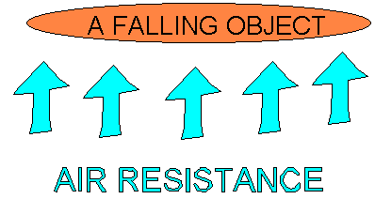
What causes items such as paper and feathers to fall more slowly in air than objects like rocks and books?
Air resistance slows down falling objects.

Slide 31
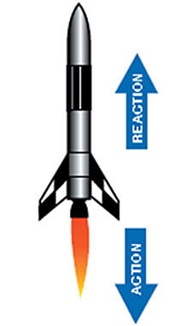
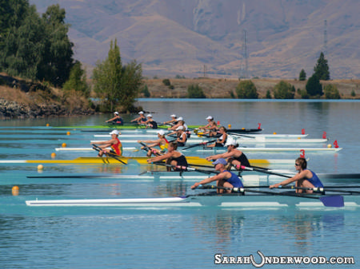
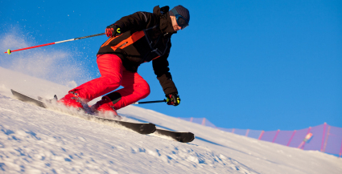
Newton’s Third Law of Motion: for every action, there is an equal and opposite reaction.

