Slide 1
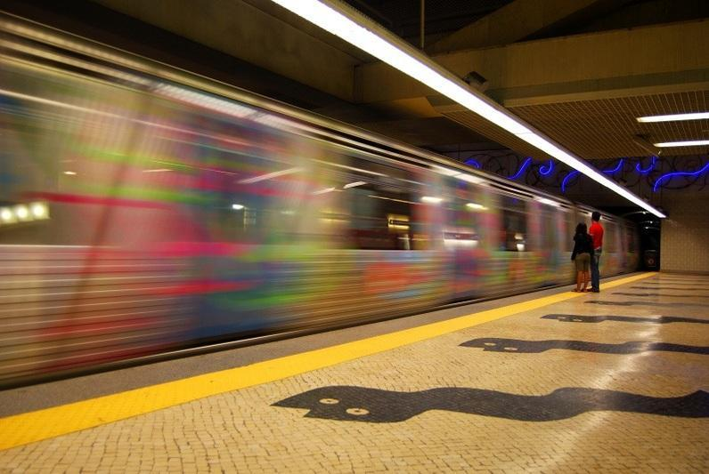
Motion, Force, and Speed!
Coach Dave Edinger
J. C. Booth Middle School
Physical Science (8A)

Slide 2
Motion
An object is in motion if its distance from another object is changing.
A reference point is a place or object used to determine if something is in motion.
An object is in motion if it changes position relative to a reference point.
Example: School bus moving past a tree or stop sign.

Slide 3
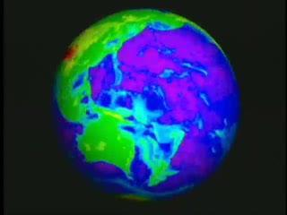
Motion
All matter in the universe is constantly in motion.
When an object is in motion it is changing position.
Examples: Earth spins on its axis (1600 km/hr), Earth revolves around the Sun (107,000 km/hr), electrons orbit around the nucleus of an atom

Slide 4
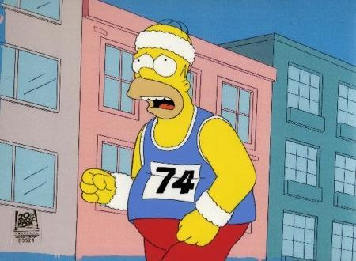
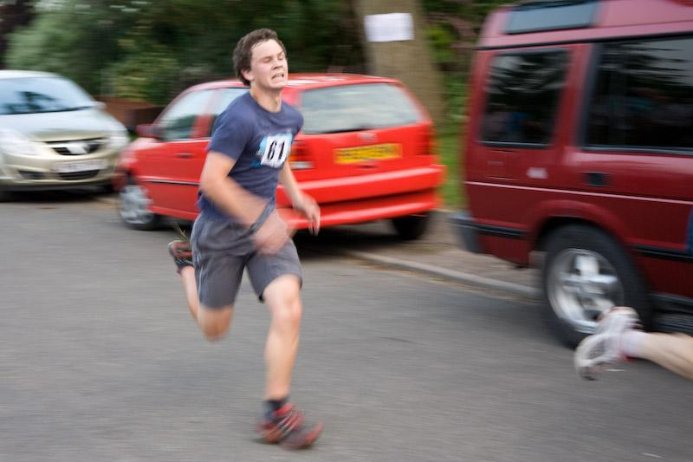
Motion
Motion occurs when something moves in relation to a reference point
How can you tell if the runner has moved?

Slide 5
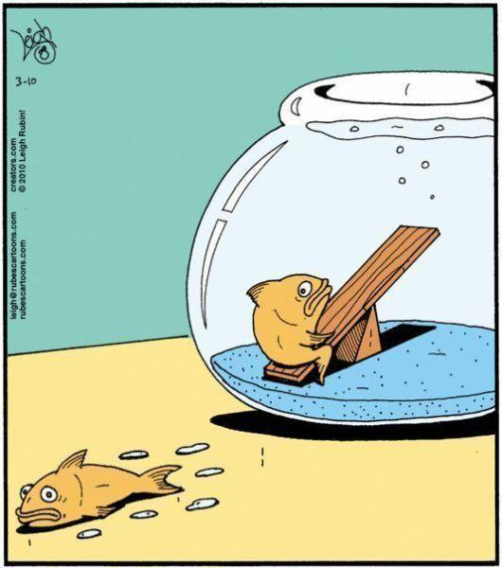

Slide 6
Use the force…
A force is a push or pull
Examples: opening a door, closing a locker, tackling a football player
Most objects have more than one force acting on them. Consider a snowboarder…
Lester Holt. "The Science of Snowboarding." © NBC Universal, Inc. 12/08/2009. Accessed Mon Jan 17 2011 from NBC Learn

Slide 7
Balanced and Unbalanced Forces
Forces are balanced if the effects on an object cancel each other and they do not cause a change in motion. The net force is zero.
Unbalanced forces cause an object’s motion to change. The net force is greater than zero.

Slide 8
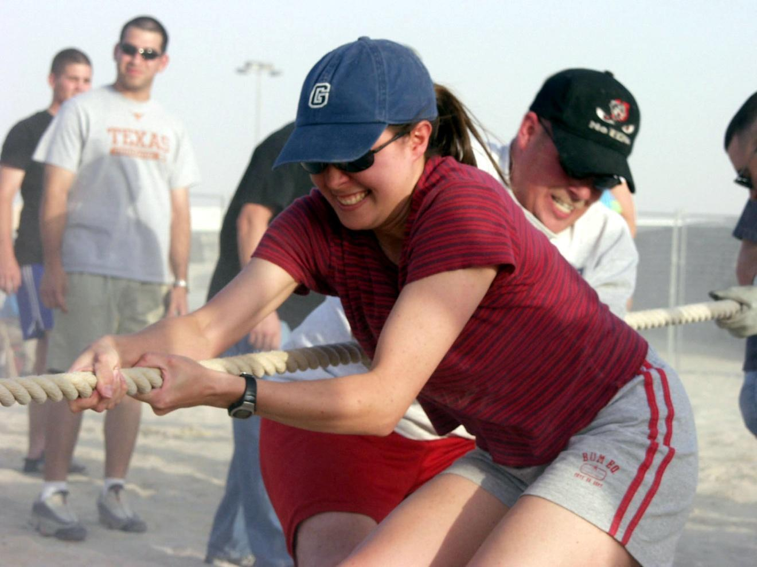
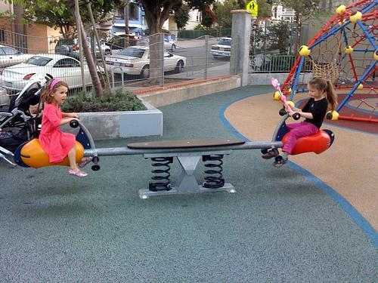

Slide 9
Speed
A measurement of distance can tell you how far an object has moved.
You can compare the distance an object has moved to the time it took to move that object. This comparison is used to calculate speed.

Slide 10
To Calculate Speed
Recall distance is measured in metric units. Which unit? Time?
To calculate the speed of an object, divide the distance the object travels by time.
Speed = Distance = m
Time s

Slide 11
Calculate Speed
Speed = Distance = m
Time s
Kobe the Yeti is climbing a hill. It is 525 meters to the top of the hill, and it takes Kobe 400 seconds to reach the top. What is Kobe’s speed in m/s?
1.) Ask yourself if it is necessary to convert any units of measurement? No.
2.) Divide distance by time.
525 meters = 1.3 m/s
400 sec

Slide 12
Calculate Speed
Speed = Distance = m
Time s
Connor Koscevic runs 3200 meters in 12 minutes. What is his speed in m/s?
1.) Ask yourself if it is necessary to convert any units of measurement? YES!
2.) Convert 12 minutes into seconds.
12 min x 60 seconds = 720 sec
1 min
3.) Divide distance in meters by time in seconds.
3200 meters = 4.4 m/s
720 sec

Slide 13
Calculate Speed
Speed = Distance = m
Time s
You and your family decided to take a cross country trip to the Grand Canyon. Your average speed was 55 mi/hr. What is this speed in m/s?
1.) Convert miles to meters. There are 1,600 meters in 1 mile.
55 miles x 1,600 meters = 88,000 m
1 mile
2.) Convert hours into seconds.
1 hour x 60 min x 60 sec = 3,600 sec
1 hour 1 min
3.) Divide meters by seconds.
88,000 m = 24.4 m/s
3,600 s

Slide 14
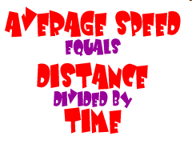
Average Speed
The speed of moving objects is not constant.
To calculate the average speed, divide the total distance traveled by the total time.
Example: Mrs. Mendenhall runs 7 miles during the first hour of her race. In the second hour, she runs only 5 ½ miles. What is her average speed?
Total distance = 7 miles + 5 ½ miles = 12 ½ miles
Total time = 1 hour + 1 hour
Average Speed = Distance = 12.5 mi = 6.25 mi/hr
Time 2 hr

Slide 15
Instantaneous Speed
The speed of moving objects is not constant.
Instantaneous speed is the speed at which an object is moving at any given instant.
Example: Kobe the Yeti runs for an hour and his average speed is 5 miles per hour. For the first ten minutes, Kobe runs faster at 7 miles per hour. What is Kobe’s instantaneous speed five minutes into his run?

Slide 16
Distance vs. time graph
You can illustrate the motion of an object using a line graph.
Plot distance (in meters or kilometers) on the y-axis. [Vertical Axis]
Plot time (in seconds or minutes) on the x-axis. [Horizontal Axis]
Slope = Rise = distance
Run time

Slide 17
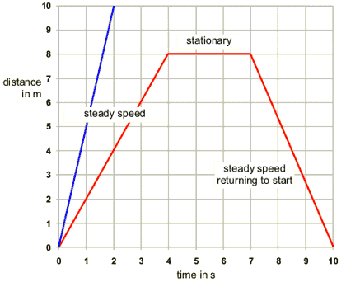
Distance vs. time graph

Slide 18
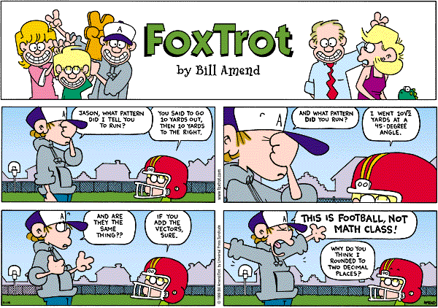

Slide 19
Velocity
The speed and direction of moving objects are not always constant.
Velocity is speed with direction!
When you know both the speed and direction of an object’s motion, you know the velocity of the object.
Example: The hot air balloon is traveling 15 miles/hour to the east.

Slide 20
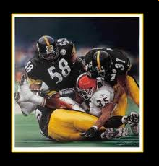
Speed, Velocity, and FOOTBALL!

Slide 21
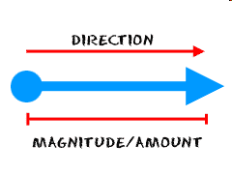
Velocity and vectors
Vectors are quantities that have both a size and a direction.
A quantity is something that you measure. (Examples: velocity and acceleration.)
Velocity vectors are used to illustrate the speed and direction that an object is traveling.
The direction and magnitude of the measurement are indicated by the direction that the arrow is drawn and its size.

Slide 22
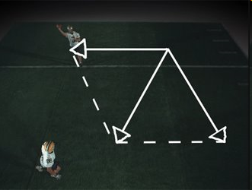
Velocity and vectors

Slide 23
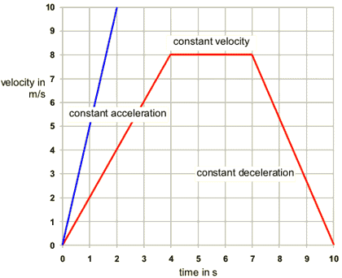
Graphing Velocity
This graph shows an initial increasing velocity with time. What is the slope when velocity is constant? What happens to the slope when velocity is decreasing?
The slope of the graph is equal to acceleration where:
a = Final velocity – initial velocity Final time – initial time
= v_{f} - v_{i} = slope t_{f} – t_{i}
acceleration ,
a = slope of a velocity-time graph
decceleration = - a = - slope

Slide 24
Acceleration
Think about when you have seen a rocket launch into the air. At first is seems to be moving slowly, and then it gains speed.
When an object changes motion, it is accelerating.
Acceleration = v_{f} – v_{i =} m/s/s = m/s²
time

Slide 25
Calculating Acceleration
As a roller coaster cart starts down a slope, its speed is 4 m/s. But 3 seconds later, its speed is 22 m/s. What is the average acceleration of the cart?
Initial speed = v_{i} = 4 m/s
Final speed = v_{f} = 22 m/s
Time = 3 seconds
1.) Divide change in velocity by time.
v_{f} - v_{i} = 22 m/s – 4 m/s = 6 m/s²
time 3 sec

Slide 26
Acceleration
Acceleration occurs when an object speeds up, slows down, or changes direction.
When the speed of an object is changing (either slowing down or speeding up) acceleration will occur. We often think of acceleration as just a speed thing, but it is not!
When an object’s speed slows down (deceleration) the acceleration is actually occurring in the opposite direction of the motion.

Slide 27
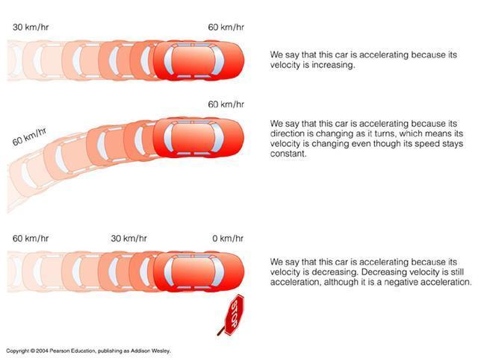
Acceleration

Slide 28
Acceleration
Acceleration does not always have to occur in a straight line; it can change direction.
When you ride a bike and want to turn, you lean to one side and turn the handlebars. Because the direction the bike’s motion has changed, the bike has accelerated. The acceleration occurs in the same direction that the bike turned.

Slide 29
Calculating Acceleration /speeding up
If an object is moving in a straight line:
Acceleration = Final speed – initial speed
Final time – Initial time
Example: Calculate the acceleration of a bus whose speed changes from 6 m/s to 12 m/s over a period of 3s.
12 m/s – 6 m/s
3 s
= 2 m/s²

Slide 30
Calculating Negative Acceleration/ Deceleration/slowing down
Remember acceleration also occurs when you slow down. When you calculate this it will come out to be negative!
Example: A bike slows down from a speed of 4 m/s to 2 m/s in 5 s.
2 m/s – 4 m/s
5s
= -0.4 m/s²

