Slide 1
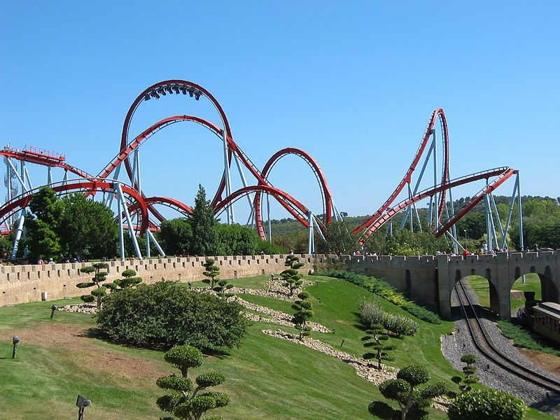
Chapter 6
Forces and Motion
Section 3
Momentum

Slide 2
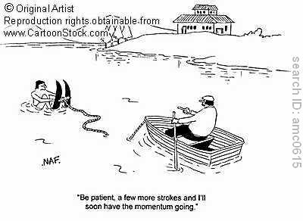
Essential Questions for 6-3
How is the momentum of a moving object calculated?
How would you explain the law of conservation of momentum?

Slide 3
Momentum
Dependent on the objects mass and velocity
More momentum = harder to stop or change direction of the object
Momentum (p) = mass in kilograms times velocity in m/s.
p = m x v
Momentum must have a direction, like velocity

Slide 4
Law of Conservation of Momentum
When objects collide, the total amount of momentum stays the same
Momentum before collision always = momentum after collision
This is called a transfer of momentum
Sometimes it is split between the objects
Sometimes one object stops and transfers all momentum to the object that was struck

Slide 5
Discussion
Use Newton’s third law to explain how a person hammering a nail into a block of wood is demonstrating conservation of momentum.

Slide 6
Problem
A 0.151 kg baseball is pitched with a velocity of 43.1 m/s. Ignoring air resistance, what is the baseball’s momentum after being pitched? Show your work.
END

Slide 7
Quiz 6-3: 2 Questions
1. When a train increases its velocity, its momentum
a. decreases.
b. remains unchanged.
c. increases.
d. is transferred to it surroundings.

Slide 8
2. The law of conservation of momentum states that when two objects collide, their combined momentum
a. increases after the collision.
b. remains the same after the collision.
c. decreases after the collision.
d. cannot be determined after the collision.

