Slide 1
FORCES
Coach Dave Edinger
J. C. Booth Middle School
Physical Science (8A)

Slide 2
What is a FORCE?
Force - a push or a pull exerted on an object in order to change the motion of the object; force has size and direction.
Force can change the acceleration of an object.
Force is expressed in a unit called NEWTON (N).

Slide 3
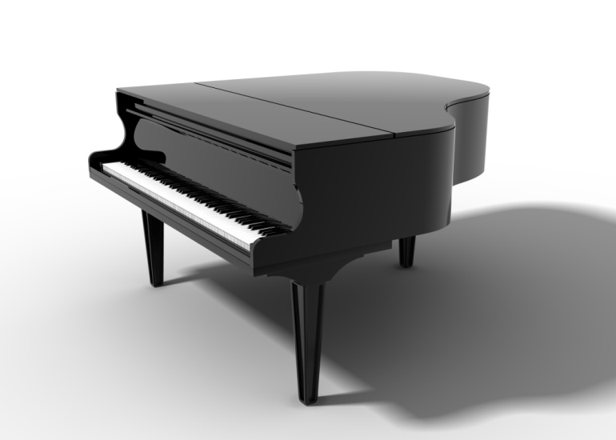
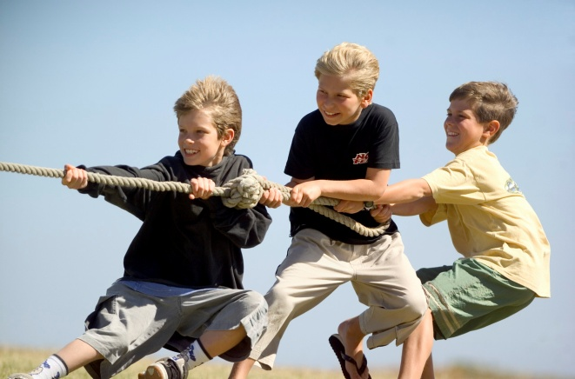
NET FORCE
Net force - the combination of all of the forces acting on an object.
Same direction - forces added
Different direction - forces subtracted

Slide 4
Practice with net force
A boy pulls a wagon with a force of 6N east as another boy pushes it with a force of 4N east.
What is the net force?
Same direction….so we ADD
6N + 4N = 10N

Slide 5
Practice with net force
A game of tug of war is occurring between Yuka and Tan. Yuka is pulling with a force of 10N while Tan is pulling opposite her with a force of 5N.
What is the net force?
10N – 5N = 5N

Slide 6
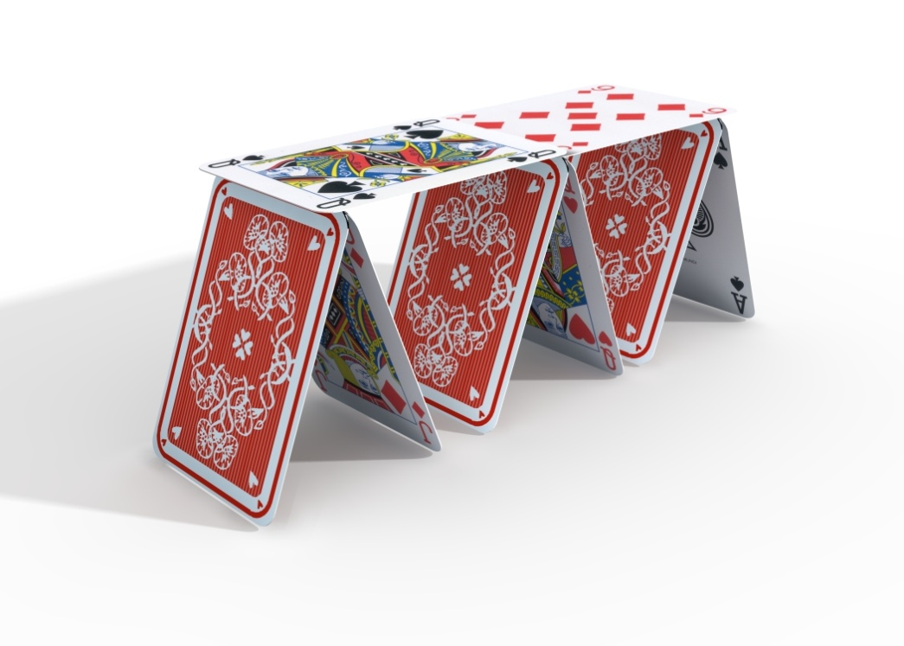
Balanced and unbalanced forces
When all the forces on an object produce a net force of 0N → the forces are balanced.
“Balanced forces” will not cause a change in motion.

Slide 7
Balanced and unbalanced forces
When the net force is NOT 0 N → the forces are UNBALANCED.
Unbalanced forces produce a change in motion.

Slide 8
CHALLENGE TIME!!!
Divide into small groups of 2-3 students.
Find a clear, flat area in which to work.
Get 26 playing cards from Coach Ed (do not fold, bend, or mutilate in any way).
Your task is to build the tallest tower you can using 26 playing cards and Balanced Forces.
You must use all of the cards…
and the force!

Slide 9
Use the Force

