Slide 1
Work and Machines
Types of Machines

Slide 2
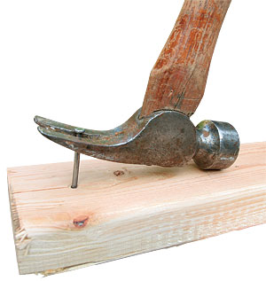
Levers
Have you ever used the “claw” of a hammer to remove a nail?
If so, you were using the hammer as a lever.
A lever is a simple machine that has a bar that pivots at a fixed point, called a fulcrum.
There are 3 different classes of levers

Slide 3
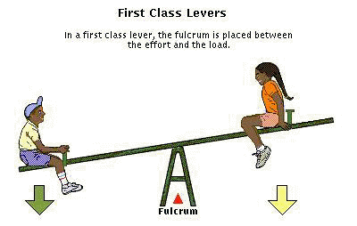
Levers
First-class levers
The fulcrum is between the input force and the load
They always change the direction of the input force
Can be used to increase force or to increase distance

Slide 4
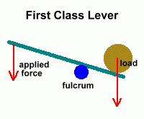

Slide 5
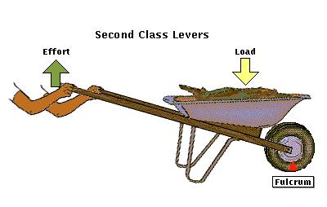
Levers
Second-class levers
The load is between the fulcrum and the input force
The output force is greater than the input force

Slide 6
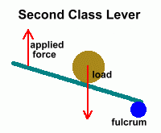

Slide 7
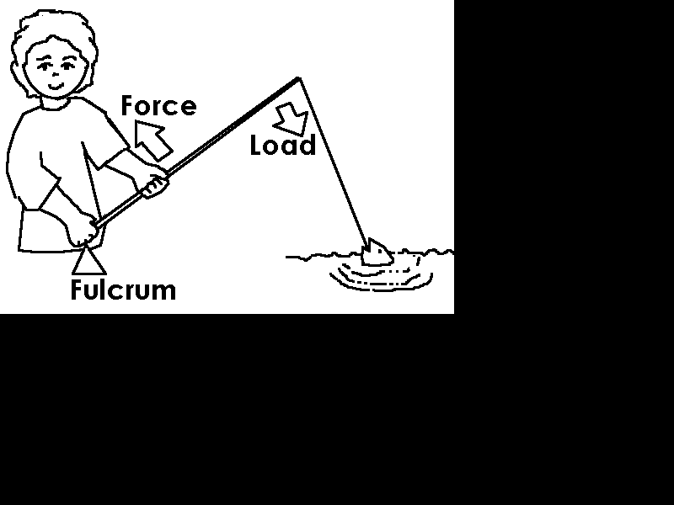
Levers
Third-class levers
The input force is between the fulcrum and the load
Do not change the direction of the input force
Do not increase the input force
The output force is less than the input force

Slide 8
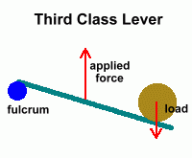

Slide 9
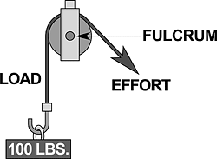
Pulleys
Pulley- a simple machine that has a grooved wheel and holds a rope or a cable
A load is attached to one end of the rope, and an input force is applied to the other end.
(input force)

Slide 10
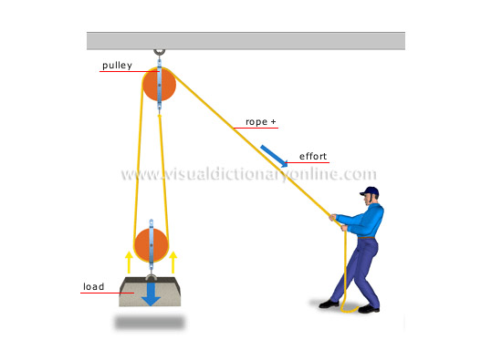

Slide 11
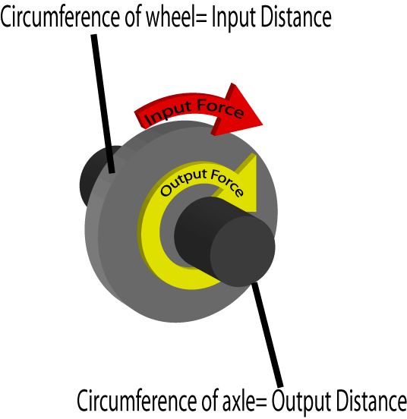
Wheel and axle
Wheel and axle- a simple machine consisting of two circular objects of different sizes
Ex: doorknobs, wrenches, steering wheels

Slide 12
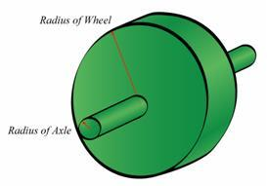
Wheel and axle
Mechanical advantage of a wheel and axle
Found by dividing the radius of the wheel by the radius of the axle
Example:
Radius of wheel is 15cm
Radius of axle is 3cm
MA= 15cm/3cm = 5
Since it’s greater than one, there is a mechanical advantage to this machine.

Slide 13
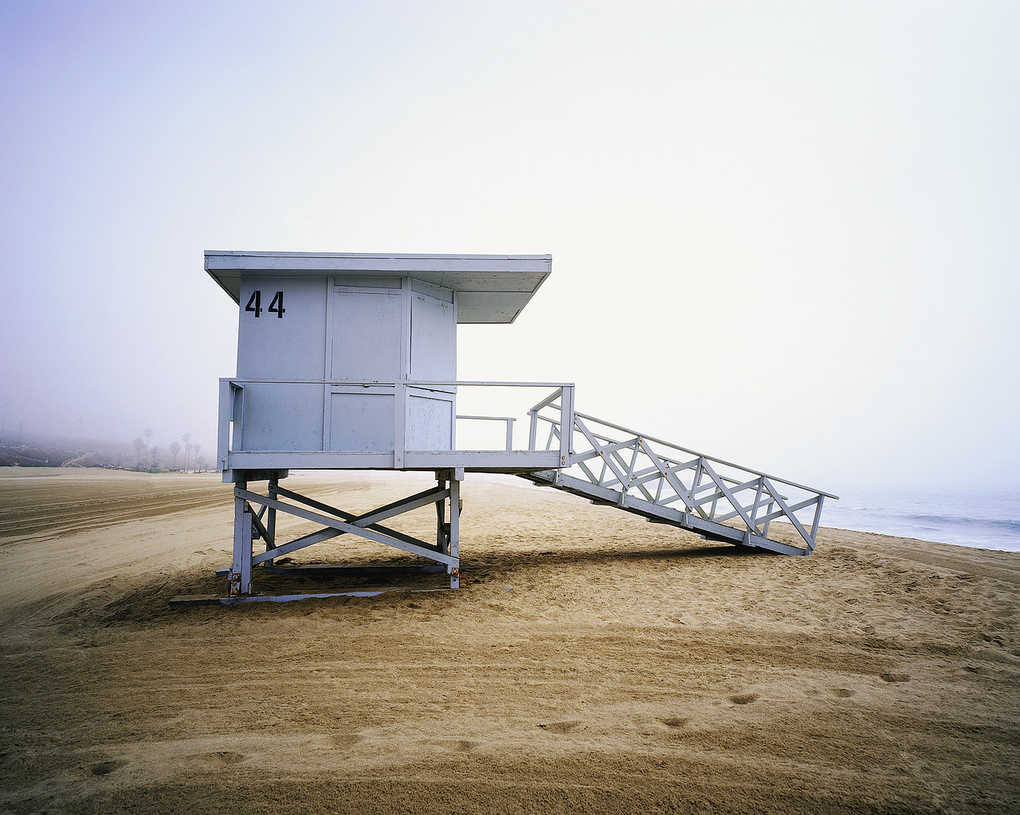
Inclined Planes
Inclined plane- a simple machine that is a straight, slanted surface such as a ramp

Slide 14
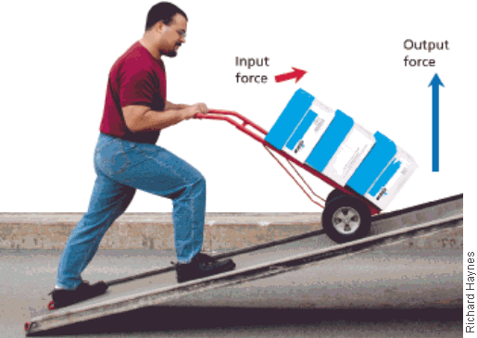
Inclined planes
Mechanical advantage
The mechanical advantage of an inclined plane is the length of the inclined plane divided by the height to which the load is lifted

Slide 15
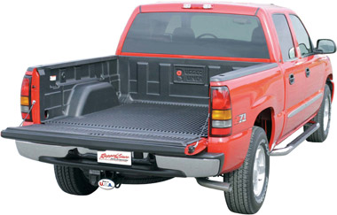
Inclined planes
Mechanical advantage example:
What is the mechanical advantage?
Length divided by height
6m / 3m
2
6m
3m

Slide 16
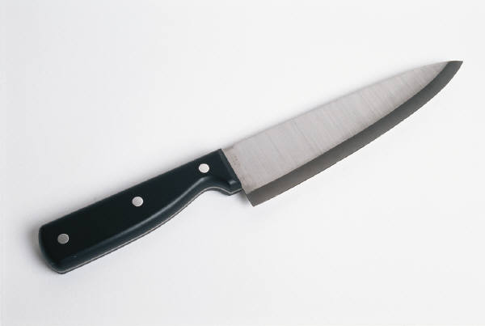
Wedges
wedge- a simple machine that is made up of two inclined planes and that moves; often for cutting
Example: KNIFE

Slide 17
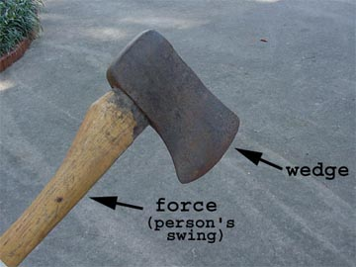
Wedges
Mechanical advantage
The longer and thinner the wedge is, the greater the mechanical advantage
That’s why sharp knifes work better
Mechanical advantage is length of wedge divided by the thickness

Slide 18
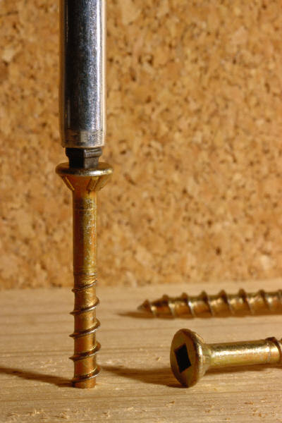
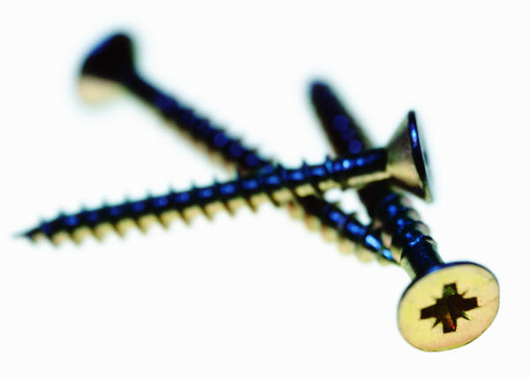
Screws
Screw- a simple machine that consists of an inclined plane wrapped around a cylinder
When a screw is turned, a small force is applied over the long distance along the inclined plane of the screw

Slide 19
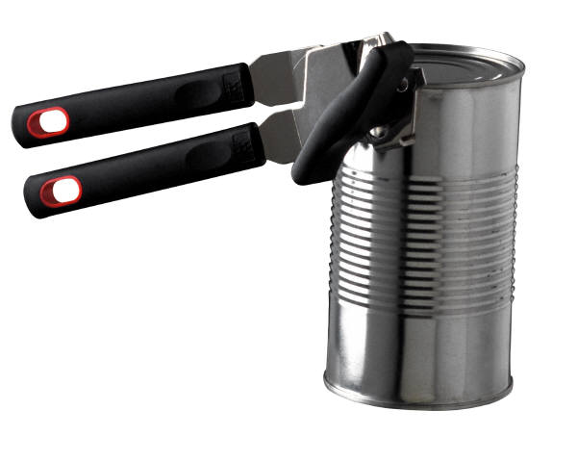
Compound machines
Compound machine- a machine made of more than one simple machines
Example: a can opener.
Second-class lever→ when you squeeze the handle
Wedge → blade of the can opener
Wheel and axle → knob you turn to open the can

Slide 20
Examples!
Levers
Pulleys
Wheel and axle
Inclined planes
Wedges
Compound machines
Notes:
If time, have class come up with examples

