Slide 1
What’s the deal with WAVE classification?
Coach Dave Edinger
Physical Science (8A)
J. C. Booth Middle School

Slide 2
How are WAVES classified?

Slide 3
What’s the deal with WAVE classification?
Waves can be classified by WHAT they move through or by HOW energy moves through them.
red words= vocabulary, blue words= connect words

Slide 4
Classification of WAVES by WHAT they move through

Slide 5
What’s the deal with WAVE classification?
There are two classifications for waves based on what they move through:
Mechanical Waves
Electromagnetic Waves
red words= vocabulary, blue words= connect words

Slide 6
What are mechanical WAVES?

Slide 7
What’s the deal with WAVE classification?
Mechanical waves are waves that can ONLY move through a medium (through matter).
red words= vocabulary, blue words= connect words

Slide 8
What’s the deal with WAVE classification?
Mechanical waves require the particles of the medium to vibrate in order for energy to be transferred.
red words= vocabulary, blue words= connect words

Slide 9
What are examples mechanical WAVES?

Slide 10
What’s the deal with WAVE classification?
water waves
earthquake/seismic waves
sound waves
waves that travel down a rope or spring
All of these examples CANNOT move through empty space.

Slide 11
What is EMPTY SPACE?

Slide 12
What’s the deal with WAVE classification?
Empty space is space in which NO MATTER is present. Another name for this is a vacuum.
red words= vocabulary, blue words= connect words

Slide 13
What are electromagnetic WAVES?

Slide 14
What’s the deal with WAVE classification?
Electromagnetic waves are waves that can travel through matter or empty space where matter is not present.
red words= vocabulary, blue words= connect words

Slide 15
What are examples of electromagnetic WAVES?

Slide 16
What’s the deal with WAVE classification?
radio waves
microwaves
infrared waves
visible light
ultraviolet rays
X-rays

Slide 17
Classification of WAVES by HOW energy moves through them

Slide 18
What’s the deal with WAVE classification?
There are two classifications for waves based on how energy moves through them:
Compressional/Longitudinal Waves
Transverse Waves
red words= vocabulary, blue words= connect words

Slide 19
What are compressional/ longitudinal WAVES?

Slide 20
What’s the deal with WAVE classification?
Mechanical waves in which the particles of matter in the medium vibrate by pushing together and moving apart parallel to the direction in which the wave travels are called compressional/longitudinal waves.
red words= vocabulary, blue words= connect words

Slide 21
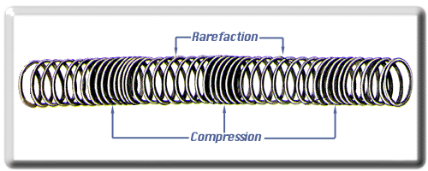
http://www.lcse.umn.edu/specs/labs/glossary_items/rarefaction_spring.html

Slide 22
What’s the deal with WAVE classification?
The place on the wave that is pushed together is called the compression and the place that is moving apart is the rarefaction.
red words= vocabulary, blue words= connect words

Slide 23
What are examples of compressional/ longitudinal waves?

Slide 24
What’s the deal with WAVE classification?
sound waves
some waves in a spring
some seismic waves (earthquake waves- primary waves, to be exact)

Slide 25
What are transverse WAVES?

Slide 26
What’s the deal with WAVE classification?
Mechanical waves in which the particles of matter in the medium vibrate by moving back and forth and perpendicular (at right angles) to the direction the wave travels are called transverse waves.
red words= vocabulary, blue words= connect words

Slide 27
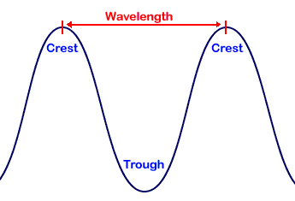
science.hq.nasa.gov/kids/imagers/ems/waves3.html

Slide 28
What’s the deal with WAVE classification?
The highest point of a transverse wave is the crest and the lowest point is called a trough.
red words= vocabulary, blue words= connect words

Slide 29
What are examples of transverse waves?

Slide 30
What’s the deal with WAVE classification?
strings on a musical instrument
waves on a rope
some waves in a spring
some seismic waves (earthquake waves- secondary waves, to be exact)

Slide 31
What’s the deal with WAVE classification?
Electromagnetic waves are transverse waves that can travel without a medium through empty space.
red words= vocabulary, blue words= connect words

Slide 32
Works Cited
Information from the South Carolina State Science Standards for 8th Grade
Microsoft Clipart (the background picture)
http://www.lcse.umn.edu/specs/labs/glossary_items/rarefaction_spring.html
science.hq.nasa.gov/kids/imagers/ems/waves3.html

