Slide 1
Simple Machines

Slide 2
What is a Simple Machine?
A simple machine has few or no moving parts.
Simple machines make work easier

Slide 3
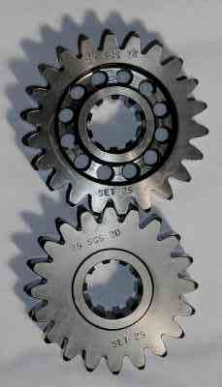
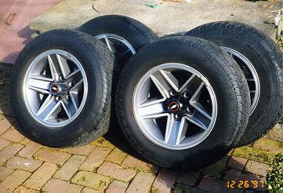
Wheels and Axles
The wheel and axle are a simple machine
The axle is a rod that goes through the wheel which allows the wheel to turn
Gears are a form of wheels and axles

Slide 4
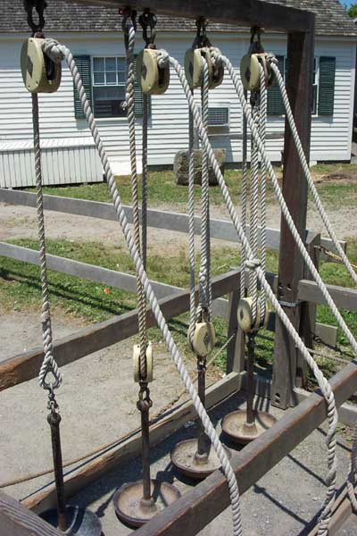
Pulleys
Pulley are wheels and axles with a groove around the outside
A pulley needs a rope, chain or belt around the groove to make it do work

Slide 5
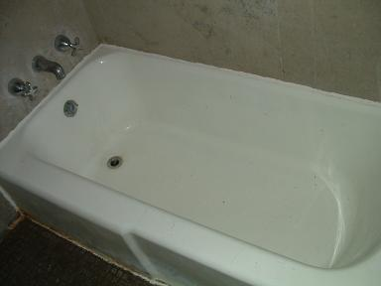
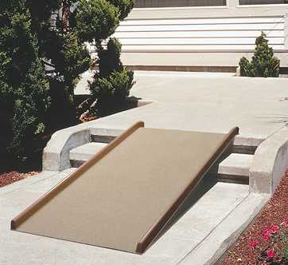
Inclined Planes
An inclined plane is a flat surface that is higher on one end
Inclined planes make the work of moving things easier
Notes:
A sloping surface, such as a ramp. An inclined plane can be used to alter the effort and distance involved in doing work, such as lifting loads. The trade-off is that an object must be moved a longer distance than if it was lifted straight up, but less force is needed. You can use this machine to move an object to a lower or higher place. Inclined planes make the work of moving things easier. You would need less energy and force to move objects with an inclined plane.

Slide 6
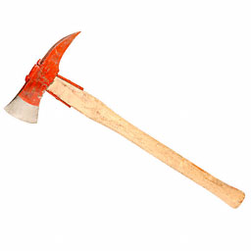
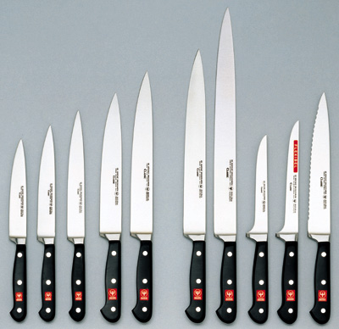
Wedges
Two inclined planes joined back to back.
Wedges are used to split things.

Slide 7
Screws
A screw is an inclined plane wrapped around a shaft or cylinder.
The inclined plane allows the screw to move itself when rotated.

Slide 8
Levers-First Class
In a first class lever the fulcrum is in the middle and the load and effort is on either side
Think of a see-saw

Slide 9
Levers-Second Class
In a second class lever the fulcrum is at the end, with the load in the middle
Think of a wheelbarrow

Slide 10
Levers-Third Class
In a third class lever the fulcrum is again at the end, but the effort is in the middle
Think of a pair of tweezers

Slide 11
Simple Machines
Simple Machines can be put together in different
ways to make complex machinery

Slide 12
Bob is helping his family move out of their old house. Help him decide which task would be easier, and then help him figure out what simple machine makes the job easier.

Slide 13
Bob has to move some heavy boxes into the moving truck.
A
B
B would be easier because a ramp is an inclined plane.

Slide 14
Bob has to move a heavy box a long distance.
A
B
A would be easier because the wagon has wheels and axles.

Slide 15
Bob needs to tear off a piece of packing tape.
A
B
B would be easier because the edges of the scissors are wedges.

Slide 16
Bob needs to move a heavy box to his room on the fourth floor.
A
B
B would be easier because Bob is using a pulley.

Slide 17
Bob needs to help his father move the refrigerator.
A
B
A would be easier because the dolly is a lever (with wheels and an axle).

Slide 18
Bob needs to help his father change a flat tire on the moving truck.
A
B
B would be easier because a jack uses a screw.

Slide 19
Now that Bob and his family have reached their new house, they need some help in unpacking their belongings. Help Bob decide on the best simple machine to use in each situation.

Slide 20
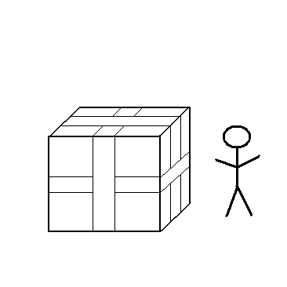
Bob needs to open the boxes his mom sealed with packing tape. What simple machine should he use?
Bob should use a wedge (probably a pair of scissors).

Slide 21
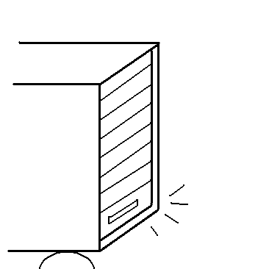
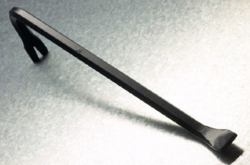
The door to the moving truck is jammed shut. What simple machine might Bob’s father use to open it?
Bob’s father should use a lever (most likely a crowbar).

Slide 22
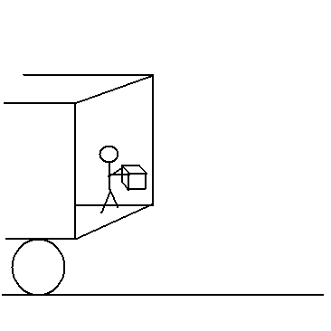
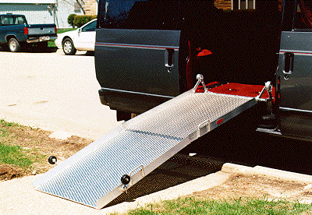
Bob needs to carry the boxes out of the moving truck. What simple machine will make this easier?
Bob needs an inclined plane (a ramp) to carry the boxes out of the truck.

Slide 23
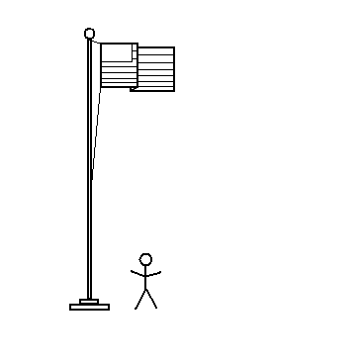
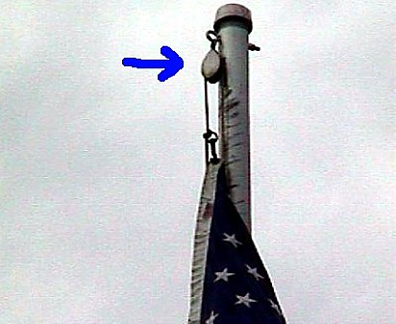
There is a flagpole outside Bob’s new school. What simple machine could be used to raise and lower the flag?
A pulley is used to raise and lower the flag.

Slide 24
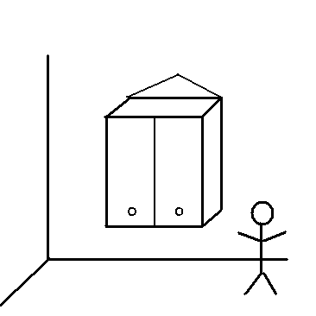
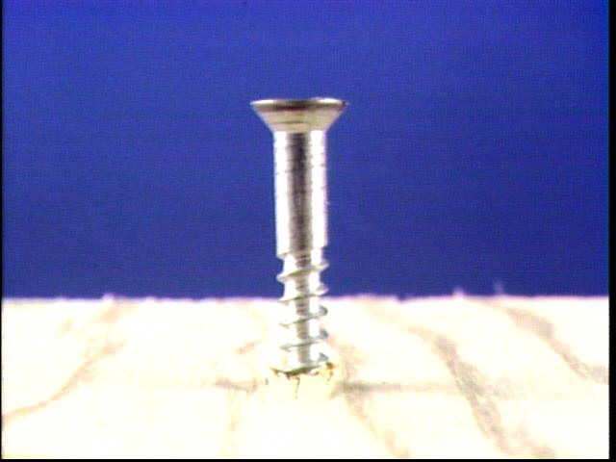
Bob’s mom wants to hang a cabinet in the new kitchen. What simple machine might she use to attach it to the wall?
Bob’s mom could use a screw to attach the cabinet to the wall and hold it in place.

Slide 25
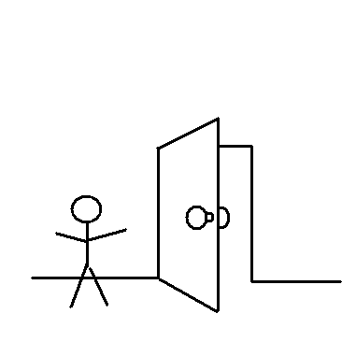
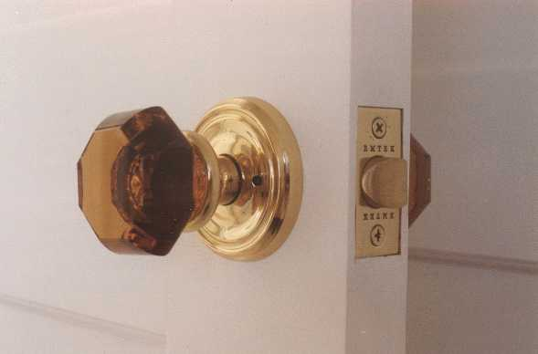
Bob helped his father install doorknobs in the new house. What kind of simple machine is a doorknob?
A doorknob is a wheel and axle.

Slide 26
Simple Machines

Slide 27
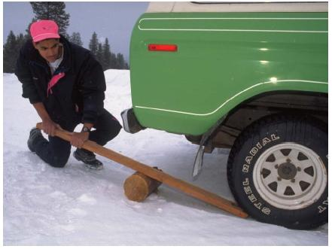
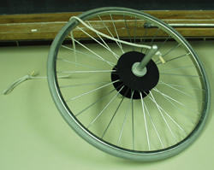
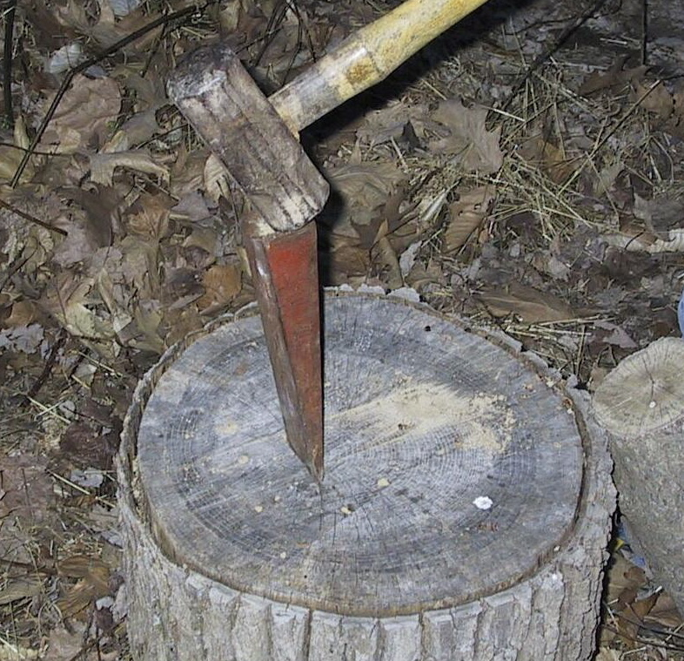
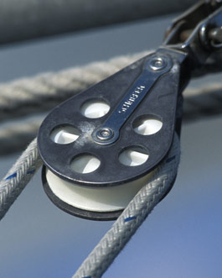
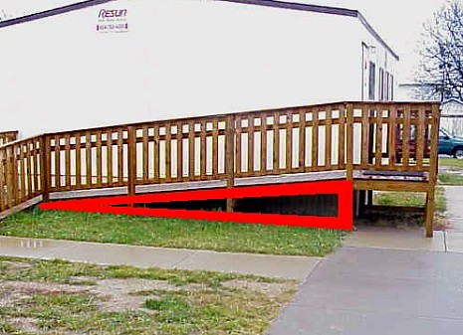
Identifying Simple Machines
1st Class Lever
Wheel and axle
Wedge
Screw
Pulley
Inclined plane

