Slide 1
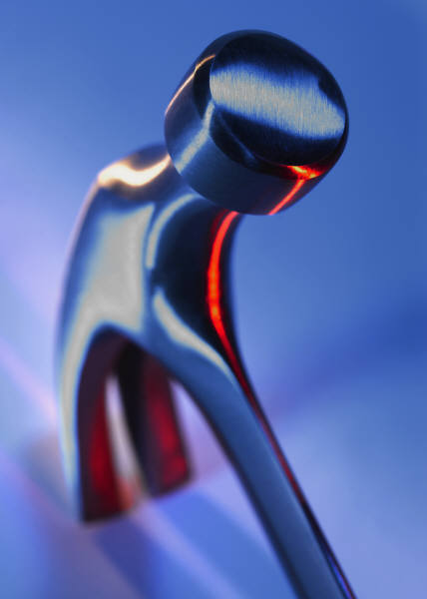
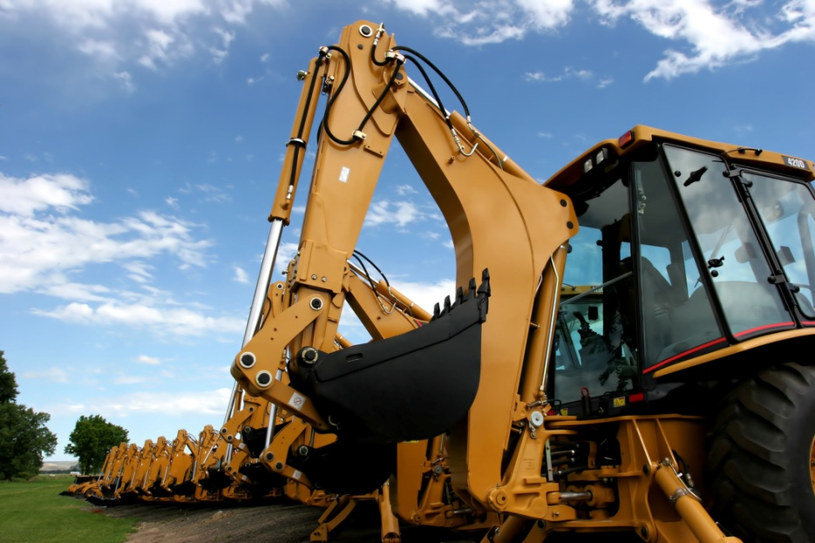
Simple Machines Notes, Part 2
Physical Science (8A)
Coach Dave Edinger

Slide 2
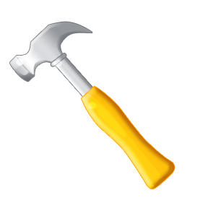
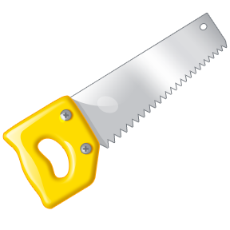
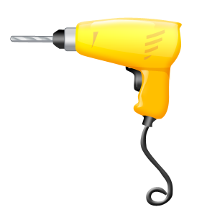
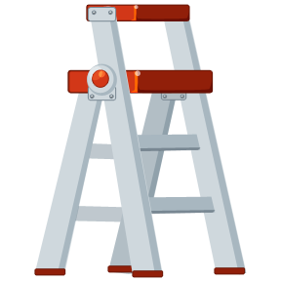

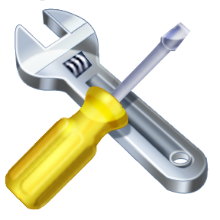
Simple Machines
A simple machine is a device that helps reduce the amount of force required to do work. Work is done when a force (effort force) is applied over a distance.

Slide 3
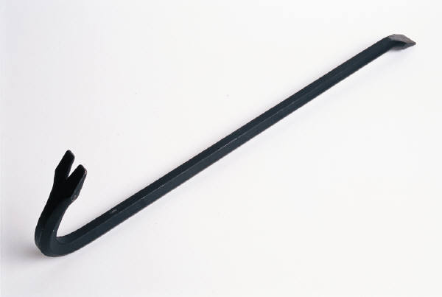
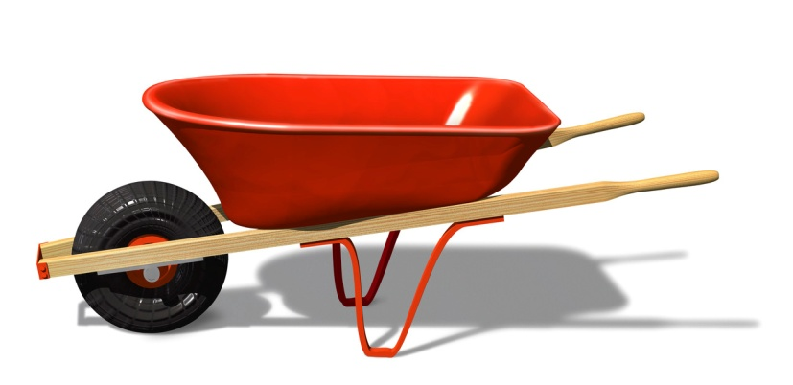
Simple Machines
Ways simple machines make work easier…
  A simple machine allows the user to apply a smaller force over a larger distance to move an object.

Slide 4
Simple Machines
Ways simple machines make work easier…
  Simple machines can change the direction of the force applied.

Slide 5

Simple Machines
Ways simple machines make work easier…
  If the distance over which the effort force is exerted is increased, the same amount of work can be done with a smaller effort.

Slide 6

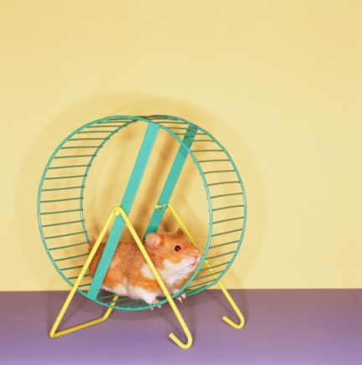
Simple Machines
  The design of the simple machines can reduce the amount of force required to do work.
  Simple machines are found in common tools, and complex (compound) machines.
6 Types of Simple Machines:
  Lever
  Pulley
  Inclined Plane
  Wheel & Axle
  Screw
  Wedge

Slide 7
Levers
A lever is a rigid bar or board that is free to move around a fixed point called a fulcrum.
By increasing the distance the effort force moves relative to the distance the weight moves, a lever can reduce the effort force needed.

Slide 8
Levers
A lever can be designed to reduce the amount of force required to lift a weight in two ways:
  By increasing the distance from the fulcrum to the point where the effort force is applied.
  By decreasing the distance the weight is from the fulcrum.

Slide 9

Levers
Levers that have the fulcrum between where the effort force is applied and where the weight is located can be found in the following tools:
  Scissors (2 levers working together)
  crowbar

Slide 10
Levers
Levers that have the fulcrum on the end and the effort force are applied on the other end to lift a weight in the middle can be found in the following tools:
  Wheelbarrow
  Bottle Opener

Slide 11
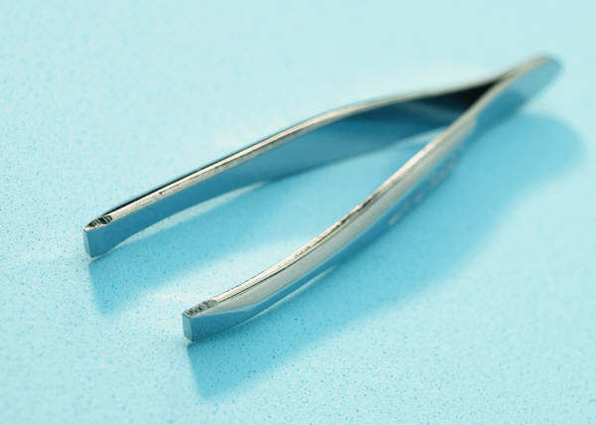

Levers
Levers that have the fulcrum on the end and the effort is applied in the middle to lift a weight on the other end can be found in the following tools:
  Tweezers (2 levers working together)
  Broom

Slide 12
Simple Machines Notes, Part 3
Physical Science (8A)
Coach Dave Edinger

Slide 13
Pulley
A pulley has a grooved wheel with a rope running along the groove.
  Pulley’s can change the amount and/or the direction of the force applied (effort force).
  By arranging the pulleys in such a way as to increase the distance that the effort force moves relative to the distance the weight moves, a pulley can reduce the effort force needed.

Slide 14
Pulley
Movable pulleys are used to reduce the effort force.
Pulleys that are moveable, meaning that they are not attached to a structure can be found on construction cranes and as part of a block and tackle system.

Slide 15

Pulleys
A single fixed pulley changes only the direction of the force (you pull down and the weight goes up).
Pulleys that are fixed , meaning that they are attached to a structure, can be found on the top of a flag pole and on window blinds.

Slide 16
Inclined Plane
An inclined plane is a sloping surface, like a ramp, that reduces the amount of force required to lift an object.
By increasing the distance the effort moves (length of the ramp) relative to the distance the weight is lifted (height of the ramp), an inclined plane can reduce the effort force needed.

Slide 17
Inclined Plane
An inclined plane can be designed to reduce the force needed to lift a weight in 2 ways:
  Increase the length of the ramp.
  Decrease the height of the ramp.

Slide 18
Inclined Planes
Inclined planes with a sloping surface can be found as ramps on a truck or wheelchair ramp and stairs.

Slide 19
Wedges
Inclined planes are used to make wedges. One inclined plane or 2 inclined planes back to back that can move are wedges.
Example:
  Knife Blades
  Nails

Slide 20

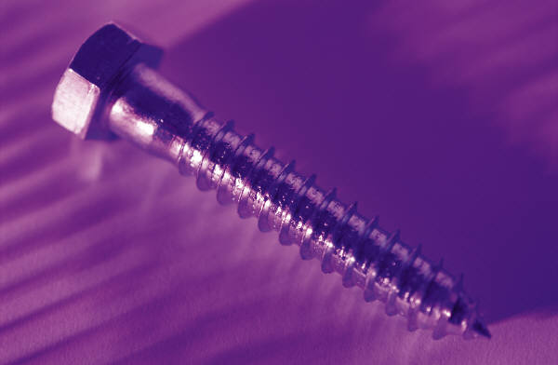
Screw
Inclined planes that are wound around a post or cylinder are called screws.
Example:
  Bolts
  Jar Lids

Slide 21
Wheel and Axle
Wheel and axles consist of two circular objects:
  A central shaft, called an axle
  The axle is inserted through the middle of a wheel

Slide 22
Wheel and Axle
Wheel and axles can be found as…
  Door Knobs
  Steering Wheels
  Gears
  Bicycle Wheels

Slide 23
Complex Machines
Complex machines, also known as compound machines, consist of two or more simple machines.
Examples:
  Scissors: two levers & 2 inclined planes (wedges)
  A fishing pole: lever, wheel and axle, and a pulley
  A bicycle: levers (handlebars & brakes), wheel and axles (gears, wheels, and pedals), and a number of screws.

