Slide 1
MECHANICAL WAVES
Physical Science
8th Grade

Slide 2

What types of waves do you see?

Slide 3
What is a wave?
A disturbance that transfers energy from place to place.
  Energy is the ability to do work
You are sitting on a raft in the middle of the ocean. A big boat goes by creating a wave in the water.
What work will that wave do to your raft?

Slide 4


What carries waves?
Most waves need something to travel through.
The material through which a wave travels is called a medium.
TRY THIS!
The next time you take a bath or go swimming, pop your knuckles underwater.
What is an ocean wave’s medium?
What is the medium for the sound waves that come from a musical instrument?

Slide 5
So waves can travel through liquids and gases…
What about solids?
Can you think of any examples?

Slide 6
Mechanical Waves
Mechanical waves are waves that need a medium to travel through.
  Mediums can be solid, liquid, or gas.
Can you remember what kind of wave carries energy through empty space?
HINT: Radiation
We’ll get to these when we talk about light
ELECTROMAGNETIC

Slide 7
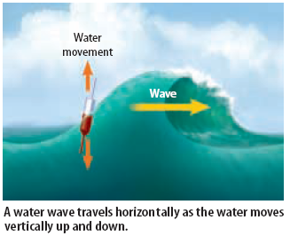
How do waves transfer energy?
Although mechanical waves travel through a medium, they do not carry the medium with them.

Slide 8
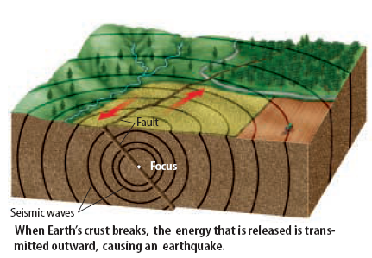
How do we know waves carry energy and not matter?
Think about an earthquake.
When seismic waves travel through an area, the ground shakes from side to side and up and down, but the ground itself does not travel over a distance.
Only the ENERGY moves!

Slide 9

Another Example…
Waves travel through the water but they do not carry the water or the bottle with them.

Slide 10

Why doesn’t the medium travel along with the wave?
All mediums are made up of tiny particles.
When a wave enters a medium, it transfers energy to the medium’s particles.
Then the particles bump into each other, passing the wave’s energy along.

Slide 11
It’s like passing food at the dinner table!

Slide 12
What causes waves?
You MUST have energy.
Mechanical waves are produced when a source of energy causes a medium to vibrate.
  A vibration is a repeated back-and-forth or up-and-down motion.
When a vibration moves through a medium, a wave results.

Slide 13

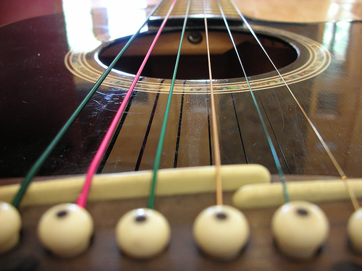

Examples

Slide 14
TYPES OF WAVES
Mechanical waves are classified by two things
  The way they move
  The medium through which they travel
There are two types of waves
  Transverse waves
  Longitudinal waves

Slide 15
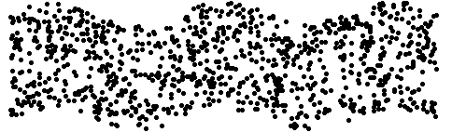
Transverse Waves
Transverse means “across”
In a transverse wave the matter in the wave moves up and down (across) at a right angle to the direction of the wave
Direction of Wave
Direction of Medium

Slide 16
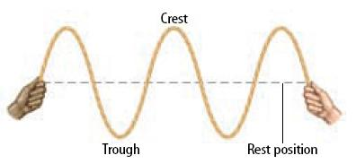
Transverse waves create points called “crests” and “troughs”, or high and low points in the waves movement.

Slide 17

Longitudinal Waves
Longitudinal waves move the medium parallel to the direction in which the wave travels.
Direction of Wave
Direction of Medium

Slide 18
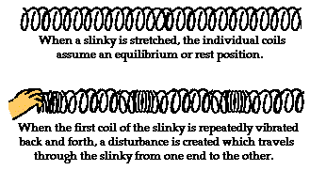
Example: A SLINKY!

Slide 19
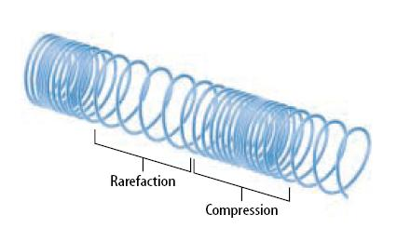
Longitudinal waves create points called compressions and rarefactions.
Compressions: parts where the coils are close together
Rarefactions: parts where the coils are spread out

Slide 20
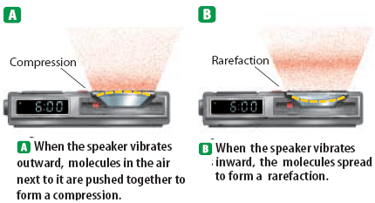
Sound waves are Longitudinal

Slide 21
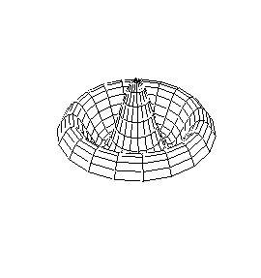

Guitar String
A drum head
after being hit

