Slide 1
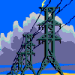
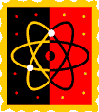
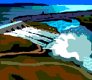
Forms of Energy
J. C. Booth Middle School
Physical Science 8A
Coach Dave Edinger

Slide 2
Energy is all around you!
Light given off by a lamp
Light from the sun
Energy from the food you have eaten
Your body uses energy to carry out all the functions needed to survive

Slide 3
What is Energy?
Energy is the ability to do
work or cause change
Work is the movement of an
object that travels a distance
Work is done when you transfer energy
to an object and the object
moves

Slide 4
Forms of Energy
Energy exists in several
different forms.
Each form of energy has its
own characteristics

Slide 5
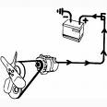
Mechanical Energy
Mechanical energy is the energy associated with the motion of an object

Slide 6
Mechanical Energy
When you toss a basketball
through the air, the moving
basketball has mechanical
energy
Wind has mechanical energy
because it involves the
movement of air.

Slide 7
Mechanical Energy
You have mechanical energy when you walk or run

Slide 8
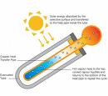
Thermal Energy
The total amount of energy in all
of the particles contained in a
sample of matter is called
thermal energy
Heat is often associated with
thermal energy

Slide 9
Thermal Energy
Heat itself is not a form of energy
Heat is thermal energy that is transferred between two objects of different temperatures

Slide 10
Chemical Energy
Most of the matter you
encounter each day exists
as compounds
A compound forms when
two or more elements join
chemically

Slide 11
Chemical Energy
The atoms of the elements
that make up a compound
are held together by
chemical bonds.
Chemical energy is the
energy that is stored in chemical bonds.

Slide 12
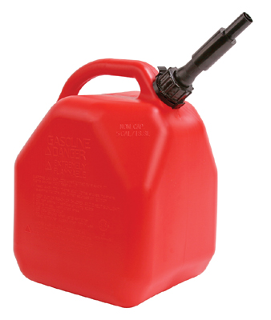
Chemical Energy
Chemical bonds form when atoms
come together to form a
compound
Chemical bonds break when a
compound is broken apart to
form elements of smaller compounds.

Slide 13
Chemical Energy
Energy is always involved in
breaking or forming chemical
bonds

Slide 14
Electrical Energy
Computers, radios,
televisions, and lamps
are all examples of
electrical devices that
operate using electrical
energy

Slide 15
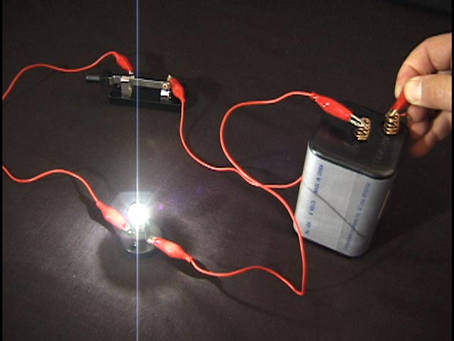
Electrical Energy
Electrical energy is
energy that results from
the flow of moving
charges

Slide 16
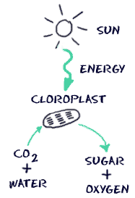
Electromagnetic Energy
The particles that make up an
atom are also in constant
motion
Electromagnetic energy is the
energy resulting from the motion of the
particles within atoms.

Slide 17
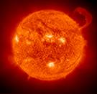
Electromagnetic Energy
Light is one form of
electromagnetic energy
Other forms of electromagnetic
energy include x-rays, microwaves,
and ultraviolet (UV) radiation

Slide 18
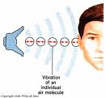
Sound Energy
Sound energy: a vibration is a
rapid, back and forth motion
Sound energy is the energy given
off by a vibrating object
This energy travels through matter in the form of waves.

Slide 19
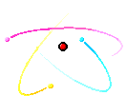
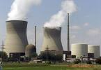
Nuclear Energy
The center of an atom is
the nucleus
The protons and neutrons
of the nucleus are held in
place by nuclear forces
Nuclear energy is the energy stored in the nucleus of an atom as a result of the nuclear forces.

Slide 20
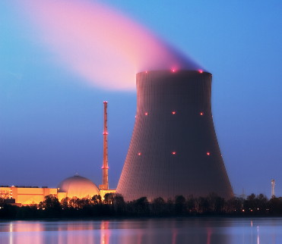
Nuclear Energy
This energy can be
released from the atom
in two ways:
Nuclear fission
Nuclear fusion

Slide 21
Nuclear Energy
Nuclear fission is a process in
which the nucleus of an atom is
split apart to form two smaller
nuclei
Each smaller nucleus formed by nuclear fission has a different number of protons (atomic number) and neutrons than the original nucleus

Slide 22
Nuclear Energy
In addition to releasing
large amounts of energy,
nuclear fission produces
new elements that continue to release energy.
The process of nuclear
fusion is opposite of nuclear fission.

Slide 23
Nuclear Energy
Nuclear fusion is a process in which two small nuclei are joined together to form a larger nucleus.
This is the process that takes place inside the sun.

Slide 24
Review- Forms of Energy
Energy takes many different forms. We can find energy all around us!
Some of the different kinds of energy are:
Mechanical energy
Thermal energy
Chemical Energy
Electrical Energy
Electromagnetic Energy
Sound Energy
Nuclear Energy
Can you give an example of each one?

