Slide 1
Work and Machines
Section 1 work and power

Slide 2
What is work?
I give you 50 pages of textbook to read by tomorrow
Is that “a lot” of work?
NO…it is not.
According to science….
WORK – the transfer of energy to an object by using a force that causes the object to move in the direction of the force.
So, the only work you will be doing with reading is flipping the pages
Sydney
Notes:
Using a student’s name from the class gets a laugh.

Slide 3
Can you identify work?
Name some things that are fun, but according to science would be considered, “work”…….
Bowling
Baseball
Football
Mini golf
Tug-o-war
Writing a love letter
Water balloon fight
Etc…..
Anything where a force is being applied to an object, causing it to move

Slide 4
Transfer of energy
One way you can tell the bowler has done work on the ball is because the ball now has kinetic energy
Kinetic energy- energy in motion
Examples of kinetic energy
A rock falling off of a cliff
a football flying in the air
A pencil dropping to the ground
A bat swinging
Can you think of more???

Slide 5
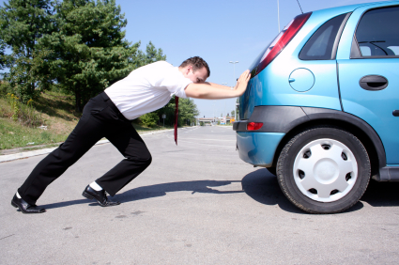
Differences between force and work
This dude is applying a lot force to the car
But the car isn’t moving….
Would this be considered work?
Applying a force doesn’t always result in work being done..
Work would begin when the car begins to move

Slide 6
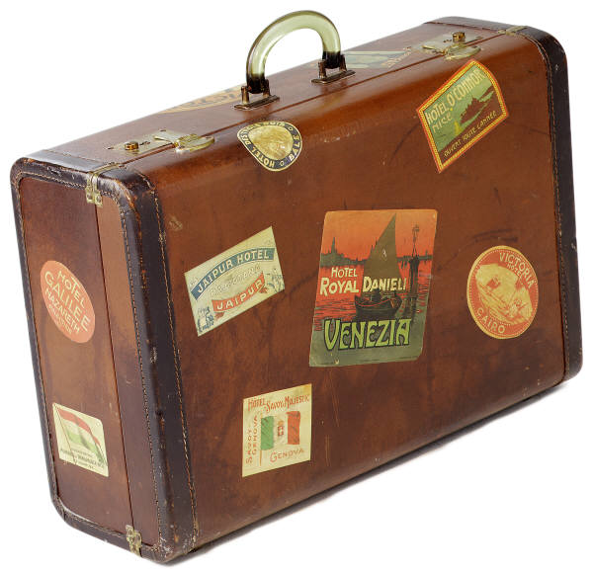
Force and motion in the same direction
Imagine this….
You are late for your flight to Florida!
You are in the airport with your suitcase
in your hand running to get on your plane.
Because you are making the suitcase move,
you are doing work on it, right?
NO, wrong! For work to be done on an object, the object must move in the same direction as the force.
YOU are applying force to hold the suitcase up, but the suitcase is moving forward. So, no work is being done on the suitcase
Work was only done when you lifted it off of the ground.

Slide 7
When is work done???
Work is done on an object if two things happen…
The object moves as a force is applied
The direction of the object’s motion is the same as the direction of the force

Slide 8
Practice
Direction of Direction of doing
Force motion work?
YES
YES
NO

Slide 9
Calculating work
The amount of work (W) done in moving an object can be calculated by multiplying the force (F) applied to the object by the distance (d) through which the force is applied
W = F x d
Work’s unit is joules (J)
Forces unit is newtons (N)
Distance’s unit is meters (m)

Slide 10
Practice
How much work is done when a 100N force moves a block 59m?
W = F x d
W = 100N x 59m
W = 5900 N x m
W = 5900J
**remember, the unit for work is in joules

Slide 11
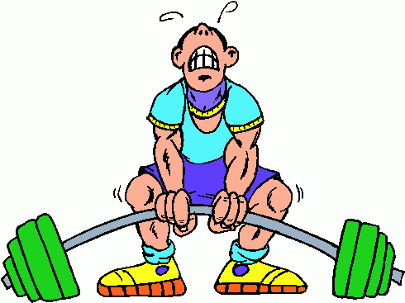
Volunteer please!!!
Let’s determine how much WORK you do lifting some weights…..
Notes:
Get a couple dumbbells and determine their weight in newtons. Use a ruler to determine distances for the students to lift the dumbbells. Have the students determine how much work was done. Ask if it would be any different if someone else lifted the same weights.

Slide 12
POWER: How fast work is done
Power- the rate at which energy is transferred
Remember: work is a transfer of energy onto an object
Calculating power (P): divide the amount of work (W) done by the time (t) it take to do the work.
P= W/t
Power’s unit is watt (W)
Work’s unit is joules (J)
Time’s unit is seconds (s)

Slide 13
Practice
A stage manager at a play raises the curtain by doing 5,976 J of work on the curtain in 12s. What is the power output of the stage manager?
P = W/t
P = 5,976J / 12 s
P = 5,976 J/s
P = 498 W

Slide 14
Videos
Work and power song!
Eureka video- work
Eureka video- kinetic energy

