Slide 1
Physical & Chemical Properties
Bell Work:
What is a chemical reaction?
8th Grade Science

Slide 2
Physical & Chemical Properties

Slide 3
What are Physical Properties?
1
Physical Properties can be observed without changing the substance
Observations are made by using your 5 senses
See, hear, taste, touch, smell

Slide 4
Physical Properties
Let’s Practice: Describe the physical properties ……..

Slide 5
Examples of Physical Changes
2
Physical changes do NOT form a new substance.
Examples:
Color Odor Shape
Hardness Solubility Melting Point
Density Freezing Boiling Point
Buoyancy Viscosity Specific Heat

Slide 6
What are Chemical Properties?
Observed when a substance interacts with another substance

Slide 7
What are Chemical Properties?
3
Chemical Properties: the original substance is changed into something different

Slide 8
Chemical Properties
3
Chemical Properties: Flammability
Rusting
Tarnishing
Cooking
Can you get it back?

Slide 9
Indications of a Chemical Reaction
4
Color Change
Precipitate (liquid + liquid = solid)
Gas production (bubbling)
Changes in Temperature (Gets hot or cold)
Changes in odor

Slide 10
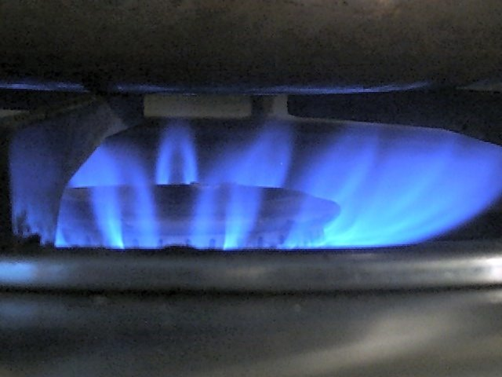
#1 Unexpected Color Change
Colorless methane burns blue

Slide 11
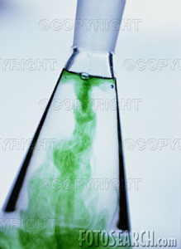
#2 Precipitate
Two clear solutions make a cloudy solution

Slide 12
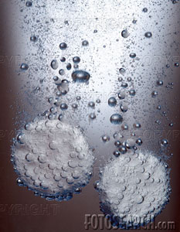
#3 Bubbles or Fizzing
Alka Seltzer in water makes carbon dioxide gas

Slide 13
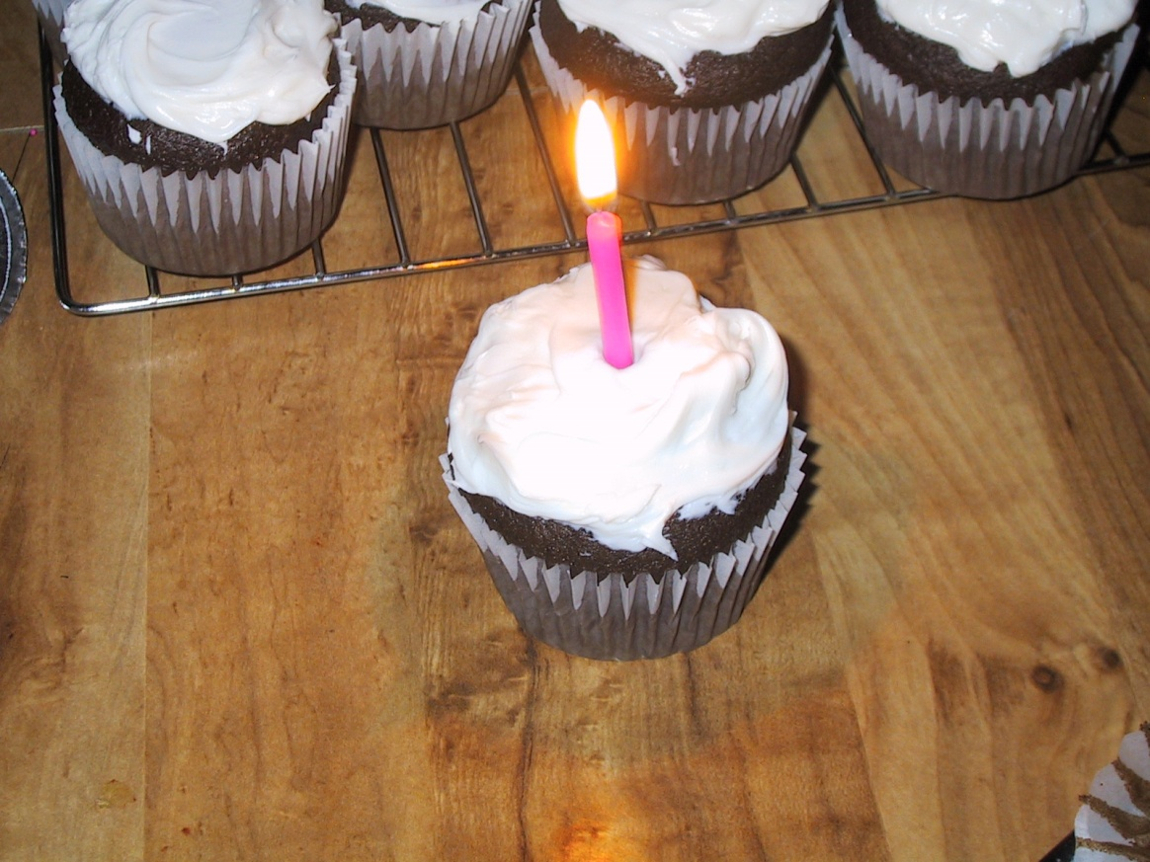
#4 Temperature Change
As candle was burns, it gives off heat and light

Slide 14
#5 Smell Change
Baked cupcakes smell differently than batter

Slide 15
Class Discussion:
Physical or Chemical?

