Slide 1
Learning Objective: I can calculate the amount of work performed by a person or machine.
Do Now
Give 1 example of potential energy.
Give 1 example of kinetic energy.

Slide 3
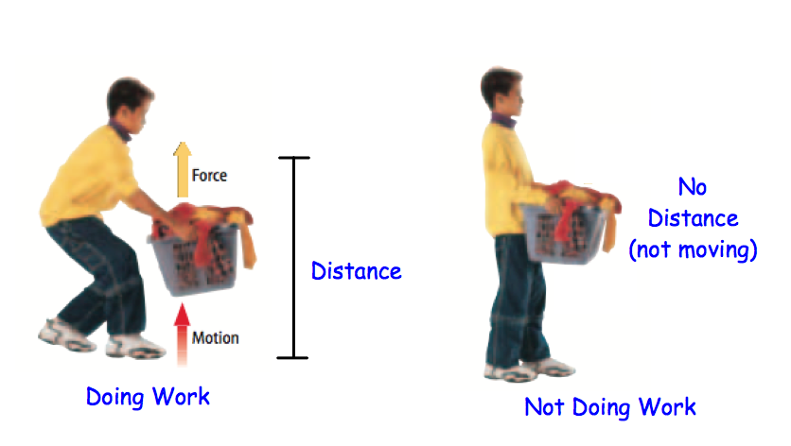
In science, WORK can be measured.
WORK = FORCE x DISTANCE

Slide 4
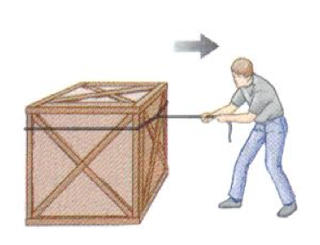
Work =
Using a force to move an object a certain distance.
But what is FORCE?
http://www.youtube.com/watch?v=_N0r1ignq1w
http://www.youtube.com/watch?v=z8ScILNusG4

Slide 5
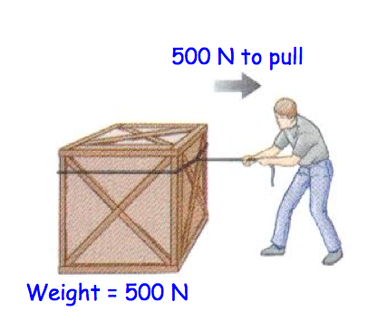
Force =
A quantitative description of the movement of an object.

Slide 15
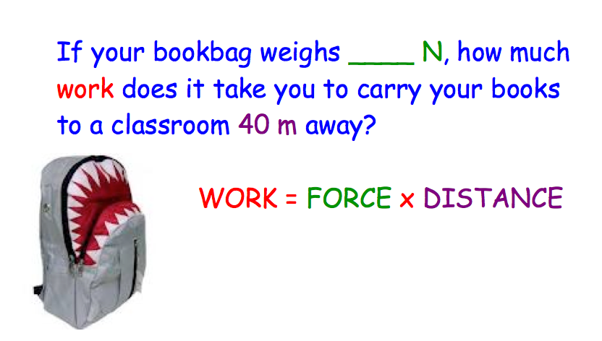
Notes:
Have students weight their backpacks with a spring scale.

