Slide 1
Pressure

Slide 2
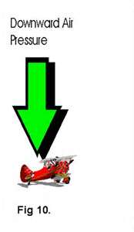
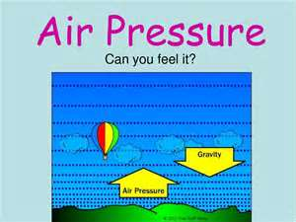
What is Pressure?
“Amount of force exerted on an area”
Earth’s gravity pulls downward
Due to gravity, your feet exert a force on the surface of Earth over an area the size of your feet

Slide 3
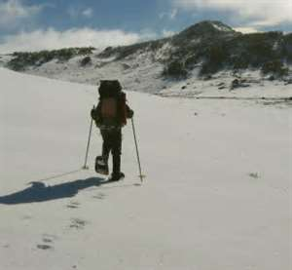
Pressure and Area
The amount of pressure you exert depends on the area over which you exert force.
Larger area = less pressure exerted

Slide 4
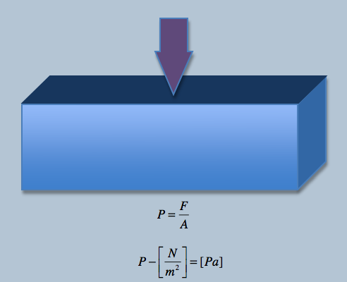
Calculating Pressure
Pressure = Force
Area
Measured in
Pascals (Pa)
1 Pa = 1 N/m²

Slide 5
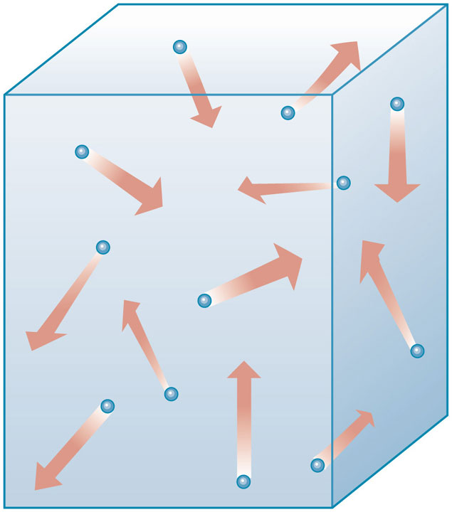
Fluid Pressure
Fluid is a material that can easily flow
Liquids
Gases
Air and helium

Slide 6
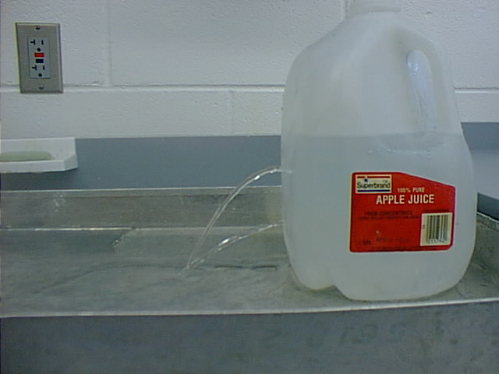
What Causes Fluid Pressure
In a fluid, all of the forces exerted by the individual particles combine to make up the pressure exerted by the fluid.

Slide 7
Air Pressure
Air exerts pressure because it has mass
Because the force of gravity pulls down on the mass of air, the air has weight
Weight of the air is the force that produces air pressure or atmospheric pressure

Slide 8
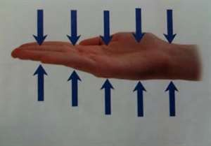
Balanced Pressure
Hold out your hand
Holding up air – 1,000 N
About the same weight as that of a large washing machine

Slide 9
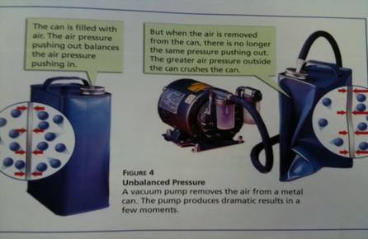
Unbalanced Pressure
What happens when air pressure becomes unbalanced?

Slide 10
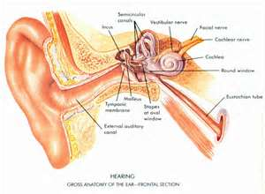
Variations in Fluid Pressure
Atmospheric Pressure and Elevation
Popping in ear is caused by changing air pressure.
Higher elevations – less air above you = less air pressure
*Atmospheric pressure decreases as your elevation increases

Slide 11
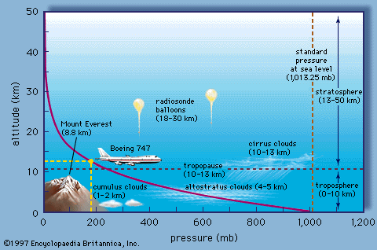
Variations in Fluid Pressure

Slide 12
Variations in Fluid Pressure
Water Pressure and Depth
Water pressure increases as depth increases
Deepest part of the ocean 1,000 times greater air pressure than we experience every day

Slide 13
Measuring Pressure
Barometer measures atmospheric pressure

