Slide 1
Gravity
Is gravity real -
or does the Earth
just suck?
Notes:
Show the box and balloon as described in the plan accompanying the PPT
Lead the discussion to find out how much they already know- this will vary across the class.
During activity 2:
As they try the different examples of forces acting, ask them what is happening as the forces act.

Slide 2
What do forces do?
Make things ----
move
move faster
move slower
change direction
also
change shape
Notes:
After the first class activity ask the children what changes are caused by forces.
This slide helps to summarise what forces do.

Slide 3
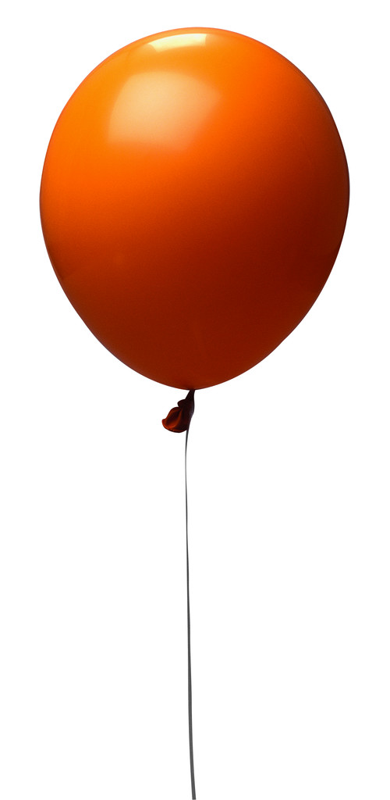
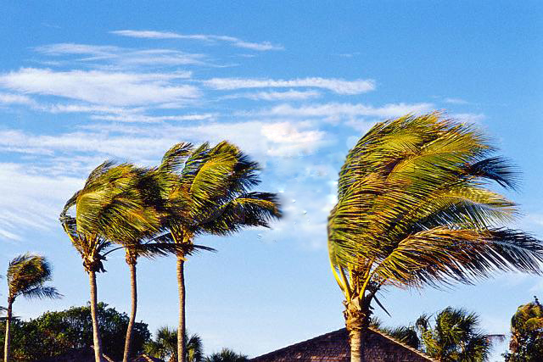
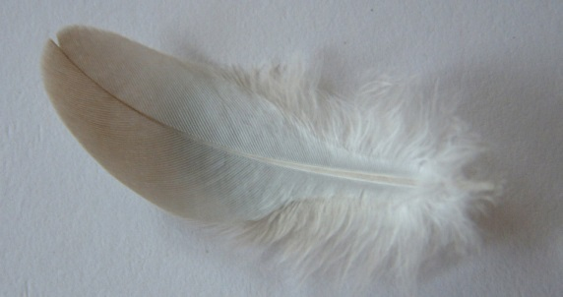
Big and Little forces
We can measure forces
Using various tools
Notes:
Forces are not all the same - some are large and others are small.
The slide gives examples. Ask which will be the larger force and how they would know this.
Then ask which of the forces they had tried earlier had been large and which were small.
Explain that forces can be measured using a force meter.

Slide 4
Sir Isaac Newton
Notes:
Ask have they heard of Sir Isaac Newton.
Story – he was sitting under a tree one day and a fruit fell on his head.
This made him think about things falling and he had an idea.

Slide 5
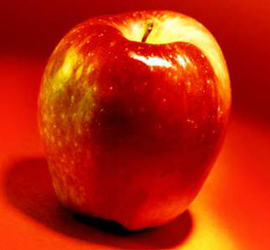
Which fruit ?
Notes:
Vote for which fruit.
Satsumas - do not grow in the UK
Melon - would have hurt him a lot – not just made him think.
Explain that it was an apple.

Slide 6
Newton?
Notes:
Emphasise that millions of people had seen apples and other things fall for thousands of years and no-one had thought out a reason ( Aristotle had reasoned that things fall because it is their nature to fall.)
Ask them to think what forces do– make things move. So there is a force acting on the apple.
Newton worked out that there is a force acting called gravity.
Ask whether the man in this picture could be Newton- No - this is a picture of a man in a modern suit- Newton lived a long time ago. (1643 – 1727)

Slide 7
Gravity is a force
When gravity pulls something towards the Earth -
- we call this force the weight.
Notes:
We can understand that Gravity is a force because it makes things move
Hold an object on your hand
What is stopping it moving?
You can feel the downward force on it pushing on your hand

Slide 8
Forces are measured in Newtons
Weight of an apple = about 1 Newton
Notes:
Hand round some 1 newton weights and/or objects which have a weight of about 1 newton.
Point out that the weight of an apple is about a newton

Slide 9
Let’s play
a game !
Notes:
Mystery BOX
First ask volunteers in turn to pull a string and estimate the size of the force on the string that they pull in newtons.
Put the results in a table. (Fill in the table on slide 10, if a white board is used. Otherwise take some sheets of paper for groups to fill in the values in case no board is available.)
Then ask more children to use a forcemeter to check values.

Slide 10
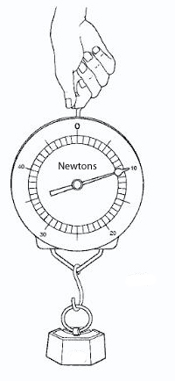
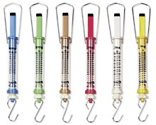
Spring Scales
Notes:
To measure a weight
Hang the object on the hook and the spring inside is stretched. The weight can be read from the scale in newtons

Slide 11
Now another game!
Notes:
Ask for volunteers and ask them to use the straw to lift a ping pong ball. Suggest they may be able to pass the ball around using the straws.
Then hand out a ping pong ball per group and enough straws for one for each child.
They should try to pass a ping-pong ball around using straws to overcome the effects of gravity; try with heavier objects.

Slide 12
Lifting a ping pong ball
Suck !
.
straw

Slide 13
ping pong ball falling
The arrow represents the force of gravity
Notes:
This slide shows the force on the ping pong ball when dropped.

Slide 14
The ball does not fall when your sucking force = force of gravity
Suck
straw
How have I shown this ?
gravity
Notes:
To stop it falling an upward force on the ball is needed. This is supplied when they suck.
If the ball does not fall the upward force must be equal to the force of gravity on the ball.
Ask them to explain why the diagram shows this. (Arrows the same length.)

Slide 15
Which diagram shows the sucking force equal to the force of gravity?
Suck
Suck
Suck
straw
straw
straw
gravity
gravity
gravity
Notes:
This slide reinforces the previous slide. Point to each diagram in turn and ask what happens in each case.

Slide 16
The ball does not fall when your upward force = force of gravity
Suck
straw
gravity
Notes:
They will find it very difficult to pass the ball around because the force to lift the ball must be upwards to balance the force of gravity.

Slide 17
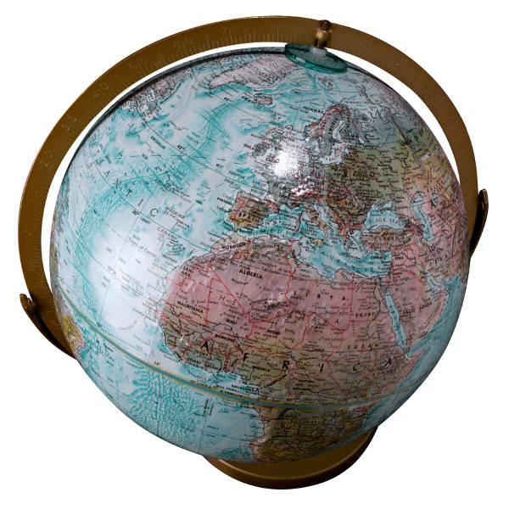
Gravity down under
People do not fall off the Earth
Notes:
Gravity pulls objects towards the Earth.
In Australia people are attracted to the Earth as we are – they do not fall off!
The children might think people should be standing on their heads.

Slide 18
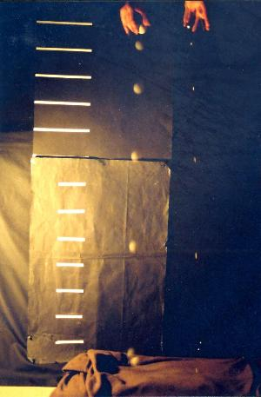
two objects dropped at the same time
Notes:
Explain that the two objects are released at the same time. As they fall the light flashes at a steady rate. For each flash the positions of the objects are shown at the same moment The pictures show that the ping pong ball and the marble fall at almost the same rate. The marble actually reaches the ground first.
Explain that this is because there is air resistance slowing the larger object down (more than the small object).

Slide 19
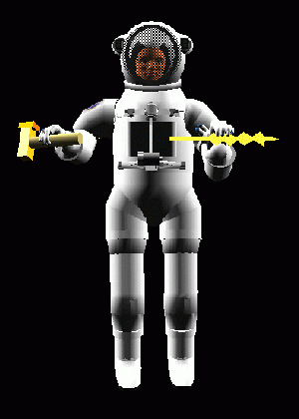
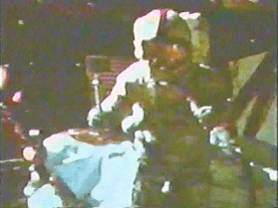
On the Moon – Apollo 15
A heavy geological hammer and a falcon feather were dropped from the same height.
They hit the lunar surface at the same time.
astronaut David Scott
NASA pictures
Notes:
If possible show them a video of the experiment when the astronaut David Scott dropped a hammer and a falcon feather on the Moon.
Explain that there is no air (atmosphere) on the Moon so both the hammer and the feather reach the surface at the same instant- if released at the same instant.

Slide 20
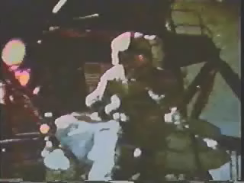
On the Moon – Apollo 15
A heavy geological hammer and a falcon feather were dropped from the same height.
They hit the lunar surface at the same time.
astronaut David Scott
NASA pictures
Notes:
If possible show them a video of the experiment when the astronaut David Scott dropped a hammer and a falcon feather on the Moon.
Explain that there is no air (atmosphere) on the Moon so both the hammer and the feather reach the surface at the same instant- if released at the same instant.

Slide 21
Hippo jump
Notes:
This is a story about air resistance.
Ask what has happened? Hippo does not have a parachute and is falling.

Slide 22
Hippo jump
Force of gravity
Notes:
What is happening?
The force of gravity is pulling Hippo down. He will be moving faster and faster! (The word acceleration is not on the curriculum.)
Ask what could save Hippo? They will suggest a parachute.

Slide 23
Saved?
Notes:
Will the parachute in the picture help?
Get them to explain that the parachute would not catch the air and slow Hippo down.

Slide 24
Hippo is still falling quickly
Notes:
Ask if Hippo is safe. – Still falling very quickly.

Slide 25
Hippo is still falling quickly but not getting faster
air resistance
How do we know?
Force of gravity
Notes:
Ask what the force arrows show
They should spot that the force of the air resistance is equal to the force of gravity on Hippo.
Ask them what change can be made so that Hippo slows down and is not hurt when he reaches the ground.
This could lead into an investigation if wanted by the teacher.

Slide 26
How can we slow Hippo down?
What can you change?
Notes:
Get them to suggest that Hippo will slow if the parachute is larger.
(This could lead into an investigation with the class teacher at another time.)

Slide 27
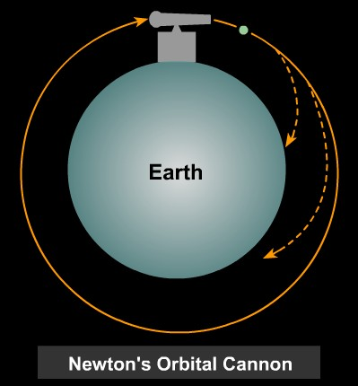
Launching a satellite
The cannon ball must move very quickly to orbit the earth.
The Moon orbits the Earth
Notes:
Discuss what happens when they throw a ball- it drops to the Earth.
If an object is projected at VERY high speed then it goes further round the Earth.
An object must be moving at high speed to orbit the Earth.
Talk about satellites and the fact that the Moon is a satellite of the Earth.

Slide 28
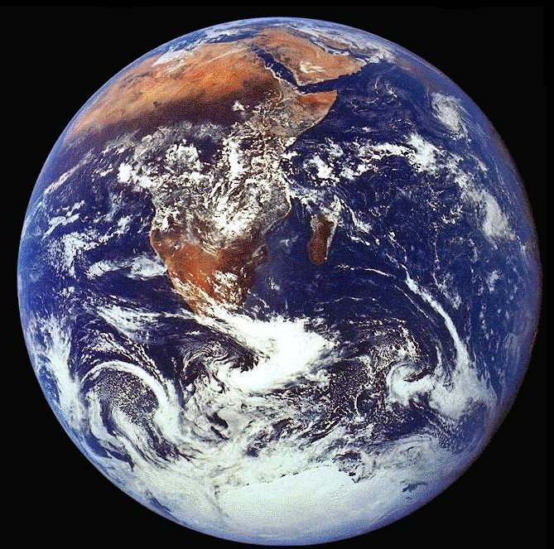
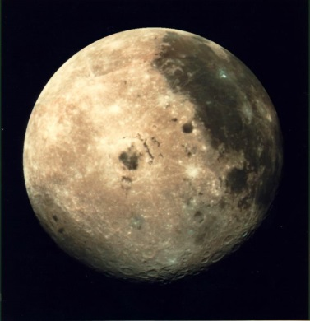
The Moon
The Earth
Notes:
The Moon is much smaller than the Earth.
(Pictures - approximately the same scale.)

Slide 29
The Moon
The Earth
Notes:
This is to help them to get the idea that there is enough material in the Earth to make lots of Moons.
Refresh the idea that big objects pull with a big force of gravity.
Help them to reason out that the Moon pulls objects towards it with a smaller force than Earth.
Ie the force of gravity on the moon is much less than on earth.

Slide 30
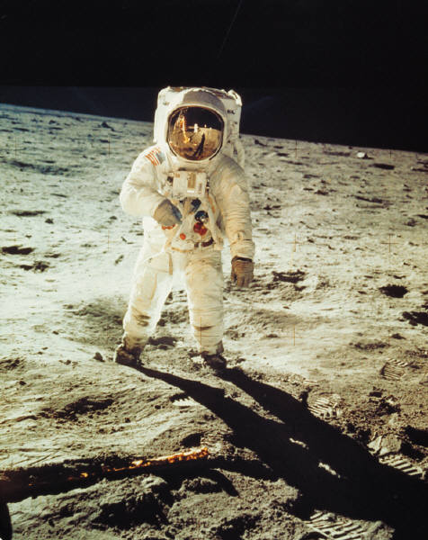
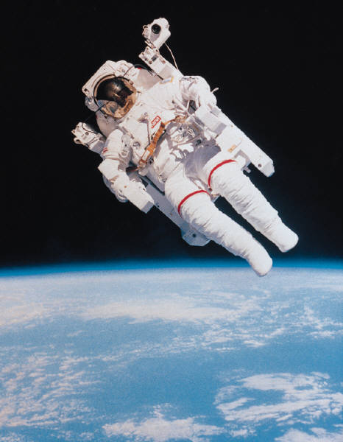
On the Moon
NASA pictures
Notes:
Astronauts on the Moon are not pulled towards the Moon with as large a force as on Earth.
Note they will think there is no gravity on the Moon.
Point out there is no air but there is gravity.
The space suits enable the astronauts to breathe and keep on living.
Also they have very heavy boots.

Slide 31
Very heavy boots- Why?
Answers?
No gravity on the Moon
Weightless on the Moon
To stop them floating away
They weigh very much less than on Earth
To stop huge bounces
The Moon’s gravity is very much less than the Earth’s gravity
Notes:
Which answers are correct?
- Because they weigh very much less than on Earth
- To stop huge bounces
- The Moon’s gravity is very much less than the Earth’s gravity

Slide 32
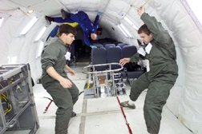
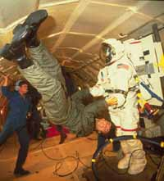
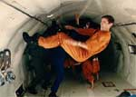
Weightless?
or are they?
(NASA pictures)
Notes:
In the discussion they will probably say that in space people are weightless.

Slide 33
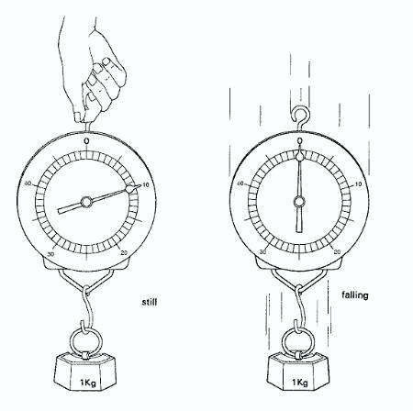
apparently weightless
(pictures or animation only –not a demonstration)
Notes:
When going down in a lift you feel an odd sensation. This is because the lift floor is moving downwards and is not pushing up on your feet as hard as usual.
When in free fall there is a sensation that you have no weight. This is because there is no force pushing on your feet. So in space people are apparently weightless.

Slide 34
GRAVITY
Things fall
Things have weight
Things stay in place
Notes:
Einstein thought more about gravity
He answered “what happens when - -?”
But no-one knows “how?” and “why?”

Slide 35
No Gravity
Would an apple fall?
Would things stay on earth?
What would happen?
What?
Why?
How?
keep asking questions
-like Newton !
Notes:
Explain that scientists ask questions.
Then try to find the answers.
There are lots of questions that we do not know the answer to.
So if they become a scientist they might be able to explain some of the puzzles.
SCIENCE IS EXCITING!

