Slide 1
Floating and Sinking

Slide 2
Density
Comparing densities, you can predict whether an object will float or sink in a fluid.
If object is more dense than fluid – it sinks
If object is less dense than fluid - it floats
An object with a density equal to that of the fluid floats at a constant depth.

Slide 3
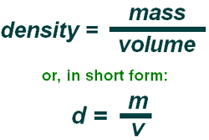
Density
Density = Mass
Volume
Density of water = 1.0

Slide 4
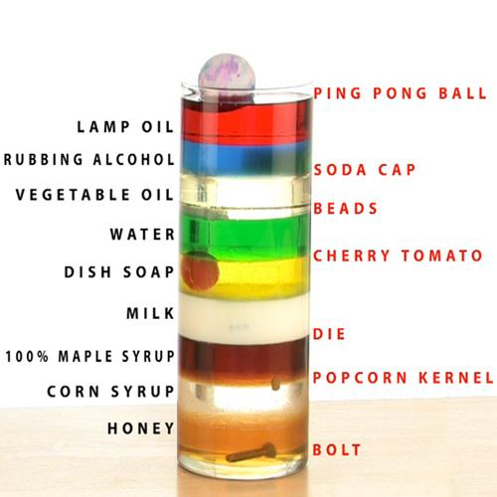
Density

Slide 5
Changing Density
Changing density can explain why an object floats or sinks.
Submarine

Slide 8
Buoyancy
Buoyancy is the ability to float.

Slide 9
Buoyant Force
Buoyant force is when water and other fluids exert an upward force.
The buoyant force acts in the direction opposite to the force of gravity, so it makes an object feel lighter.
The less dense the object is, the greater the buoyant force it experiences.

Slide 10
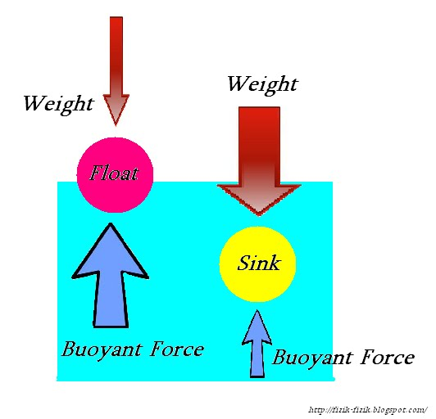
Buoyant Force

Slide 11
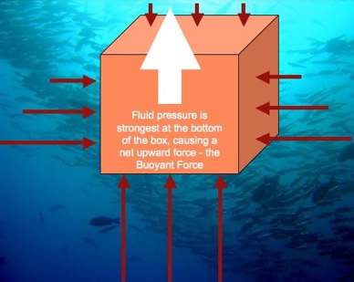
Buoyant Force

Slide 12
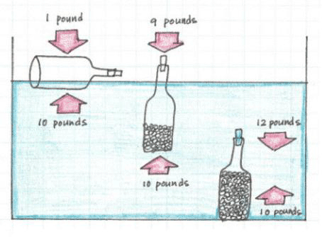
Buoyant Force

Slide 13
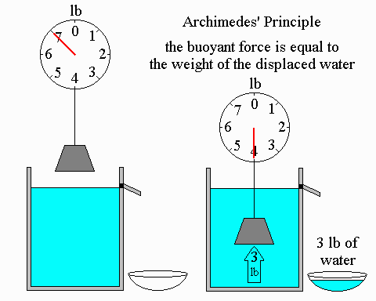
Archimedes’ Principle
The buoyant force acting on a submerged object is equal to the weight of the volume of fluid displaced by the object.

