Slide 1
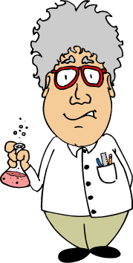
Chemical Reactions, Counting Atoms, and Balancing Chemical Equations.

Slide 2
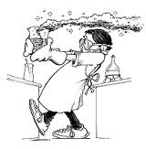
A Chemical Reaction is…
A process where one or more elements or compounds are changed into one or more different substances
A process where the original substance changes into a new substance with new properties
But, are new atoms created? Are other atoms destroyed?

Slide 3
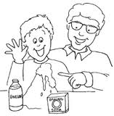
Law of Conservation of Mass states that…
Matter is never created or destroyed…
Therefore, the mass and types of atoms that make up the reactants must be equal to the mass and types of atoms in the products. The atoms are simply rearranged.

Slide 4
Reactants and Products
Reactant: the original substance (s)
Product: the new substance (s)
In the chemical equation, A + B AB, the reactants are ‘A’ and ‘B’, which are on the left side of the equation.
The product is ‘AB’ and is found on the right side of the equation.
The arrow in the equation means ‘yields’, or ‘produces’.

Slide 5
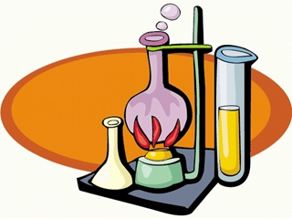
How Do We Know If It Is A Chemical Reaction?
The following observations provide evidence that a chemical reaction is taking place:
The temperature changes
A gas is produced (bubbling)
A precipitate forms (a solid forms from the combination of two solutions and separates out)
A permanent change in color
Be aware: Some physical changes produce some of the above observations. For example, food coloring in water and boiling water may look like chemical changes, but are physical changes.

Slide 6
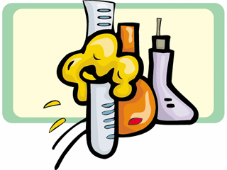
A Chemical Reaction
Adding HCl (hydrochloric acid) to zinc metal will produce bubbling and a temperature increase, two indications that a chemical change has taken place.
The atoms are simply rearranged during the reaction.

Slide 7
Chemical Equation
A chemical equation, or formula equation, represents what happens in a chemical reaction.
For instance: The formula equation for the addition of zinc metal and hydrochloric acid looks like this:
2HCl + Zn H₂ + ZnCl₂
The arrow means ‘yields’ or ‘produces’.

Slide 8
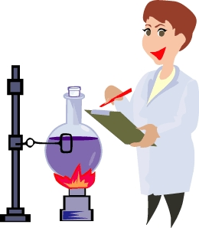
Counting Atoms in Formulas
Before you can correctly write and balance an equation, you must be able to correctly count atoms in chemical formulas.
Let’s learn some basics…

Slide 9
Know Your ‘Equation’ Terms
Coefficient – a whole number in front of the formula that represents the relative number of moles of the substance
Subscript – the small number to the lower right of an atom that represents the number of atoms of that element in the molecule
2H₂O
Coefficient of 2 means there are 2 moles of water
Subscript of 2 means there are 2 hydrogen atoms in a molecule of water

Slide 10
Counting Atoms in Formulas
How many atoms are in this formula?
The subscript ‘2’ belongs to the oxygen only and does not affect the carbon atom.
CO₂
1 mole of CO₂
1 atom of carbon
2 atoms of oxygen
3 atoms in this formula

Slide 11
Counting Atoms in Formulas
How many atoms are in this formula?
3 moles of CH₄
3CH₄
1 atom of carbon and
4 atoms of hydrogen per molecule
15 atoms in this formula

Slide 12
Counting Atoms in Formulas
Al(OH)₃
How many atoms are in this formula?
(OH)₃ means there are three molecules of OH bonded to the atom of aluminum.
‘OH’ is in parentheses because the oxygen and hydrogen atoms are a ‘pair’.
1 mole of Al(OH)₃
There are 7 atoms in this formula.

Slide 13
Counting Atoms in Formulas
How many atoms are in this formula?
2Cr₂(CO₃)₃
2 moles of 2Cr₂(CO₃)₃
(CO₃)₃ means there are three molecules of CO₃ bonded to two atoms of chromium.
Count carefully!
There are 28 atoms in this formula.

Slide 14
How To Balance Chemical Equations
Now that we know how to count atoms in formulas, we can begin to balance equations.
Let’s look at a balanced equation.

Slide 15
Chemical Equations
2HCl + Zn H₂ + ZnCl₂
The chemical equation above is a balanced equation.
The reactants are: HCl and Zn
The products are: H₂ and ZnCl₂
There are equal numbers and kinds of atoms in the reactants as there are in the products.

Slide 16
Chemical Equations
H₂O
H₂
O₂
H₂O
H₂
A well-written chemical equation must:
Represent a real situation – the actual reactants must be able to react and form the products given
Contain correct formulas for the reactants and products
Abide by the Law of Conservation of Mass, which means that atoms are never created nor destroyed during chemical reactions
2H₂O 2H₂ + O₂

Slide 17
Chemical Equations
Balancing chemical equations is easy if you follow some rules.
You can only add a coefficient in front of a chemical formula 2H₂O
You cannot change any subscripts, nor add any subscripts O₂
You may not place a coefficient in the ‘middle’ of a chemical formula Ca2Cl
You must end up with the same number and kinds of atoms on both sides of the equation when you are finished. Count atoms on both sides upon completion to check yourself. 2AB₂ A₂ + 4B

Slide 18
Let’s Try To Balance An Equation…
The word equation is:
Hydrogen gas + chlorine gas hydrogen chloride
The formula, or chemical equation is:
H₂ + Cl₂ HCl
The above equation does not satisfy the requirements of a balanced equation. Let’s balance it.

Slide 19
Balance the Equation
Begin by counting atoms on both sides of the arrow. Remember that the number and kinds of atoms in the reactants has to equal the numbers and kinds of atoms in the products.
H₂ + Cl₂ HCl
H - 2
Cl - 2
H - 1
Cl - 1
It will help if you divide the two sides with a line below the arrow and list the atoms.

Slide 20
Balance the Equation
H₂ + Cl₂ HCl
You can see that it appears as if a hydrogen and an oxygen atom were lost in this reaction. That violates the Law of Conservation of Mass, so we must balance the equation by adding coefficients where necessary.
2
H - 2
Cl - 2
H - 1
Cl - 1
H - 2
Cl - 2
Let’s add the coefficient ‘2’ in front of the ‘HCl’.
Now let’s adjust our atom totals below the equation and check.

Slide 21
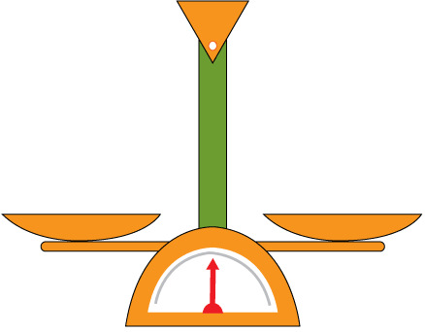
Balanced!
H₂ + Cl₂ 2HCl
Now we have a balanced equation that satisfies the Law of Conservation of Mass.
H - 2
Cl - 2
H - 2
Cl - 2

Slide 22
Balance This Equation
Here’s another example:
Al + O₂ Al₂O₃
Al – 1 Al – 2
O – 2 O – 3
Count the number of atoms and list them under the equation. Compare each side.
You might try adding a coefficient of 2 in front of the Al to balance the aluminum atoms.
2Al + O₂ Al₂O₃
Al – 2 Al – 2
O – 2 O - 3
It’s OK if the first coefficient you try does not balance the equation.

Slide 23
Balance This Equation
2Al + O₂ Al₂O₃
Al – 2 Al – 2
O – 2 O - 3
3
2
How should we fix the number of oxygen atoms?
Add a coefficient of 3 in front of the O₂ on the left, and a coefficient of 2 in front of the Al₂O₃ on the right.
Adjust the numbers of atoms below the equation.

Slide 24
Balance This Equation
2Al + O₂ Al₂O₃
Al – 2 Al – 4
O – 6 O - 6
3
2
How should we fix the number of oxygen atoms?
Add a coefficient of 3 in front of the O₂ on the left, and a coefficient of 2 in front of the Al₂O₃ on the right.
Adjust the numbers of atoms below the equation.

Slide 25
Balance This Equation
2Al + 3O₂ 2Al₂O₃
Al – 2 Al – 4
O – 6 O - 6
Now we still have a problem.
The number of aluminum atoms do not match.
Remove the 2 in front of the Al, and add a coefficient of 4. Adjust the numbers of atoms.

Slide 26
Balanced!
4Al + 3O₂ 2Al₂O₃
Al – 4 Al – 4
O – 6 O - 6
Now we have a balanced equation!

Slide 27
Types of Chemical Reactions
Now that you know how to balance equations, let’s look at the different types of reactions.

Slide 28
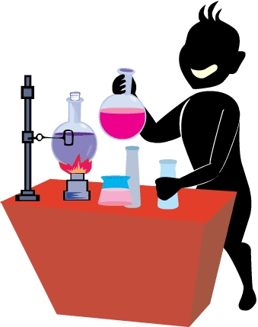
Types of Chemical Reactions
The basic types of chemical reactions are:
Synthesis
Decomposition
Combustion
Single Replacement
Double Replacement

Slide 29
Synthesis
Two or more substances combine to form a new compound.
General equation:
A + B AB
(A and B represent an element, molecule, or compound)
Example of synthesis:
SO₂ + H₂O H₂SO₃

Slide 30
Decomposition
A compound decomposes into two or more simpler substances.
General equation:
XY X + Y
X and Y represent an element, molecule, or compound.
Example of Decomposition:
2NaNO₃ 2NaNO₂ + O₂

Slide 31
Combustion
Combustion: A substance will combine with oxygen, and in the process, give off energy in the form of light and heat.
General Equation:
A + O₂ AO₂
Example of the combustion of propane:
C₃H₈ + 5O₂ 3CO₂ + 4H₂O

Slide 32
Single Replacement
One element replaces another element in a compound.
General equation:
C + DF CF + D
C, D, and F are elements, and CD and CF are compounds.
Example:
3Fe + 4H₂O Fe₃O₄ + 4H₂

Slide 33
Double Replacement
Two ionic compounds exchange ions in solution to form two new compounds.
General equation: G⁺H⁻ + J⁺K⁻ G⁺K⁻ + J⁺H⁻
G⁺, H⁻, J⁺, and K⁻ represent ions.
Example:
FeS + 2HCl H₂S + FeCl₂

Slide 34
Practice
Which of the following are balanced equations?
NaCl Na + Cl₂
2H₂O 2H₂ + O₂
2Fe(OH)₃ + 3H₂SO₄ Fe₂(SO₄)₃ + 6H₂O
4NH₃ + 3O₂ 2N₂ + 4H₂O

Slide 35
Practice
Balance the following equation:
CO₂ + H₂O C₆H₁₂O₆ + O₂

Slide 36
Practice
Name the type of reaction:
2Na + Cl₂ 2NaCl
K + AgCl Ag + KCl
2HgO 2Hg + O₂
HCl + NaOH NaCl + H₂O
2H₂ + O₂ 2H₂O

Slide 37
Practice Answers
Which of the following are balanced equations?
NaCl Na + Cl₂
2H₂O 2H₂ + O₂
2Fe(OH)₃ + 3H₂SO₄ Fe₂(SO₄)₃ + 6H₂O
4NH₃ + 3O₂ 2N₂ + 4H₂O

Slide 38
Practice Answers
Balance the following equation:
CO₂ + H₂O C₆ H₁₂O₆ + O₂
C 1 C 6
O 3 O 8
H 2 H 12
Start by adding a coefficient of 6 in front of the ‘CO₂’ and recount the atoms; add a coefficient of 6 in front of the ‘H₂O’ and recount; finish by adding a ‘6’ in front of the ‘O₂’ and check.
6CO₂ + 6H₂O C₆H₁₂O₆ + 6O₂

Slide 39
Practice Answers
Name the type of reaction:
2Na + Cl₂ 2NaCl synthesis
K + AgCl Ag + KCl single replacement
2HgO 2Hg + O₂ decomposition
HCl + NaOH NaCl + H₂O double replacement
2H₂ + O₂ 2H₂O combustion

