Slide 1
Bonding Basics
PART I

Slide 2

Bonding is ALL about….
VALENCE ELECTRONS-
    the electrons on the outer (valence) shell of an atom

Slide 3
How many electrons makes the valence shell full or “happy”?
The first shell holds2electrons.
After the 1st shell, each shell needs8 electrons to be FULL and HAPPY!

Slide 4

The Octet Rule
Atoms give away or steal electrons in order to have a full valence shell!
  Atoms with less than 4 valence electrons tend to lose electrons.
  Atoms with more than 4 valence electrons tend to gain electrons.

Slide 5
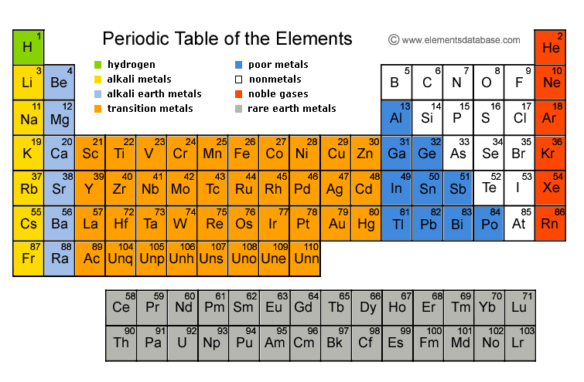
What is the “cheater” way to find valence electrons?
Look at the Periodic Table

Slide 6
Valence Electrons:
8
7
1
2
3
4
5
6

Slide 7
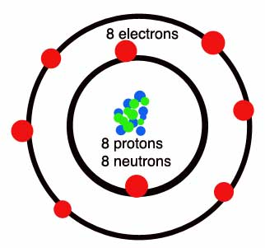
There are 2 ways to represent the # of Valence Electrons:
2 types of diagrams to show electrons
Shows ALL electrons
Shows ONLY valence electrons
O
Bohr Diagram
Lewis Dot

Slide 8
Discuss Quickly With Your Group…
1. How many electrons in each atom below?
2. Which element does each atom represent?
3. How many valence electrons does each have?

Slide 9
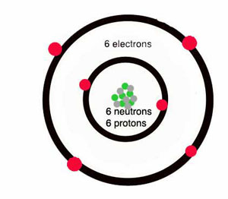
EXAMPLES…
What about an element like carbon?
  Carbon has 4 valence electrons, so what will it do? BOTH!
  The fact that carbon
  has 4 valence electrons
  allows it to bond with
  many elements!

Slide 10


Reminder:
Atoms will give away or steal electrons in order to be HAPPY!
When they do this, they bond with other atoms to make molecules!

Slide 11

EXAMPLES…
Here are 2 elements that have a few extra electrons. What do they want to do?

Slide 12
EXAMPLES…
Here are 2 elements that are missing a few electrons. What do they want to do?

Slide 13
EXAMPLES…
We have Sodium (Na) who has an extra electron, and Fluorine (F) who is looking for an electron SO…
They end up bonding so they can both be happy!

Slide 14
But Remember…
ION = an atom with a charge because it loses or gains one or more electrons.
Positive ion = cation
loses electrons
(now has more positive particles than negative)
Negative ion = anion
gains electrons
(now has more negative particles than positive)
Notes:
http://www.brainpop.com/science/matterandchemistry/ions/

Slide 15
Let’s Try It!
Fill in the electron table using your periodic table.
If you are confused, DRAW IT!

Slide 16
Element | Element Symbol | Atomic Number | Total # of Electrons | # of Valence Electrons | # of Electrons Gained or Lost | Overall Charge (+/-)
Chlorine
Potassium
Magnesium
Fluorine
Aluminum
Sodium
Nitrogen
Oxygen
Hydrogen
Carbon
Iodine

Slide 17
Bonding Basics
PART 2

Slide 18
Two Types of Chemical Bonds
Ionic Bonds
Covalent Bonds

Slide 19
Ionic Bonds
TRANSFER
Atoms will ____________ one or more electrons to another atom to form the bond.
Each atom is left with a ________________ outer shell.
An ionic bond forms between a ___________ion with a positive charge and a ________________ ion with a negative charge.
COMPLETE
METAL
NONMETAL

Slide 20
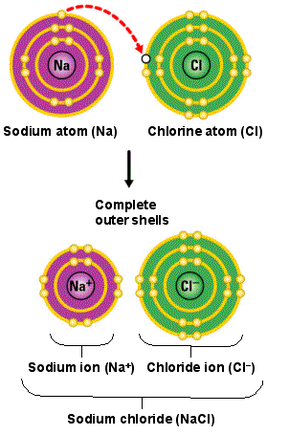
Ionic Bonds

Slide 21
Ionic Bonds
Li
F

Slide 22
Covalent Bonds
SHARE
Atoms ___________ one or more electrons with each other to form the bond.
Each atom is left with a ________________ outer shell.
A covalent bond forms between two ________________.
COMPLETE
NONMETALS

Slide 23


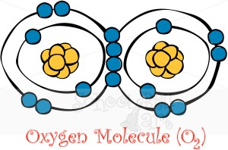

Covalent Bonds
=
=

Slide 24
Covalent Bonds
H
O
H

Slide 25
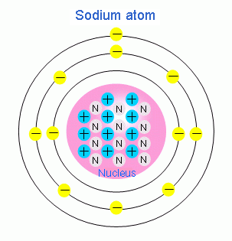
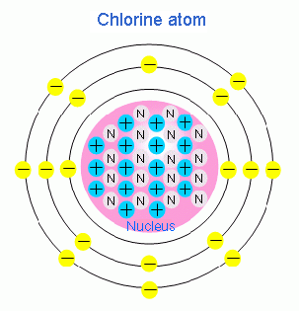
Ionic or Covalent Bond?

Slide 26

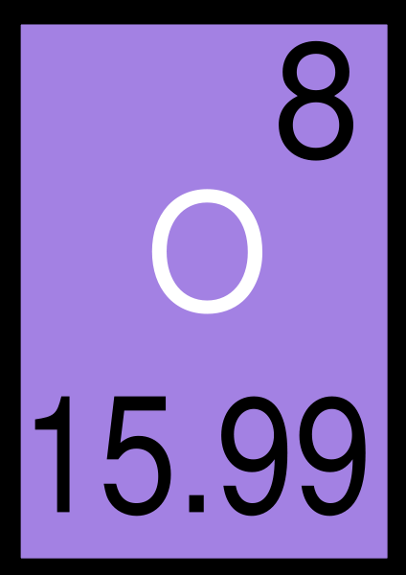
Ionic or Covalent Bond?

Slide 27
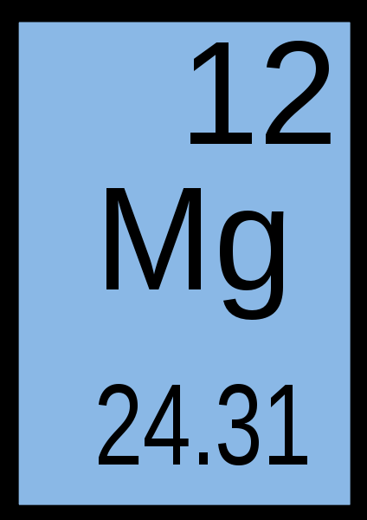
Ionic or Covalent Bond?

Slide 28
Ionic or Covalent Bond?
Bromine
Iodine

Slide 29
Ionic or Covalent Bond?
Calcium
Chlorine

Slide 30
Bonding Videos
Metals Reacting with Oxygen
http://www.youtube.com/watch?v=m2i9jLPXprQ
Bonding Rap
http://www.youtube.com/watch?v=Xaoy94mx2EU

Slide 31
Bonding Mini Quiz!
ON THE BACK OF YOUR ELEMENT SQUARE WARM-UP NUMBER 1-10
Leave a little space between questions #3 and #4
Make sure your name & block are on it somewhere!

Slide 32
Bonding Quiz:
1. After the first shell, each electron shell needs how many electrons to be “happy” or complete?
  A. 8
  B. 2
  C. 4
  D. 18

Slide 33
Bonding Quiz:
2. The picture below is a Bohr diagram of an Oxygen (O) atom. Which of the following is TRUE about Bohr diagrams?
  A. The Bohr diagram shows ONLY
  valence electrons.
  B. The Bohr diagram shows ALL
  electrons, not just valence
  electrons.
  C. The Bohr diagram shows ONLY
  protons.
D. The Bohr diagram shows ONLY
neutrons.

Slide 34

Bonding Quiz:
3. Draw the Lewis Dot diagram for Oxygen (O):

Slide 35
Bonding Quiz:
4. How many valence electrons does Neon (Ne) have?
A. 5
B. 4
C. 8
D. 1

Slide 36
Bonding Quiz:
5.Sodium (Na) is “happy” because it has a full valence shell.
A. True
B. False

Slide 37
Bonding Quiz:
6. Which type of bond is between a metal and a nonmetal?
A. Covalent
B. Ionic

Slide 38
Bonding Quiz:
7. ____________ bonds involve transferring electrons to be “happy” or complete.
  A. Ionic
  B. Covalent

Slide 39
Bonding Quiz:
8. A _______________ bond is between two or more nonmetals and involves sharing electrons.
A. Ionic
B. Covalent

Slide 40
Bonding Quiz:
9. Which of the following is an example of a covalent bond?
A. NaCl
  B. LiF
  C. CaO
  D. CO₂

Slide 41
Bonding Quiz:
10. Which of the following is an example of an ionic bond?
A. NF₃
B. NaCl
  C. CF₄
  D. CO₂

Slide 42
Equation Challenge-
Copy the equations into your notebook under your Ion “Cheater” Chart
Identify each as physical or chemical
Provide an explanation as to how you know: include your prior knowledge of physical vs. chemical as well as your new knowledge on bonding!
H₂O_{(liquid)}→ H₂O_{(gas)}
CH₄ + 2O₂ → CO₂ + 2H₂O

