Slide 1
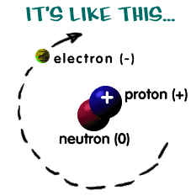
Ionic Bonds What is an Ion?
An atom or group of atoms that has become electrically charged.

Slide 2
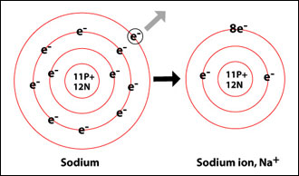
What happens when an atom loses an electron? What type of ion does it become?
When an atom loses an electron, it loses a negative charge and become a positive ion.

Slide 3
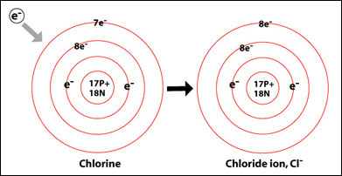
What happens when an atom gains an electron? What type of ion does it become?
When an atom gains an electron, it gains a negative charge and becomes a negative ion.

Slide 4
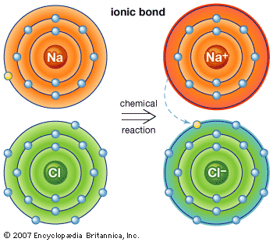
In the bond between sodium and chlorine, what changes each atom into an ion?
The transfer of sodium’s one valence electron to chlorine.

Slide 5
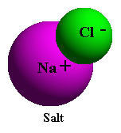
What type of ion does sodium become after it transfers its’ one valence electron?
The sodium atom becomes a positive ion (Na⁺).

Slide 6
What type of ion does chlorine become after it accepts sodium's one valence electron?
The chlorine atom becomes a negative ion (Cl⁻).

Slide 7
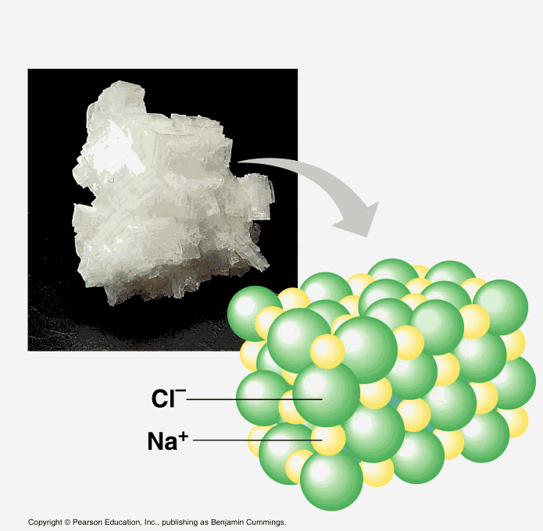
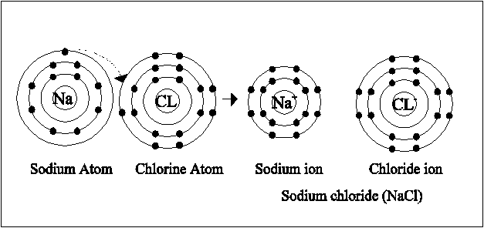
Why are sodium and chlorine attracted to one another?
Negative and Positive electric charges attract each other; Na⁺ and Cl⁻ come together to form sodium chloride

Slide 8
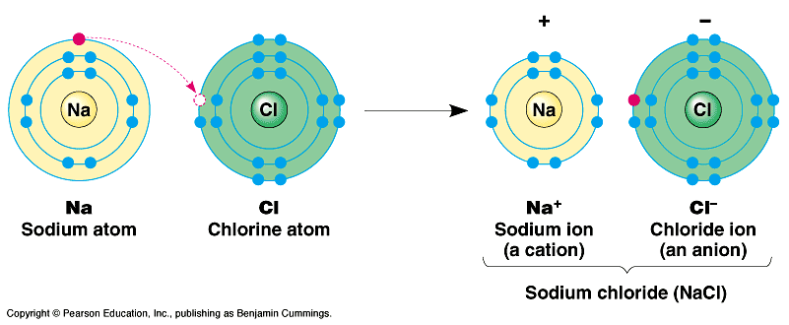
Why do atoms not have a charge but ions do?
An atom has an equal number of electrons and protons, ions have an unequal number

Slide 9
What is an ionic bond?
The attraction between two oppositely charged ions
When the two ions come together, the opposite charges cancel out (Na 1+ and Cl 1-)

Slide 10
What charge do compounds have?
Compounds are electrically neutral
When ions come together, they do so in a way that balances out the charges on the ions

Slide 11
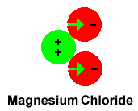
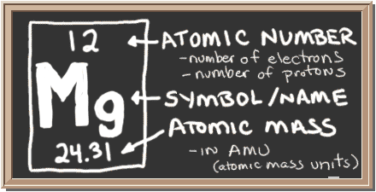
If Mg has a charge of 2+ and Cl has a charge of 1-, how many Cl ions would be needed to cancel out the 2+ charge of Mg?
2

Slide 12
Checkpoint: What effect does gaining an electron have on the charge of an atom?
An atom that gains an electron becomes a negatively charged ion

Slide 13
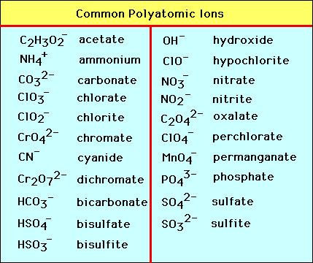
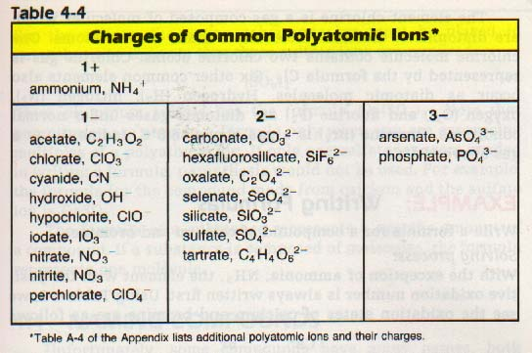
What is a polyatomic ion?
Ions that are made up of more than one atom
A group of atoms that react as one
Has an overall positive or negative charge
Example: CaCO₃ calcium carbonate

Slide 14
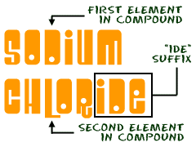
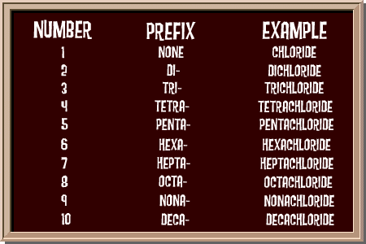
How do you name Ionic Compounds?
The name of the positive ion comes first, followed by the name of the negative ion
If the negative ion is an element, the end changes to –ide. Example: MgO (Magnesium Oxide)
If the negative ion is polyatomic, its name remains unchanged. Example: NaHCO₃ (Sodium Carbonate)

Slide 15
What are the characteristic properties of ionic compounds?
Crystal shape – in an ionic compound every ion is attracted to ions near it that have an opposite charge
High melting points – Ions are held together by attractions between them
Electrical conductivity – When ionic compounds dissolve in water the solution conducts electricity

Slide 16
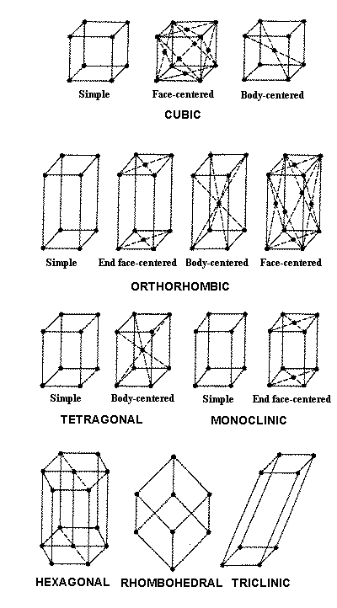
What is a Crystal?
An orderly, three dimensional arrangement
When ions combine, they form alternating patterns and bond with each other on all sides – this makes crystals

Slide 17
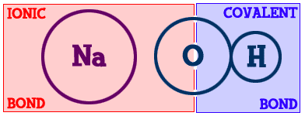
Covalent Bonds What is a covalent bond?
A chemical bond formed when two atoms share electrons

Slide 18
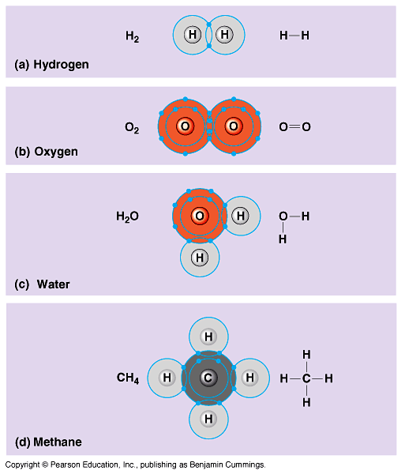
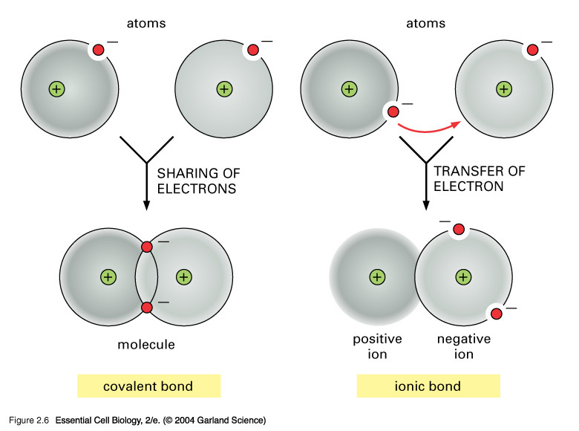
How are covalent bonds different from ionic bonds?
Ionic bonds form between metals and nonmetals, covalent bonds form between two or more nonmetals

Slide 19
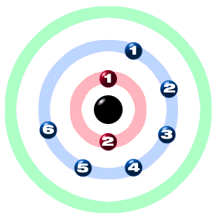
How many bonds can each atom form?
The number of bonds these atoms can form equals the number of valence electrons needed to make a total of 8
Example: Oxygen has 6 valence electrons; therefore it can form 2 bonds because it needs 2 more electrons to equal 8

Slide 20
What is a double bond?
A chemical bond formed when atoms share two pairs of electrons
Example: Carbon Dioxide

Slide 21
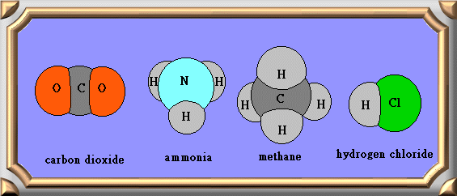
What is a molecular compound?
A compound consisting of molecules of covalently bonded atoms
Example: Carbon Dioxide
Molecules are close together but the forces are weaker than those holding ions together

Slide 22
Checkpoint: Why are molecular compounds poor conductors?
Molecular compounds are poor conductors because they do not contain any charged particles that are available to move
Example: pure water, plastic

Slide 23
Do the atoms share the electrons equally?
No, some atoms pull more strongly on the shared electrons than other atoms do. As a results, the electrons move closer to one atom, causing the atoms to have slight electrical charges

Slide 24
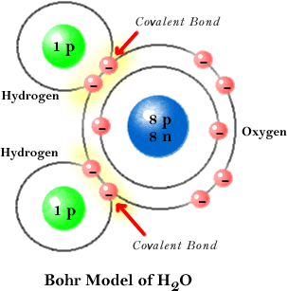
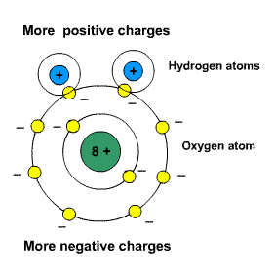
What is a covalent bond called where the electrons are shared unequally?
Polar; these charges are not as strong as the charges on ions but it is enough to make one atom slightly negative and the other slightly positive

Slide 25
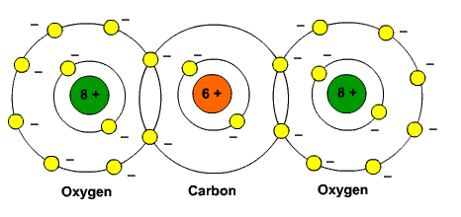
If two atoms pull equally on the electrons, what is this bond called?
Nonpolar
The electrons are shared equally
Occurs when the two atoms are identical
Example: F₂ (Fluorine gas)

Slide 26
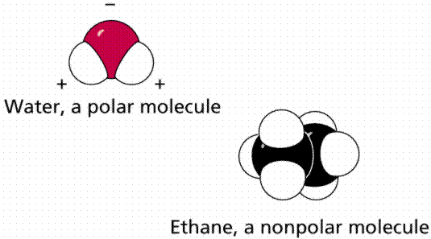
Checkpoint: What makes a covalent bond polar?
A covalent bond is polar when the electrons are shared unequally

Slide 27
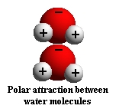
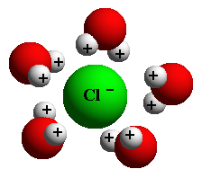
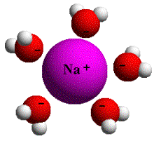
Why don’t water and oil mix?
Differences in the attractions between molecules lead to different properties in polar and nonpolar compounds
Oil is nonpolar, nonpolar compounds do not dissolve well in water; water is more attracted to itself

Slide 28
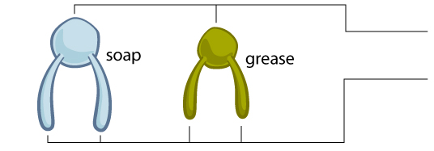
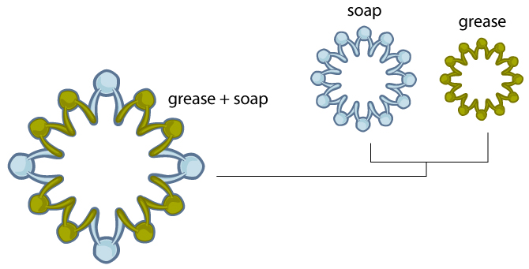
What does chemistry have to with laundry?
Dirt is nonpolar so it does not mix well with water which is polar
Detergents cause the nonpolar dirt to mix with the polar water so when the water washes down the drain the soap and dirt go with it

Slide 29
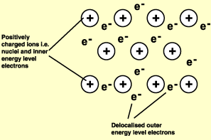
Bonding in Metals What is a metallic bond?
An attraction between a positive metal ion and electrons surrounding it

Slide 30
How are metal atoms bonded in solid metal?
A metal consists of positively charged metal ions embedded in a “sea” of valence electrons

Slide 31
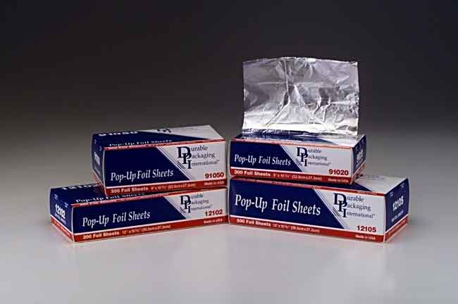
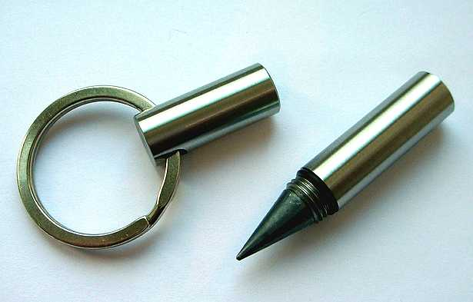
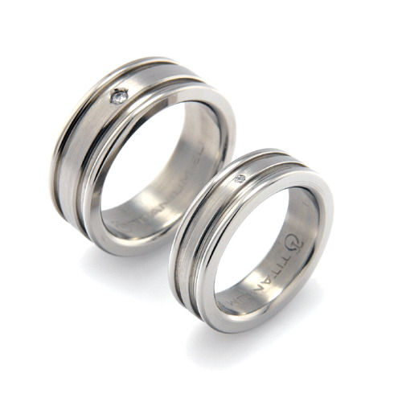
How does metallic bonding result in useful properties of metals and their alloys?
The “sea of electrons” model of solid metals explains their ability to conduct heat and electricity, the ease with which they can be made to change shape, and their luster
Alloy – a material made of two or more elements that has the properties of a metal

Slide 32
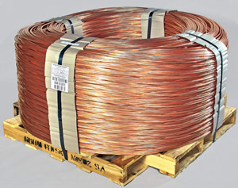
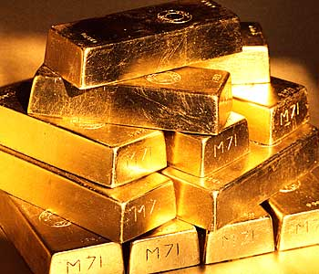
What are some metallic properties?
Heat conductivity – heat travels easily through metals
Electrical conductivity – metals conduct electricity easily because the electrons in a metal can move freely among the atoms
Changes in Shape – ductile (bends easily) and malleable (rolled into thin sheets)
Luster – shiny and reflective

