Slide 1

Heat Transfer

Slide 2
Temperature
Temperature
  is the measure of the average
  kinetic energy of all particles
  in an object.
  Remember that kinetic energy is the energy of motion and that all atoms are constantly in motion.

Slide 3
Temperature Examples
Liquid high temperature
  Particles are fast moving
  High average kinetic energy
Liquid low temperature
  Particles move more slowly
  Low average kinetic energy
High Average Kinetic Energy = High Temperature
Low Average Kinetic Energy = Low Temperature

Slide 4
Heat
– the flow of energy from an object at a warmer temperature to an object
at a cooler temperature.

Slide 5
Heat Transfer
Heat transfer is the movement of thermal energy from a warmer
item to a cooler item.
Remember, heat moves in predictable ways, from a high to a low.

Slide 6
3 Kinds of Heat Transfers
Conduction
Convection
Radiation

Slide 7
Conduction
Heat transfer through a solid by direct contact.
Examples:
Your hands transfer (conduct) heat to
an ice cube causing it to melt.
A spoon placed in hot soup becomes warmer as the spoon conducts heat
away from the hot soup

Slide 8
Conduction
Conductors – materials that transfer energy easily.
  Examples: Metals (copper wires,
  pans for cooking
Insulators – poor conductors.
  Examples: Foam Cup, plastic or
  rubber ends on pan handles
Check it out!

Slide 9
Convection
Heat transfer through a fluid
A fluid is defined as a liquid or a
gas because a fluid has the ability
to flow from place to the next.
Solids have a fixed shape.

Slide 10
Convection
Consider this - when you look at the road in the summertime on a hot day, you
may notice that the air above the road
looks “blurry” – this is convection
taking place as the hot air directly
over the road absorbs the heat from
the road and rises.
Mirage

Slide 11
Convection

Slide 12
Convection
Dependent on Density
Hot air is less dense, so it rises
Colder air is more dense, so it sinks
Check it out…

Slide 13
Question: If conduction deals with solids and convection deals with liquids,
how does heat arrive to Earth from
the Sun?
There is very little matter in between
the Earth and Sun.
RADIATION!

Slide 14
Radiation
Heat can travel in waves without a medium (a liquid, solid, or gas).
Radiation is the term that describes
heat movement without a medium of matter.
Check it out!

Slide 15
Radiation, Con’t
All of the forms of electromagnetic energy in the spectrum can travel through the universe as waves – we call this radiation.

Slide 16
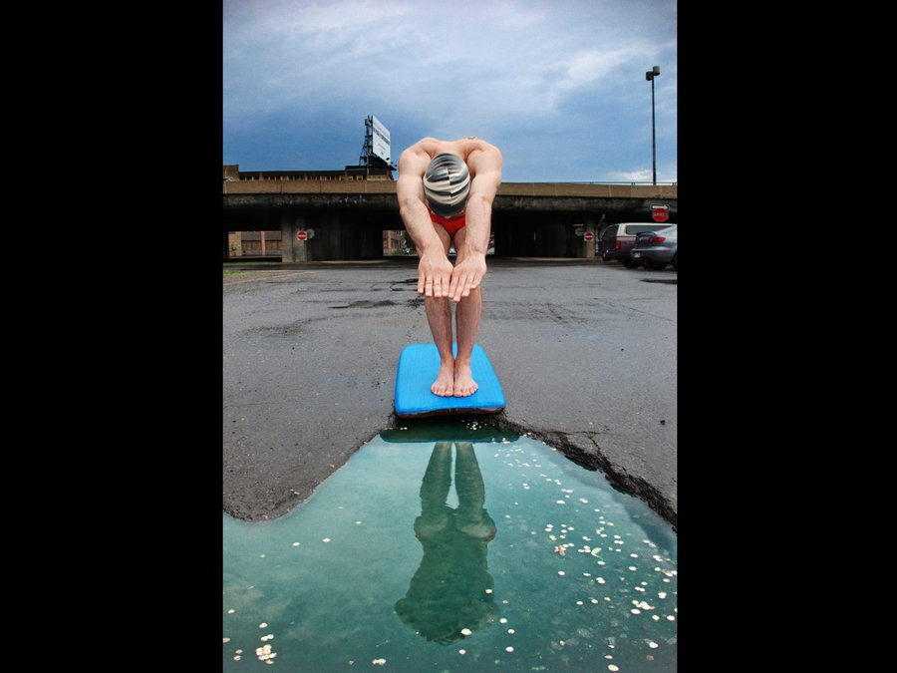
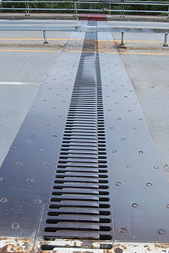
Practical Applications
Discuss and Explain how potholes are
formed.
Discuss the purpose of expansion joints on bridges and elevated roadways

Slide 17

Transfer of Heat
(Chocolate Bunny)

