Slide 1
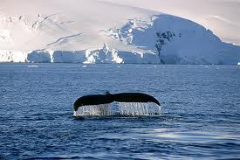
States of Matter
And Their Properties

Slide 2
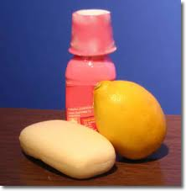
Matter
Matter is anything that has mass
Matter is anything that takes up space

Slide 3
Matter
Some forms of matter are easy to see
Some forms of matter, like air, aren’t easy to see, but they still have mass and take up space

Slide 4
Matter
Most matter we know of exists in one of three states or phases:
Solids
Liquids
Gases
But there are really
FIVE states of matter!

Slide 5
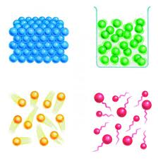
States of Matter
The five states of matter are:
Solid
Liquid
Gas
Plasma
Bose-Einstein Condensate (not pictured)

Slide 6
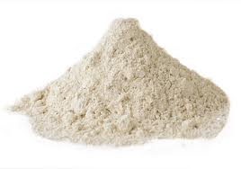
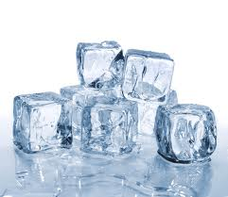
Properties of Solids
have a rigid, definite shape
do not take the shape of their container
have a definite volume
have a definite melting point

Slide 7
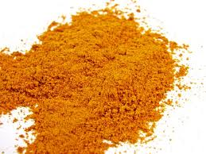
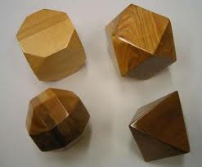
Properties of Solids
are of high density
are incompressible
particles are relatively motionless

Slide 8
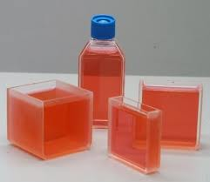
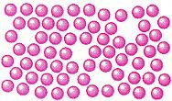
Properties of Liquids
take the shape of their container
have a definite volume
have particles that are in constant motion
have a relatively high density

Slide 9
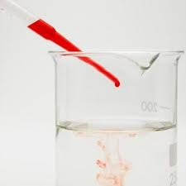
Properties of Liquids
are relatively incompressible
have the ability to diffuse
exhibit surface tension

Slide 10
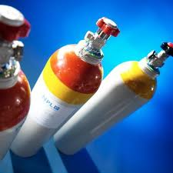
Properties of Gases
take the shape of their container,
do not have a definite volume,
have particles that are in constant, and rapid motion,

Slide 11
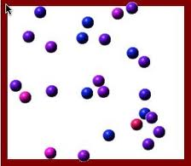
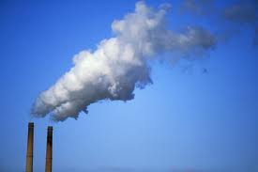
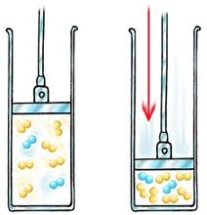
Properties of Gases
have particles that are very far apart,
have a relatively low density,
are very compressible,
have the ability to diffuse.

Slide 12
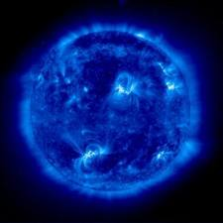
Properties of Plasmas
No definite shape
No definite volume
Free electrical charges make plasma electrically conductive
Found under certain conditions

Slide 13
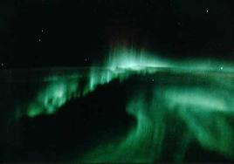
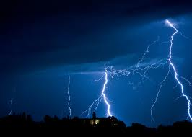
Plasma
Found in lightning, Northern lights, and stars

Slide 14
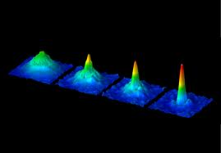
Properties of Bose-Einstein condensates
super cold
super slow
The atoms are clumping from left to right.
atoms all converge at same energy level and become a single blob of identical atoms – they condense

Slide 15
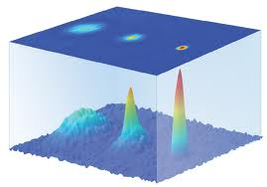
Bose-Einstein Condensates
Can only be made in the lab at super cold temperatures – one millionth of a degree above Absolute Zero.
Laser light can be used to slow down atoms when it is aimed at them and then evaporative cooling slows them down to near Absolute Zero.
The atoms are clumping from left to right.

Slide 16
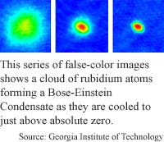
Bose-Einstein Condensates
Predicted by Satyenda Bose and Albert Einstein in the 1920’s.
Finally created by Eric Cornell and Carl Weiman in 1995.

Slide 17
Review
Solids
Liquids
Definite shape
Definite volume
Particles barely move
Incompressible
Little to no diffusion
No definite shape
Definite volume
Particles can slide past each other, have some movement
Relatively incompressible
Particles can diffuse

Slide 18
Review
Liquids
Gases
No definite shape
Definite volume
Particles can slide past each other, have some movement
Relatively incompressible
Particles can diffuse
No definite shape
No definite volume
Particles move freely and quickly and are far apart
Compressible
Particles can diffuse

