Slide 1
Physical & chemical properties & changes
Physical Science (8A)
J. C. Booth Middle School
Coach Dave Edinger

Slide 2
Physical & Chemical
Properties
All substances have properties that we can use to identify them.
For example we can identify a person by their face, voice, height, clothing, hair color, eye color, finger prints, DNA etc.
The more of these properties that we can identify, the better we know the person.
In a similar way matter has properties - and there are many of them.

Slide 3
Types of Properties
Chemical properties describe a substance’s ability to turn into a completely different substance with new & different properties.
For example, the fact that sodium reacts with water is a
chemical property.
Physical properties are properties of an element or compound that
can be observed without a chemical reaction of the substance.
Examples : A substance's color and density are physical properties.

Slide 4
Physical Properties
Physical properties: Properties that do not change the chemical
nature of the matter. It remains the same substance.
Physical properties can be observed or measured without
changing the composition of matter. Physical properties are
used to observe and describe matter.

Slide 5
Physical Properties include:
appearance
texture
color
odor
melting point
boiling point
density
solubility

Slide 6
Chemical Properties
Chemical properties of matter describes its "potential" to undergo some chemical change or reaction by virtue of its composition. What elements, electrons, and bonding are present to give the potential for chemical change.
It is quite difficult to define a chemical property without using the word "change.” Eventually, you should be able to look at the formula of a compound and state some chemical property. At this time, this is very difficult to do and you are not expected to be able to do it.

Slide 7
Chemical properties: Properties that change the chemical nature of matter
Examples of chemical properties are:
combustibility
flammability
reactivity with water
pH

Slide 8
Physical Changes
A physical change takes place without any changes in molecular composition.
The same element or compound is present before and after the change.
The same molecule is present through out the changes.
Physical changes are related to physical properties since some measurements require that changes be made.

Slide 9
Chemical Changes
Chemical change results in one or more substances of entirely different composition from the original substances. The elements and/or compounds at the start of the reaction are rearranged into new product compounds or elements.
A CHEMICAL CHANGE alters the composition of the original matter.
Different elements or compounds are present at the end of the chemical change. The atoms in compounds are rearranged to make new and different compounds.

Slide 10
Physical
OR
Chemical
You Decide

Slide 11
Breaking Glass

Slide 12
Rusty, old bicycle

Slide 13
Melting Butter for popcorn

Slide 14
PHYSICAL CHANGE
OR
CHEMICAL CHANGE?
SEPARATING
SAND FROM
GRAVEL

Slide 15

PHYSICAL CHANGE
OR
CHEMICAL CHANGE?
MIXING KOOL-AID POWDER IN WATER

Slide 16
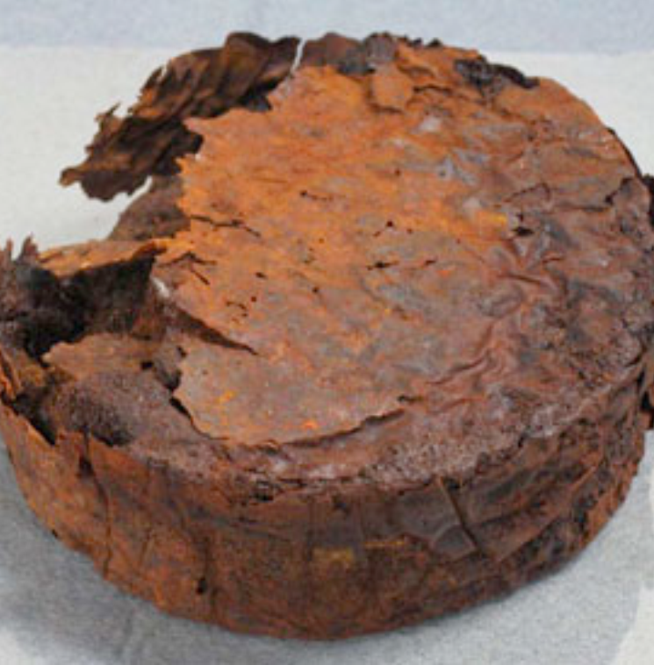
PHYSICAL CHANGE
OR
CHEMICAL CHANGE?
CORRODING
METAL

Slide 17
PHYSICAL CHANGE
OR
CHEMICAL CHANGE?
FRYING
AN EGG

Slide 18
POURING MILK ON
YOUR OATMEAL?

Slide 19
Burning Leaves
Physical or
Chemical Change?

Slide 20
PHYSICAL CHANGE
OR
CHEMICAL CHANGE?
MAKING
SALT WATER
TO
GARGLE

Slide 21
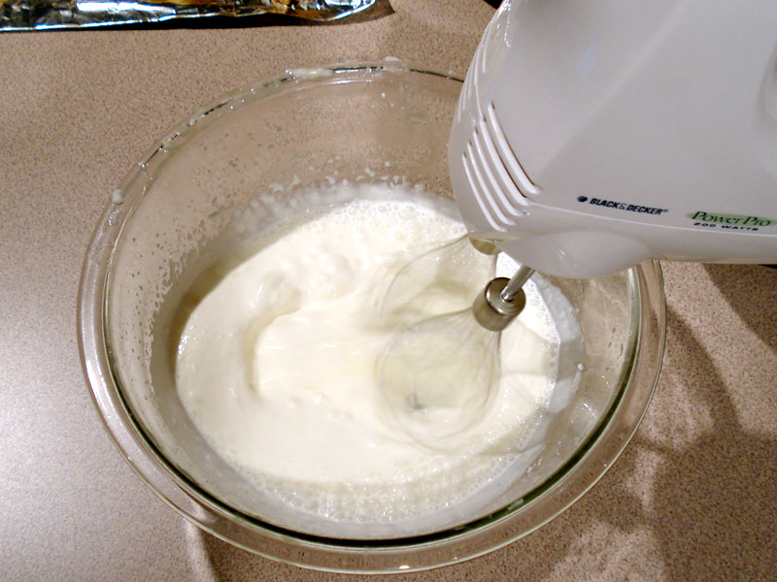
PHYSICAL CHANGE
OR
CHEMICAL CHANGE?
CREAM BEING WHIPPED

Slide 22
FROZEN CHOCOLATE COVERED BANANAS

Slide 23
MELTING ICE CREAM

Slide 24
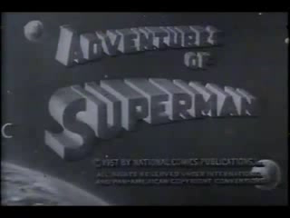

Physical Change? Or is it?

Slide 25
Check Your Answers!

Slide 26
Physical Change

Slide 27
Chemical Change

Slide 28
Physical change

Slide 29
PHYSICAL
CHANGE
SEPARATING
SAND FROM
GRAVEL

Slide 30
PHYSICAL
CHANGE
MIXING KOOL-AID POWDER IN WATER

Slide 31
CHEMICAL
CHANGE
CORRODING
METAL

Slide 32
CHEMICAL
CHANGE
FRYING
AN EGG

Slide 33
POURING MILK ON
YOUR OATMEAL?
PHYSICAL
CHANGE

Slide 34
Burning Leaves
Chemical change

Slide 35
PHYSICAL CHANGE
MAKING
SALT WATER
TO
GARGLE

Slide 36
PHYSICAL
CHANGE
CREAM BEING WHIPPED

Slide 37
FROZEN CHOCOLATE COVERED BANANAS
PHYSICAL CHANGE

Slide 38
MELTING ICE CREAM
PHYSICAL
CHANGE

Slide 39

HMMMMMMM ????????
Coach Ed
That’s Weird !!!

Slide 40
SUMMARY
Glass Breaking (PHYSICAL CHANGE)
A Rusting Bicycle (CHEMICAL CHANGE)
Melting Butter for Popcorn (PHYSICAL CHANGE)
Separating Sand From Gravel (PHYSICAL CHANGE)
Mixing Kool-Aid powder into water (PHYSICAL CHANGE)
Corroding Metal (CHEMICAL CHANGE)
Frying an Egg (CHEMICAL CHANGE)
Pouring Milk on Your Oatmeal (PHYSICAL CHANGE)
Burning Leaves (CHEMICAL CHANGE)
Making Salt Water to Gargle With (PHYSICAL CHANGE)
Cream Being Whipped (PHYSICAL CHANGE)
Freezing Chocolate Covered Bananas (PHYSICAL CHANGE)
Melting Ice Cream (PHYSICAL CHANGE)
Coach Ed / Superman (PHYSICAL CHANGE… They are ONE in the same!)

