Slide 1
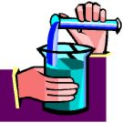
Matter and Change
Introductory Concepts for Physical Science

Slide 2
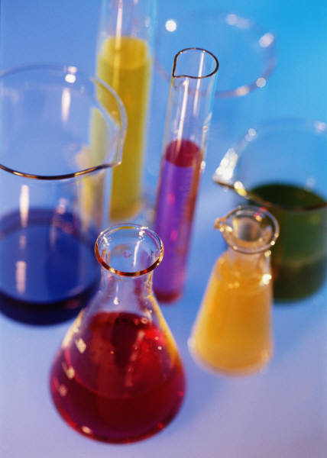

Properties of Matter
Matter
Anything that has mass and occupies space

Slide 3

How does one describe the quantities of matter?
VOLUME
Volume
WEIGHT
Weight
A measure of the gravitational pull on matter.
RELIABILITY
These are not reliable!
Volume and weight can change depending on temperature and location.
The amount of three dimensional space an object occupies

Slide 4
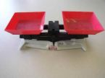
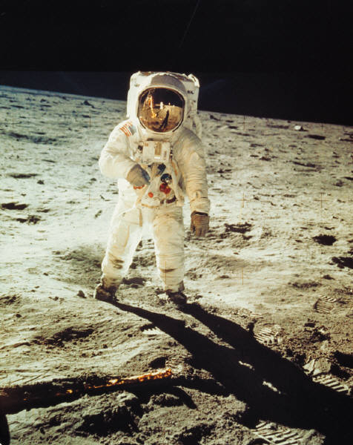
Mass is a reliable way to measure matter!
Mass is a measure of the amount of matter.
Mass is not affected by temperature or location or any other factor.
Weight is a measure of the Earth’s gravitational force on a body.
An astronaut will have a different weight on the moon, but his mass will remain the same.

Slide 5
Question?
Why is mass a more reliable measure of the quantity of a sample of matter than weight or volume?
Answer: The mass of the sample will be constant regardless of other factors such as temperature, pressure or location.

Slide 6

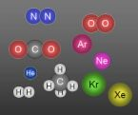
Elements and Compounds
The fundamental building blocks of matter are atoms and molecules.
ATOM
MOLECULE
A molecule is a neutral group of atoms held together by covalent bonds.
An atom is the smallest unit of an element that retains the properties of that element.

Slide 7
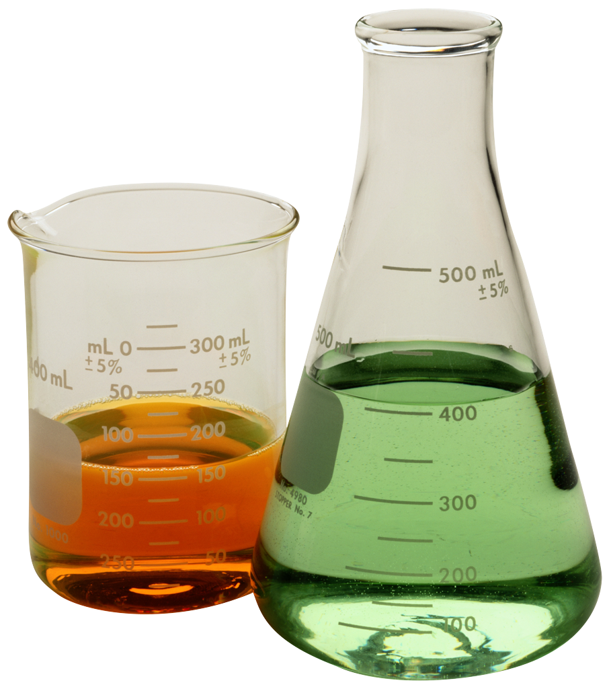
All matter can be classified into three groups:
Elements
Compounds
Mixtures

Slide 8
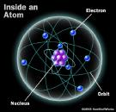
Element:
1. A pure substance made of only one kind of atom.
2. A substance that cannot be broken down into other substances by ordinary means.

Slide 9


Compound:
A compound is a substance made up of two or more elements that are chemically combined.
A compound can be broken down into simpler substances.
For example: Water is a compound composed of the elements hydrogen and oxygen bonded together. Water can be broken back down into its individual elements of hydrogen and oxygen.

Slide 10
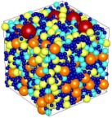
Characteristics of a Compound
1. The elements making up a compound are combined in a definite proportion by mass. This proportion or ratio is the same for all samples of the compound.
2. The set of chemical and physical properties of a compound differ from those of its constituents. For example: the properties of water are different from the properties of oxygen and hydrogen.
3. Compounds can be formed from simpler substances by chemical change.

Slide 11

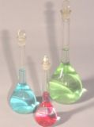
Mixtures
A mixture is a combination of two or more substances that are not chemically combined.
Each of the individual substances retains its own individual properties. The properties of a mixture are a combination of the properties of its components.
The parts of a mixture are simply mixed together physically and can usually be separated.

Slide 12
How are mixtures distinguished from elements and compounds?
An element or compound has one set of properties, but a mixture retains the properties of each of its constituents. This characteristic can be used to separate a mixture into its constituents.
The composition of a compound is fixed, but the composition of a mixture can vary.
Mixtures may be homogeneous or heterogeneous
Homogeneous: A mixture with uniform characteristics
throughout. An example is a salt water solution.
b) Heterogeneous: A mixture that has parts with different
compositions; it is not uniform throughout the mixture.
Example: the mixing of oil and water.

Slide 13
Methods of separating mixtures into their individual components:
Evaporation
Filtration
Decanting
Paper
Chromatography
Centrifuge

Slide 14
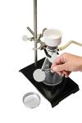
Filtration
Filtration: The process of passing a mixture through a porous device, such as filter paper, to separate one component from another.

Slide 15

Evaporation
Evaporation: If a salt water solution was allowed to stand, the water would evaporate and leave behind the crystals of salt.

Slide 16
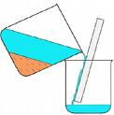
Decanting
Decanting: If the solid particles of a liquid mixture settle to the bottom of the container, the liquid can be carefully poured off.

Slide 17

Centrifuge
Centrifuge: The centrifuge spins rapidly which causes the solids to settle to the bottom of the container.

Slide 18
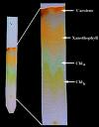
Paper Chromatography
Paper chromatography: Separates mixtures of dyes or pigments because the different substances will move at different rates on the paper.

Slide 19
Questions / Practice Problems
Classify each of the following as a homogeneous mixture or a heterogeneous mixture:
a) oil and vinegar salad dressing
b) a bowl of vegetable soup
c) a soft drink
d) blood
e) motor oil
Answers:
Heterogeneous
Heterogeneous
Homogeneous
Heterogeneous
Homogeneous

Slide 20
There are three states of matter:
Solid
Liquid
Gas

Slide 21
Characteristics of Solids
Solids have a definite volume and a definite shape.
The particles of a solid are packed close together in relatively fixed positions.
The particles are held by strong attractive forces between them.
The particles of a solid simply vibrate about a fixed position.

Slide 22
Characteristics of Liquids
1. A liquid has a definite volume but no definite shape.
2. A liquid assumes the shape of the container.
3. The particles of a liquid are held close together but can move past one another.
4. The particles in a liquid move much faster than in a solid. This allows the particles of a liquid to temporarily overcome the attractive forces between them.

Slide 23
Characteristics of Gases
Gases
A gas has neither a definite shape nor definite volume.
Gases
Gases are composed of particles that move very rapidly and are at great distance from one another.
Gases
At these great distances, the attractive forces between gas particles are much weaker than those in liquids and solids.

Slide 24


Solids, Liquids, and Gases
Solid
Liquid
Gas
When a substance changes from one phase of matter to another, there is no change in composition of the substance. Water freezes to a solid and melts to a liquid, but it is still just water. When substances change state, the only change is the distances and the interactions between the particles that make them up.

Slide 25

Properties of Matter
Every substance, whether it is an element or a compound, has characteristic properties.
A property is a characteristic that defines an entire group of substances. For example: A property of all metals is that they can conduct electricity.
These properties are used to distinguish between substances and to separate them.

Slide 26
Intensive and Extensive Properties
Extensive
Intensive
Extensive properties depend on the amount of matter.
Intensive properties do not depend on the amount of matter present.
These properties include volume, mass, or the amount of energy in a substance.
These properties include melting point, boiling point, density, and the ability to conduct heat or electricity.
These properties are the least useful when attempting to identify an unknown substance.
These properties are the same for a given substance regardless of how much of the substance is present.

Slide 27

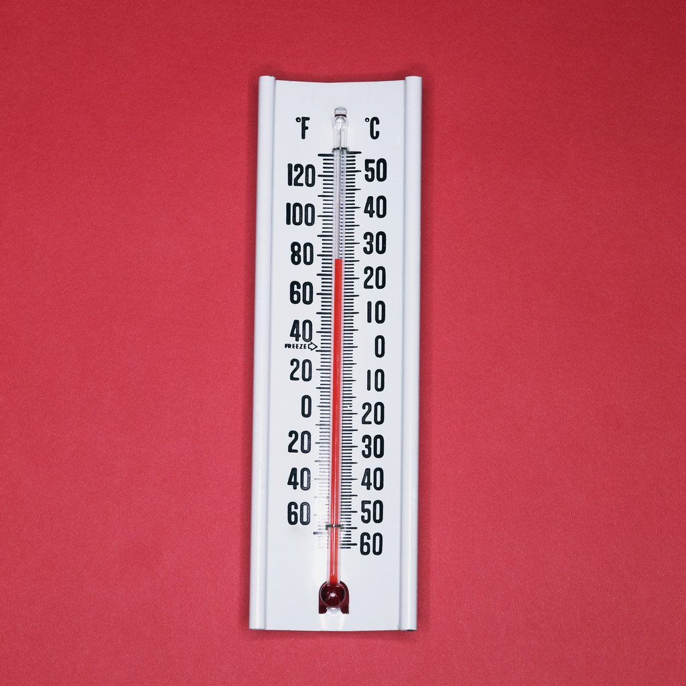
Physical and Chemical Properties
Physical
Chemical
Can be observed or measured without changing the identity of the substance.
A characteristic that describes how the substance interacts with other substances to produce new substances.
Physical properties describe the substance itself, rather than describing how it can change into other substances during chemical reactions.
Example: The ability of charcoal (carbon) to burn in air to form carbon dioxide is an example of a chemical property.
Examples are color, odor, taste, hardness, density, melting points and freezing points.

Slide 28




Physical Change
1. A change in physical properties, but there is no change in the substances' chemical properties or chemical composition.
2. No new substance is formed.
3. It is a change from one phase of matter to another.
4. Examples include: grinding, cutting, melting, and boiling. These types of changes do not change the identity of the substance.

Slide 29
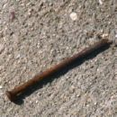

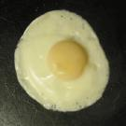
Chemical Change
Results in the production of one or more new substances that differ in chemical properties and composition from the original substance.
Examples include: Iron rusting, the souring of milk, the burning of paper.

Slide 30
Reactants
Products
The new and different substances formed as a result of a chemical change
The original substances participating in the chemical reaction
Example:
Carbon + Oxygen → Carbon Dioxide
Carbon and oxygen are the reactants and carbon dioxide is the product.

Slide 31

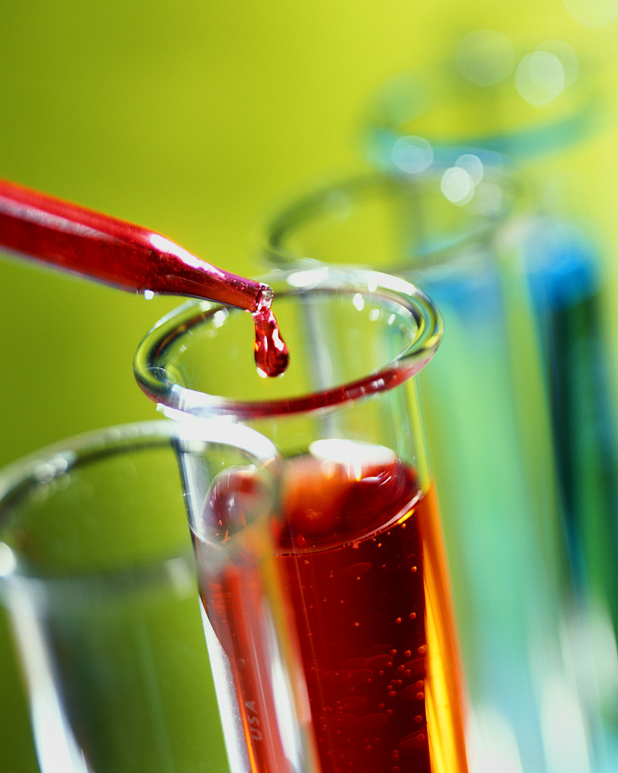
Practice Problems
Answers
Physical
Chemical
Physical
Physical
Chemical
Physical
Indicate if each of the following is a physical or a chemical change:
a) Tearing a sheet of paper
b) Burning a log
c) Melting a piece of wax
d) Melted butter solidifies in the refrigerator
e) The rusting of iron
f) The dissolving of sugar in water

Slide 32
Conservation of Mass
During any chemical reaction, the quantity of matter remains unchanged. The mass of the products is always equal to the mass of the reactants.
The Law of Conservation of Matter states: Matter cannot be created or destroyed by a chemical change.
Example:
48 kilograms of oxygen gas and
6 kilograms of hydrogen gas react completely to form how many kilograms of water?
Answer:
54 kilograms of water

Slide 33
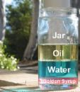
Density
Density is a measure of how much mass of a substance occupies a certain volume.
Mass
Density =
Volume
Or, in short form:
D = M
V
Density is a physical property of a substance. Therefore, density can be used as one property to help identify an unknown substance.

Slide 34
Density changes slightly with temperature and pressure.
When heated, most solids and liquids expand. The volume is greater, but the mass remains the same. Therefore, the density decreases. This change is usually too small to be noticed in solids and liquids.
Changes in temperature and pressure will greatly affect the density of a gas.

Slide 35
P
R
A
C
T
I
C
E
ROBLEM 1
A piece of lead has a mass of 22.7 grams. It occupies a volume of 2 cm³. What is the density of the lead?
D = M
V
D = 22.7 g
2 cm³
D = 11.35 g/cm³

Slide 36
P
R
A
C
T
I
C
E
ROBLEM 2
A piece of lead occupies a volume of 4 cm3. The density of lead was determined in the above problem. What is the mass of the lead?
D = M therefore, M = DV
V
Mass = (11.35 g/cm³) (4 cm³)
Mass = 45.4 g

Slide 37
P
R
A
C
T
I
C
E
ROBLEM 3
A piece of lead has a mass of 302 grams. The density of lead was determined in problem 1. What volume does it occupy?
D = M therefore, V = M
V D
V = 302 g
11.35 g/cm³
V = 26.61 cm³

