Slide 1
Classifying Matter:
Elements, Compounds, and Mixtures

Slide 2
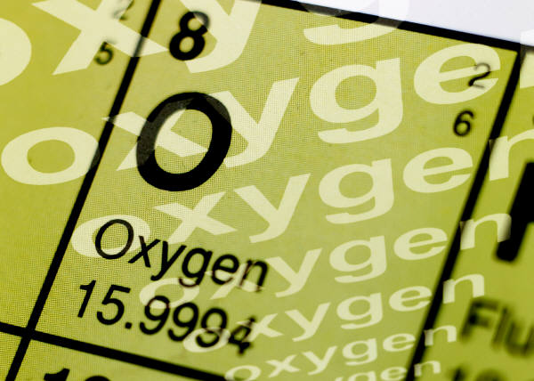
Pure Substances
A sample of matter that has definite chemical and physical properties.
Elements
Atoms
Compounds
Molecules

Slide 3

Elements
pure substance that cannot be separated into simpler substance by physical or chemical means.

Slide 4
Compounds
Pure substance composed of two or more different elements joined by chemical bonds.
  Made of elements in a specific ratio
  that is always the same
  Has a chemical formula
  Can only be separated by
  chemical means, not physically
H₂O
NaCl
CO₂

Slide 5

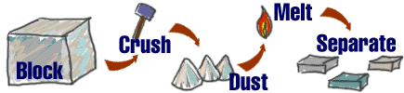
Mixtures
A combination of two or more pure substances that are not chemically combined.
substances held together by physical forces, not chemical
No chemical change takes place
Each item retains its properties
in the mixture
They can be separated physically
Chem4kids.com

Slide 6
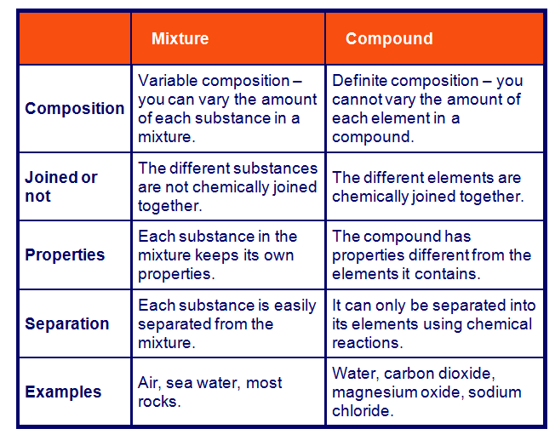
Mixtures vs. Compounds
http://www.bbc.co.uk/schools/ks3bitesize/science/chemistry/elements_com_mix_6.shtml

Slide 7
Can you identify the following?
You will be shown a series of photos. Tell if each photo represents an item composed of an element, compound, or mixture.
Review:
An element contains just one type of atom.
A compound contains two or more different atoms joined together.
A mixture contains two or more different substances that are only physically joined together, not chemically.
  A mixture can contain both elements and compounds.

Slide 8

Element, Compound, or Mixture?
Rocks

Slide 9
Element, Compound, or Mixture?
Rocks

Slide 10
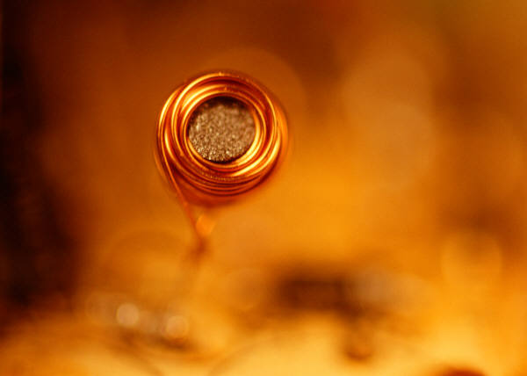
Element, Compound, or Mixture?
Copper

Slide 11
Element, Compound, or Mixture?
Copper
Cu

Slide 12
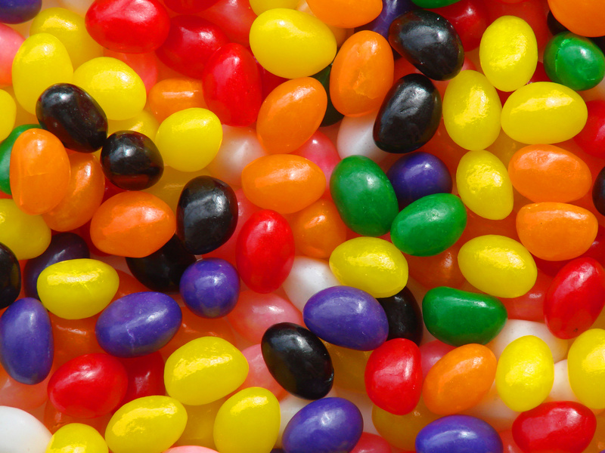
Element, Compound, or Mixture?
Jelly Beans

Slide 13
Element, Compound, or Mixture?
Jelly Beans

Slide 14
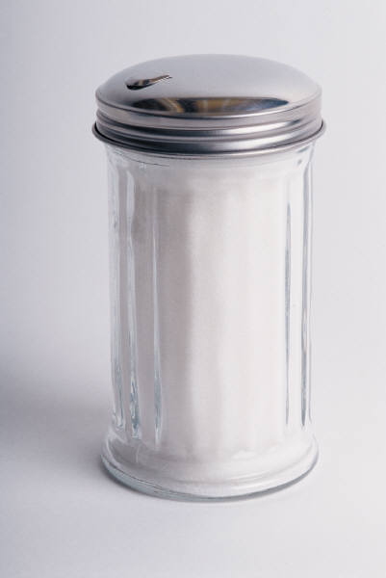
Element, Compound, or Mixture?
Table Sugar

Slide 15
Element, Compound, or Mixture?
Table Sugar
C₁₂H₂₂O₁₁

Slide 16
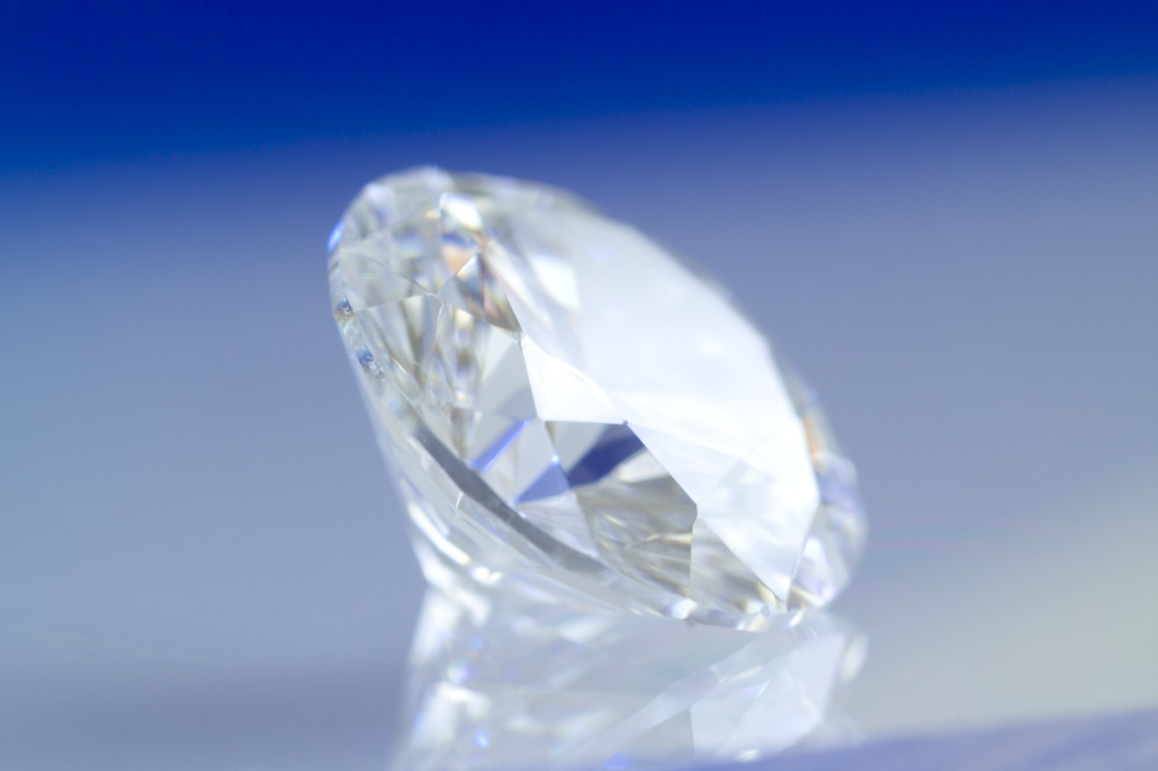
Element, Compound, or Mixture?
Diamond

Slide 17
Element, Compound, or Mixture?
Diamond
C

Slide 18
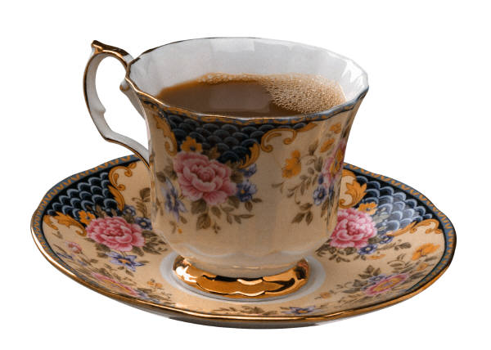
Element, Compound, or Mixture?
Tea

Slide 19
Element, Compound, or Mixture?
Tea

Slide 20
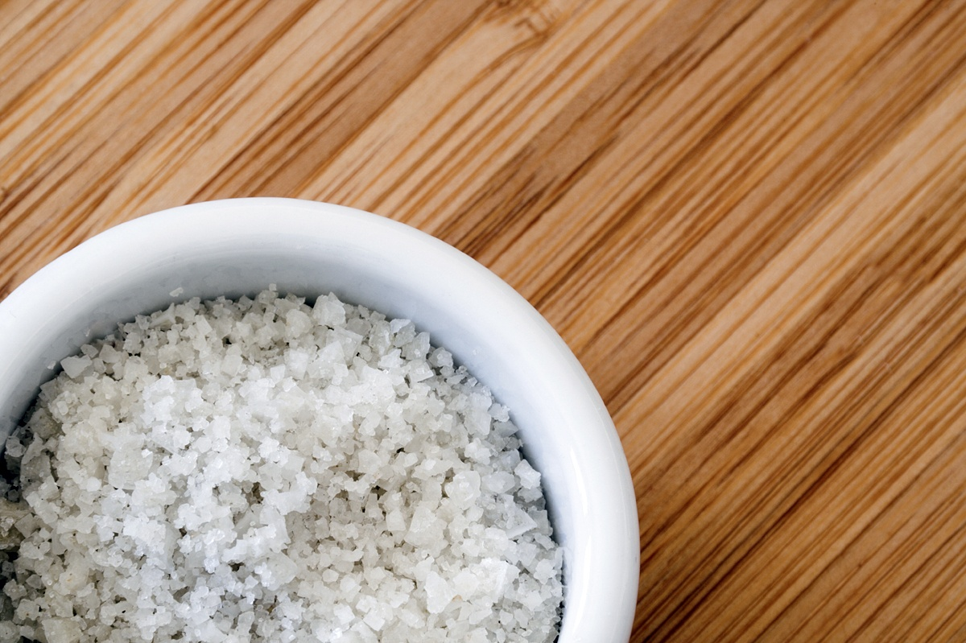
Element, Compound, or Mixture?
Salt

Slide 21
Element, Compound, or Mixture?
NaCl
Salt

Slide 22

Element, Compound, or Mixture?
Neon Gas

Slide 23
Element, Compound, or Mixture?
Ne
Neon Gas

Slide 24
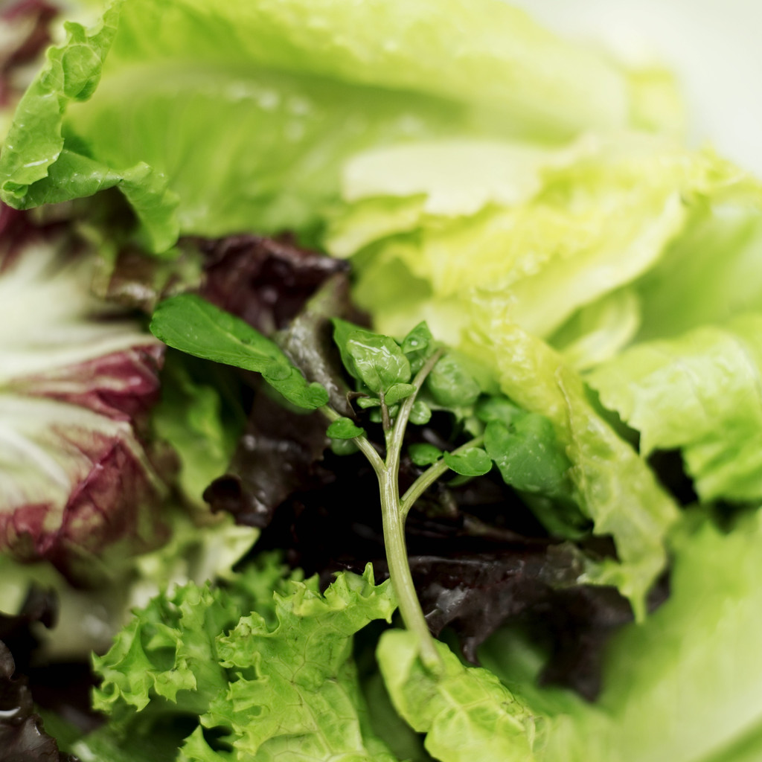
Element, Compound, or Mixture?
Salad

Slide 25
Element, Compound, or Mixture?
Salad

Slide 26
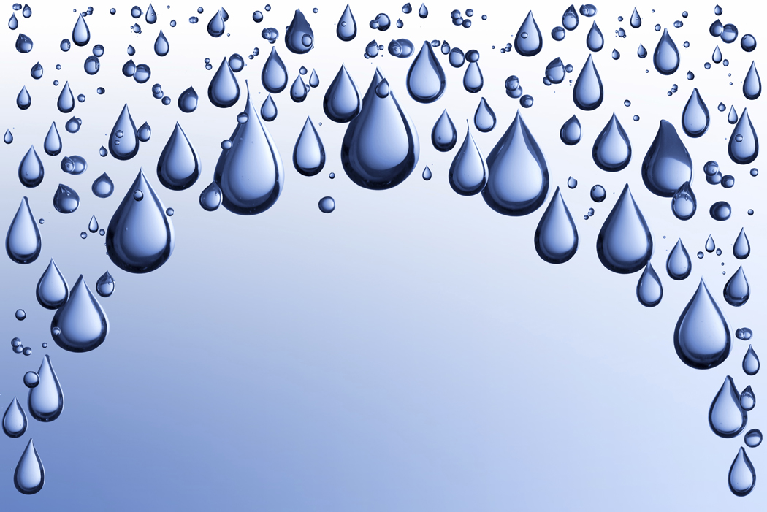
Element, Compound, or Mixture?
Pure Water

Slide 27
Element, Compound, or Mixture?
Pure Water
H₂O

Slide 28
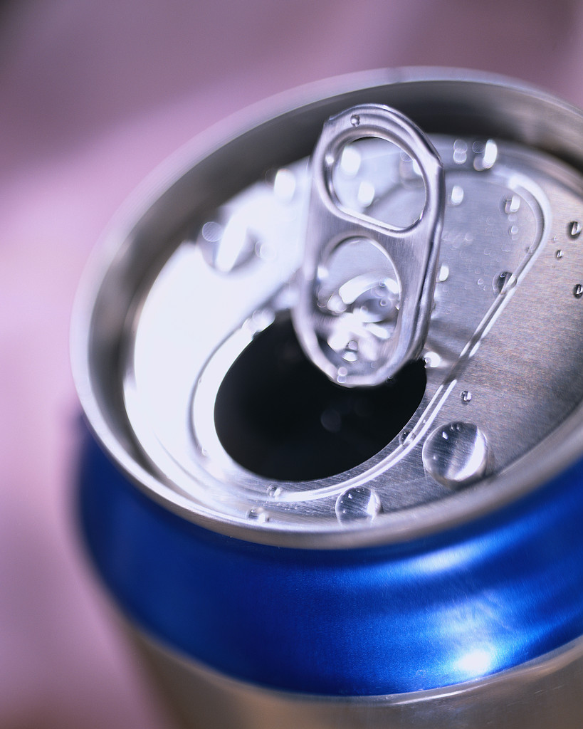
Element, Compound, or Mixture?
Aluminum

Slide 29
Element, Compound, or Mixture?
Aluminum
Al

Slide 30
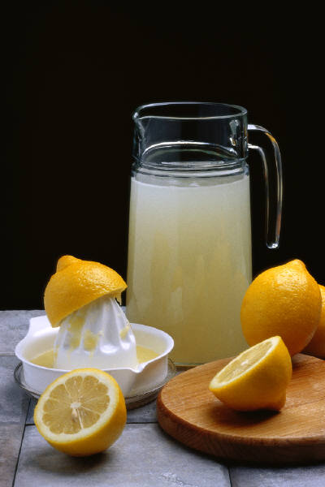
Element, Compound, or Mixture?
Lemonade

Slide 31
Element, Compound, or Mixture?
Lemonade

Slide 32
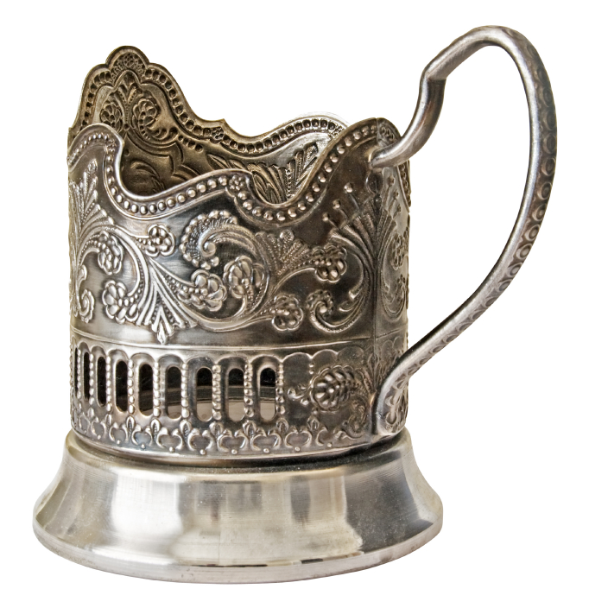
Element, Compound, or Mixture?
Silver

Slide 33
Element, Compound, or Mixture?
Silver
Ag

Slide 34

Element, Compound, or Mixture?
Sand

Slide 35
Element, Compound, or Mixture?
Sand

Slide 36
