Slide 1
Calculating Density
Coach Dave Edinger
J. C. Booth Middle School
Physical Science (8A)

Slide 2
Which weighs more: 1 kg of feathers or 1 kg of rocks? Why?
1 kg of rock
1 kg of feathers

Slide 3
Which would have the greater volume? mass? Why?
1 kg of rock
1 kg of feathers

Slide 4
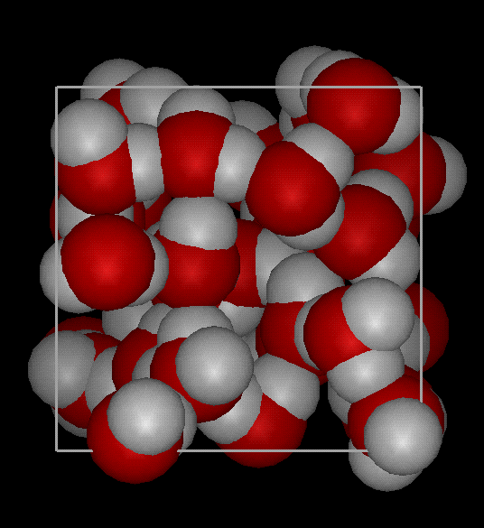
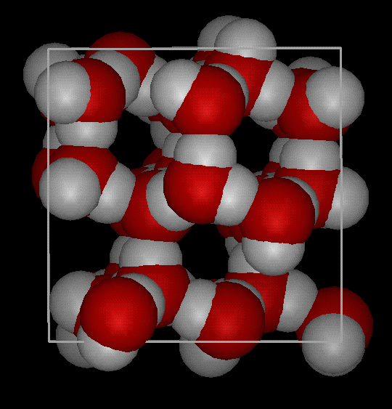
DENSITY
Density is defined as mass per unit volume. It is a measure of how tightly packed and how heavy the molecules are in an object. Density is the amount of matter within a certain volume.
Notes:
Density is the amount of matter within a certain volume.

Slide 5
Proof that water and ice have different densities

Slide 6
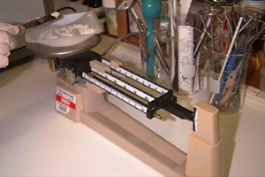
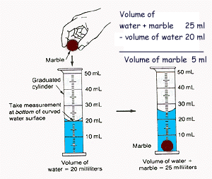
To find the density
1. Find the mass of
the object
2. Find the volume of the object
3. Divide
Density = Mass
Volume

Slide 7
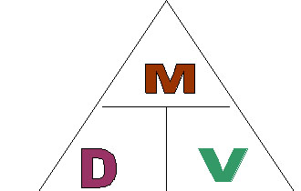
Units for density g/cm³ or g/ml
Formula:
M = mass V= volume D = density
M = D x V V = M / D D = M / V

Slide 8
To find density:
Find the mass of the object
Find the volume of the object
Divide : Density = Mass - Volume
Example:
If the mass of an object is 35 grams and it takes up 7 cm³ of space, calculate the density.

Slide 9
To find density:
Find the mass of the object
Find the volume of the object
Divide : Density = Mass - Volume
Example: If the mass of an object is 35 grams and it takes up 7 cm³ of space, calculate the density.
Set up your density problems like this:
Given: Mass = 35 grams Unknown: Density (g/ cm³) Volume = 7 cm³
Formula: D = M / V Solution: D = 35g/7 cm³
D = 5 g/cm³

Slide 10
Now, let’s try some problems…
Thinking Caps ON!!!

