Slide 1
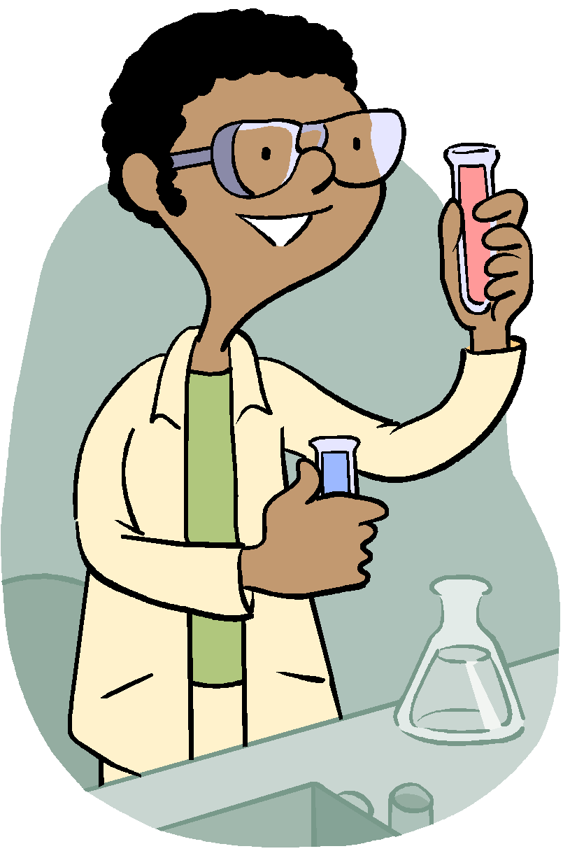
Lab Equipment

Slide 2
Test Tubes
Test tubes are used to mix, measure, or heat liquids. Test tubes are not usually marked with measurements, so they are only used to make approximate measurements
Notes:
*
Ask if anyone has heard of The Right to Know law.
This is a required topic in all science classrooms.

Slide 3
Watch Glass
A watch glass is a holding container.
Notes:
*
Remind students that their job is to produce good work at school.

Slide 4
Eyedropper
An eyedropper is used to dispense small measures of a liquid.
Notes:
*
Ask if anyone has seen an MSDS sheet before.
Reinforce that we have them, but all chemicals that we use are not seriously harmful.

Slide 5
Bunsen Burner
A Bunsen burner is a source of gas heat.
Notes:
*
Overview of what students are entitled to.

Slide 6
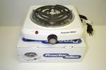
Hotplate
A hotplate is a source of electric heat.
Notes:
*
Overview of student’s responsibilities in the science classroom.

Slide 7
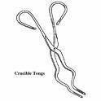
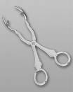
Tongs
Tongs are used to grasp heated materials.
Notes:
*
Overview of what the teachers have a right to know in the science classroom.

Slide 8
Triple-beam balance
A triple-beam balance is used to determine the mass of heavier materials to the nearest gram.
Notes:
*
What teachers much do in the science classroom to ensure safe environment.

Slide 9
Spring scale
A spring scale is used to determine force.

Slide 10
Wire gauze/Tripod
Wire gauze usually goes on top of a tripod to hold the glassware being heated.
A tripod holds glassware above a Bunsen burner.

Slide 11
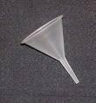
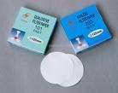
Filter paper/Funnel
Filter paper is often used with a funnel to filter solid particles out of a liquid.
A funnel helps in transferring a liquid from one container to another.

Slide 12
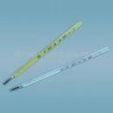
Thermometers
Thermometers measure temperature.

Slide 13
Petri dish
A petri dish is used to culture bacteria and other microorganisms.

Slide 14
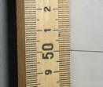
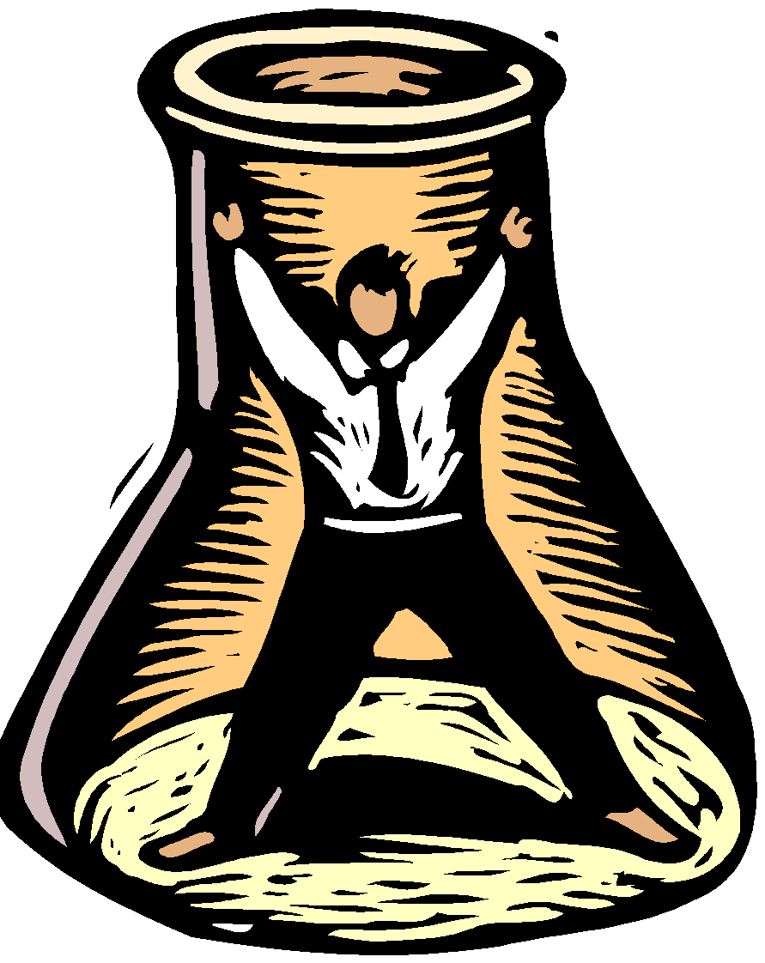
Meter stick
A meter stick measures length or width.

Slide 15
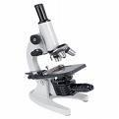
Microscope
A microscope enables us to see very small objects or organisms too small to see with the unaided eye.

Slide 16
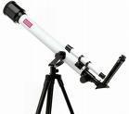
Telescope
A telescope enables us to see objects too far away to be seen with the unaided eye.

Slide 17
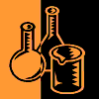
Beakers
Beakers are used to mix, measure, or heat liquids, but they are not designed for accurate measurement.

Slide 18
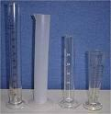
Graduate cylinders
Graduated cylinders are “graduate” or marked with a scale for measurement. They are used to accurately measure liquid volume.

Slide 19
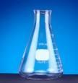
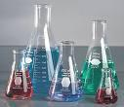
Erlenmeyer flask
Read labels on containers of chemicals
An Erlenmeyer flask is used to measure liquid and helps prevent liquids from splashing or giving off nauseous fumes.

Slide 20
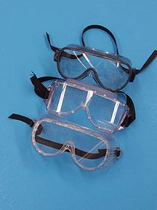
Safety Goggles
Safety goggles are used to protect your eyes while conducting experimentation in a science lab.

